Slide 1

The King and His Kingdom Part 49
“Not a Sign, But a Savior”
Matthew 12:38-42
January 4, 2026

Slide 2

Matthew 12:38-42 (ESV) – [38] Then some of the scribes and Pharisees answered him, saying, “Teacher, we wish to see a sign from you.” [39] But he answered them, “An evil and adulterous generation seeks for a sign, but no sign will be given to it except the sign of the prophet Jonah.

Slide 3
[40] For just as Jonah was three days and three nights in the belly of the great fish, so will the Son of Man be three days and three nights in the heart of the earth. [41] The men of Nineveh will rise up at the judgment with this generation and condemn it, for they repented at the preaching of Jonah, and behold, something greater than Jonah is here.

Slide 4
[42] The queen of the South will rise up at the judgment with this generation and condemn it, for she came from the ends of the earth to hear the wisdom of Solomon, and behold, something greater than Solomon is here.

Slide 5
The issue was obviously not a lack of evidence.
The issue rather was rejection of the truth.

Slide 6
“Devoutly religious people, confident that their self-righteousness has earned them favor with God, are self-satisfied.”
– John MacArthur

Slide 7
[40] For just as Jonah was three days and three nights in the belly of the great fish, so will the Son of Man be three days and three nights in the heart of the earth.

Slide 8
Jonah is the only prophet to whom Jesus directly compared Himself.
When Jesus alluded to Jonah and the great fish, He referred to the story as an actual historical event – not a metaphor.

Slide 9
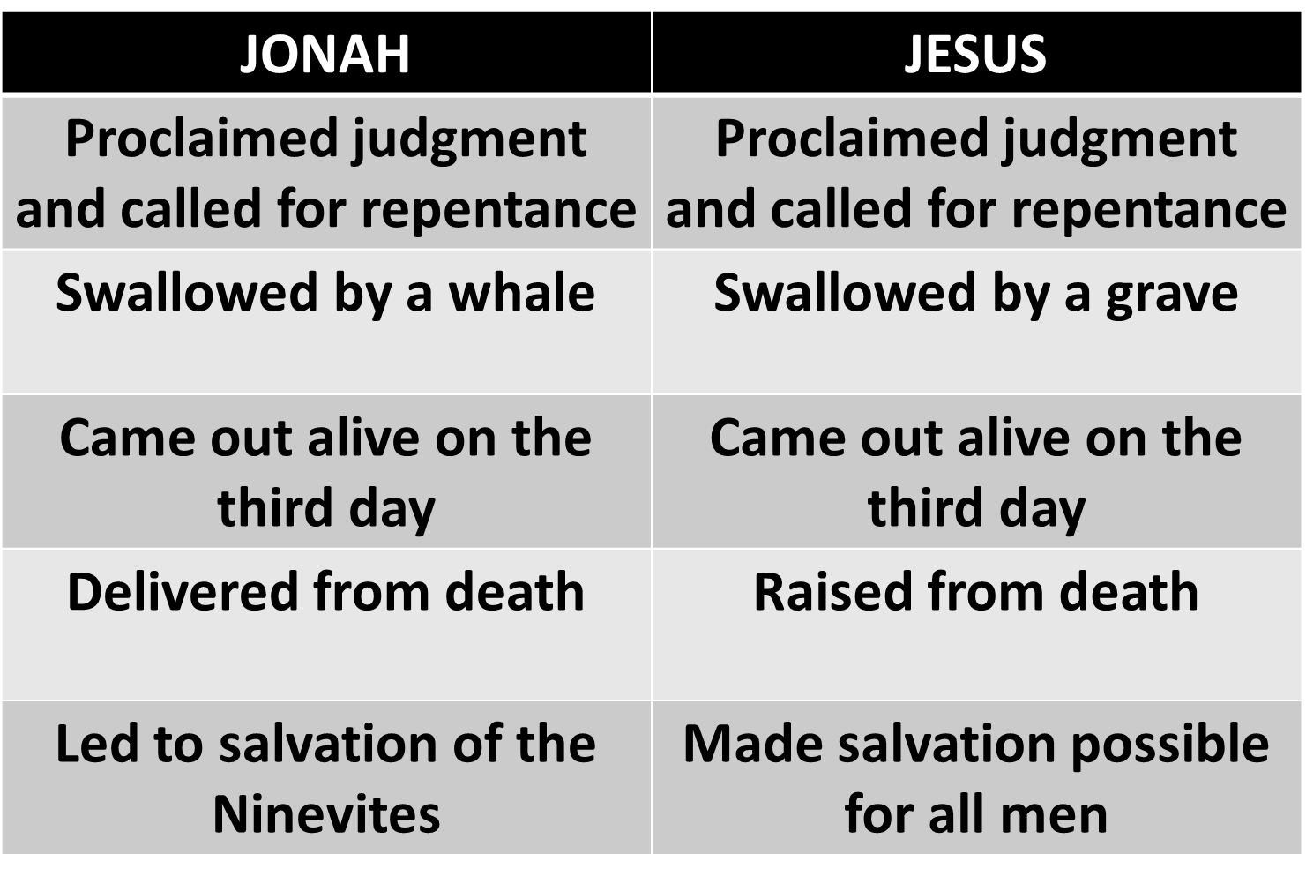

Slide 10
[42] The queen of the South will rise up at the judgment with this generation and condemn it, for she came from the ends of the earth to hear the wisdom of Solomon, and behold, something greater than Solomon is here.

Slide 11
Queen of Sheba – 1 Kings 10:1-13
Pagan idolater
Traveled to see Solomon for his wisdom
Eventually believed in the God of Israel

Slide 12
[41] The men of Nineveh will rise up at the judgment with this generation and condemn it, for they repented at the preaching of Jonah, and behold, something greater than Jonah is here.

Slide 13
Two Illustrations:
The Queen of Sheba’s life changed upon believing in the God of Israel after hearing the words of an imperfect, earthly King (Solomon).
The evil and cruel Ninevites repented of their sin and turned to God because of the message of a foolish and rebellious prophet (Jonah).

Slide 14
“The Queen of Sheba traveled across the world to be instructed by Solomon, but the Pharisees, who were supposed to be majoring in the quest for truth, would not go across the street to hear the Son of God.”
– R.C. Sproul

Slide 15
The men of Nineveh and the Queen of Sheba did two things the Jewish leaders did not:
They believed in God by faith.
They repented of their sins.

Slide 16
We do not need more miracles or more “evidence.” Instead we need to learn to relish being in the belly of the great fish – walking through the storms of life as God transforms us into who He wants us to be.

Slide 17
Resources (1):
J. Vernon McGee. “Thru the Bible with J. Vernon McGee, Volume IV, Matthew-Romans.” Thomas Nelson Publishing, 1982.
John MacArthur. “The MacArthur New Testament Commentary.” Moody Publishers, 1985.
Warren W. Wiersbe. “The Wiersbe Bible Commentary, The Complete New Testament in One Volume.” David C. Cook, 2007.
David Platt. “Christ Centered Exposition: Exalting Jesus in Matthew.” Series Editors: David Platt, Daniel L. Akin, and Tony Merida. B&H Publishing Group, 2013.

Slide 18
Resources (2):
Charles H. Spurgeon. “Commentary on Matthew: The Gospel of the Kingdom.” The Banner of Truth Trust, first publication 1893, reprinted 2010, 2013.
Donald Castle, Episcopal priest. https://www.preachingtoday.com/illustrations/2000/december/12756.html

