Slide 1

How Should We Study the BIBLE?
Madison UMC
Wednesday, January 11, 2023
1

Slide 2
Four Questions:
1. Why should I study the Bible?

Slide 3
Four Questions:
1. Why should I study the Bible?
2. What method should I use?
3

Slide 4
Four Questions:
1. Why should I study the Bible?
2. What method should I use?
3. Where should I begin?
4

Slide 5
Four Questions:
1. Why should I study the Bible?
2. What method should I use?
3. Where should I begin?
4. Would you give us an example showing the steps we should follow?
5

Slide 6
Why Should I Study the Bible?
6

Slide 7
Why Should I Study the Bible?
7

Slide 8
Jesus said,
“Blessed rather are those who hear the word of God and keep it!”
Luke 11:28.
8

Slide 9
What Method Should I Use?
9

Slide 10
What Method Should I Use?
The “Inductive” Method.
10

Slide 11
The Inductive Method
1. Listen
11

Slide 12
The Inductive Method
1. Listen
2. Understand
12

Slide 13
The Inductive Method
1. Listen
2. Understand
3. Obey
13

Slide 14
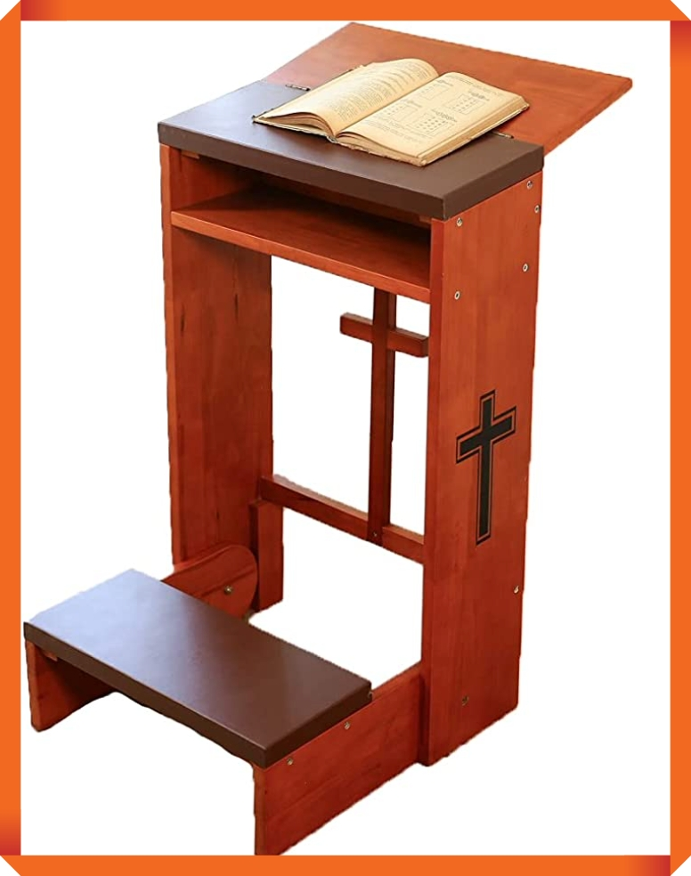
The Inductive Method
1. Listen
2. Understand
3. Obey
14

Slide 15

Where Should I Begin?
?
15

Slide 16
Where Should I Begin?
WORDS?
16

Slide 17
Where Should I Begin?
WORDS
17

Slide 18
Where Should I Begin?
BEGIN
BIG!
18

Slide 19
Where Should I Begin?
SECTIONS
19

Slide 20
Where Should I Begin?
SECTIONS
PASSAGES
20

Slide 21
Where Should I Begin?
SECTIONS
PASSAGES
PARAGRAPHS
21

Slide 22

Where Should I Begin?
How do the words, sentences, and paragraphs fit together?
22

Slide 23
How Things Fit Together
Preparation or Introduction
Comparison
Contrast
Turning Point
Climax
Cause and Effect (Substantiation, Result, Purpose).
Question and Answer
Explanation or Analysis
23

Slide 24
Would you give us an example showing the steps we should follow?
24

Slide 25
Would you give us an example showing the steps we should follow?
Mark 2:1–12
An Example
25

Slide 26
Mark 2:1-12—An Example “Who Can Forgive Sins but God Alone?”
1 And when he returned to Capernaum after some days, it was reported that he was at home. 2 And many were gathered together, so that there was no more room, not even at the door. And he was preaching the word to them. 3 And they came, bringing to him a paralytic carried by four men. 4 And when they could not get near him because of the crowd, they removed the roof above him, and when they had made an opening, they let down the bed on which the paralytic lay. 5 And when Jesus saw their faith, he said to the paralytic, “Son, your sins are forgiven.”
26

Slide 27
6 Now some of the scribes were sitting there, questioning in their hearts, 7 “Why does this man speak like that? He is blaspheming! Who can forgive sins but God alone?” 8 And immediately Jesus, perceiving in his spirit that they thus questioned within themselves, said to them, “Why do you question these things in your hearts? 9 Which is easier, to say to the paralytic, ‘Your sins are forgiven,’ or to say, ‘Rise, take up your bed and walk’? 10 But that you may know that the Son of Man has authority on earth to forgive sins”—he said to the paralytic— 11 “I say to you, rise, pick up your bed, and go home.” 12 And he rose and immediately picked up his bed and went out before them all, so that they were all amazed and glorified God, saying, “We never saw anything like this!”
27

Slide 28
What Steps Should I Follow?
PLACE of Mark 2:1–12 .
28
Notes:
28

Slide 29
What Steps Should I Follow?
PLACE of Mark 2:1–12 .
SECTION
Mark 1:16–3:12
29
Notes:
29

Slide 30
Jesus presents His claim in Galilee 1:14–3:12
A. Demonstration of his authority 1:16-45
30

Slide 31
Jesus presents His claim in Galilee 1:14–3:12
A. Demonstration of his authority 1:16-45
To call disciples 1:16–20
In his teaching 1:21, 22
Over evil spirits 1:23–28
Over all diseases 1:29–45
31

Slide 32
Jesus presents His claim in Galilee 1:14–3:12
A. Demonstration of his authority 1:16-45
To call disciples 1:16–20
In his teaching 1:21, 22
Over evil spirits 1:23–28
Over all diseases 1:29–45
B. Resistance to His claim 2:1–3:6
32

Slide 33
Jesus presents His claim in Galilee 1:14–3:12
A. Demonstration of his authority 1:16-45
To call disciples 1:16–20
In his teaching 1:21, 22
Over evil spirits 1:23–28
Over all diseases 1:29–45
B. Resistance to His claim 2:1–3:6
"How can He forgive sins?" 2:1–12
“Why does He eat with sinners?” 2:13–17
"Why don't His disciples fast?" 2:18–22
"How can He break the Sabbath?" 2:23–3:6
33

Slide 34
Jesus presents His claim in Galilee 1:14–3:12
A. Demonstration of his authority 1:16-45
To call disciples 1:16–20
In his teaching 1:21, 22
Over evil spirits 1:23–28
Over all diseases 1:29–45
B. Resistance to His claim 2:1–3:6
"How can He forgive sins?" 2:1–12
“Why does He eat with sinners?” 2:13–17
"Why don't His disciples fast?" 2:18–22
"How can He break the Sabbath?" 2:23–3:6
C. Summary of His ministry 3:7–12
34

Slide 35
Mark 2:1–12
Resistance to His
Claim 2:1–3:6
Demonstration of His
Authority 1:16–45
35

Slide 36
Observing the place of Mark 2:1–12 raises a QUESTION:
36

Slide 37
Observing the place of Mark 2:1–12 raises a QUESTION:
What did Jesus do in Mark 12:1–12 that incurred the hostility of the authorities?
37

Slide 38
What Steps Should I Follow?
PLACE .
PLAN .
38
Notes:
38

Slide 39
What Steps Should I Follow?
2. PLAN of Mark 2:1–12.
39
Notes:
39

Slide 40
What Steps Should I Follow?
2. PLAN of Mark 2:1–12.
PARAGRAPHS
40
Notes:
40

Slide 41
What Steps Should I Follow?
2. PLAN of Mark 2:1–12.
PARAGRAPHS
2:1–4, 5, 6–7, 8–11, 12
41
Notes:
41

Slide 42
Mark 2:1-4
1 And when he returned to Capernaum after some days, it was reported that he was at home. 2 And many were gathered together, so that there was no more room, not even at the door. And he was preaching the word to them.
3 And they came, bringing to him a paralytic carried by four men. 4 And when they could not get near him because of the crowd, they removed the roof above him, and when they had made an opening, they let down the bed on which the paralytic lay.
42

Slide 43
Mark 2:1-4
1 And when he returned to Capernaum after some days, it was reported that he was at home. 2 And many were gathered together, so that there was no more room, not even at the door. And he was preaching the word to them.
3 And they came, bringing to him a paralytic carried by four men. 4 And when they could not get near him because of the crowd, they removed the roof above him, and when they had made an opening, they let down the bed on which the paralytic lay.
PREPARATION
43

Slide 44
2. The PLAN of Mark 2:1-12
Preparation
Verses 1–2 General–A Crowd
Verses 3–4 Specific–A Paralytic / Roof
44

Slide 45
Mark 2:5
5 And when Jesus saw their faith, he said to the paralytic, “Son, your sins are forgiven.”
45

Slide 46
Mark 2:5
5 And when Jesus saw their faith, he said to the paralytic, “Son, your sins are forgiven.”
TURNING POINT
46

Slide 47
2. The PLAN of Mark 2:1-12
Preparation
Verses 1–2 General–A Crowd
Verses 3–4 Specific–A Paralytic / Roof
Turning Point Verse 5—Jesus Forgives Sin
47

Slide 48
Mark 2:6–7
6 Now some of the scribes were sitting there, questioning in their hearts, 7 “Why does this man speak like that? He is blaspheming! Who can forgive sins but God alone?”
48

Slide 49
Challenge EXPLANATION
Mark 2:6–7
6 Now some of the scribes were sitting there, questioning in their hearts, 7 “Why does this man speak like that? He is blaspheming! Who can forgive sins but God alone?”
49

Slide 50
2. The PLAN of Mark 2:1-12
Preparation
Verses 1–2 General–A Crowd
Verses 3–4 Specific–A Paralytic / Roof
Turning Point Verse 5—Jesus Forgives Sin
Challenge
Verse 6–7
“Who can forgive but God?”
Explanation
50

Slide 51
Mark 2:8–11
8 And immediately Jesus, perceiving in his spirit that they thus questioned within themselves, said to them, “Why do you question these things in your hearts? 9 Which is easier, to say to the paralytic, ‘Your sins are forgiven,’ or to say, ‘Rise, take up your bed and walk’? 10 But that you may know that the Son of Man has authority on earth to forgive sins”—he said to the paralytic— 11 “I say to you, rise, pick up your bed, and go home.”
51

Slide 52
Mark 2:8–11
8 And immediately Jesus, perceiving in his spirit that they thus questioned within themselves, said to them, “Why do you question these things in your hearts? 9 Which is easier, to say to the paralytic, ‘Your sins are forgiven,’ or to say, ‘Rise, take up your bed and walk’? 10 But that you may know that the Son of Man has authority on earth to forgive sins”—he said to the paralytic— 11 “I say to you, rise, pick up your bed, and go home.”
SUBSTANTIATION
52

Slide 53
2. The PLAN of Mark 2:1-12
Preparation
Verses 1–2 General–A Crowd
Verses 3–4 Specific–A Paralytic / Roof
Turning Point Verse 5—Jesus Forgives Sin
Challenge
Verse 6–7
“Who can forgive but God?”
Explanation
Substantiation
Verses 8–11
“Why do you question?”
“Which is easier?”
53

Slide 54
Mark 2:12
12 And he rose and immediately picked up his bed and went out before them all, so that they were all amazed and glorified God, saying, “We never saw anything like this!”
54

Slide 55
Mark 2:12
12 And he rose and immediately picked up his bed and went out before them all, so that they were all amazed and glorified God, saying, “We never saw anything like this!”
CONCLUSION
(Contrast the paralytic’s entrance with his exit)
55

Slide 56
2. The PLAN of Mark 2:1-12
Preparation
Verses 1–2 General–A Crowd
Verses 3–4 Specific–A Paralytic / Roof
Turning Point Verse 5—Jesus Forgives Sin
Challenge
Verse 6–7
“Who can forgive but God?”
Explanation
Substantiation
Verses 8–11
“Why do you question?”
“Which is easier?”
Conclusion Verse 12 (Contrast exit/entrance)
“they were all amazed and glorified God”
56

Slide 57
What Steps Should I Follow?
PLACE .
PLAN .
3. PARTICULARS (WORDS).
57
Notes:
57

Slide 58
What Steps Should I Follow?
2. PARTICULARS of Mark 2:1–12.
58
Notes:
58

Slide 59
3. The PARTICULARS of Mark 2:1-4
Capernaum:
preaching the word:
no more room:
59

Slide 60
3. The PARTICULARS of Mark 2:1-4, 2:5
Capernaum:
preaching the word:
no more room:
Jesus saw their Faith:
Paralytic:
Son, your sins are forgiven:
60

Slide 61
3. The PARTICULARS of Mark 2:6–7
Blaspheming:
61

Slide 62
3. The PARTICULARS of Mark 2:6–7, 2:8–11
Blaspheming:
Which is easier? . . . Authority:
Son of Man:
62

Slide 63
3. The PARTICULARS of Mark 2:6–7, 2:8–11, 2:13
Blaspheming:
Which is easier? . . . Authority:
Son of Man:
“We never saw anything like this?”
63

Slide 64
What Steps Should I Follow?
PLACE .
PLAN .
3. PARTICULARS (WORDS).
4. POINT .
?
64
Notes:
64

Slide 65
4. The POINT of Mark 2:1-12
?
65

Slide 66
I. The POINT of Mark 2:1-12
By forgiving sins here and now Jesus acts as God and claims that His authority is Divine Authority.
66

Slide 67
The Inductive Method
1. Listen
67

Slide 68
The Inductive Method
1. Listen
2. Understand
68

Slide 69
The Inductive Method
1. Listen
2. Understand
3. Obey
69

Slide 70
What Steps Should I Follow?
PLACE .
70
Notes:
70

Slide 71
What Steps Should I Follow?
PLACE .
PLAN .
71
Notes:
71

Slide 72
What Steps Should I Follow?
PLACE .
PLAN .
3. PARTICULARS (WORDS).
72
Notes:
72

Slide 73
What Steps Should I Follow?
PLACE .
PLAN .
3. PARTICULARS (WORDS).
4. POINT .
?
73
Notes:
73

Slide 74
Your Questions?
Madison UMC
Wednesday, January 11, 2023
74

