Slide 1


Slide 2
I. Moses’ Song (Deut. 31:28—32:52)
A. Moses’ call to listen (31:28—32:2)
B. Moses’ praise of God (32:3, 4)
C. Israel’s response to God’s person (32:5, 6)
D. God’s goodness to Israel (32:7–14)
E. Israel’s response to God’s goodness (32:15–18)
F. God’s response to Israel’s unfaithfulness (32:19–35)
G. God’s salvation of Israel (32:36–43)

Slide 3
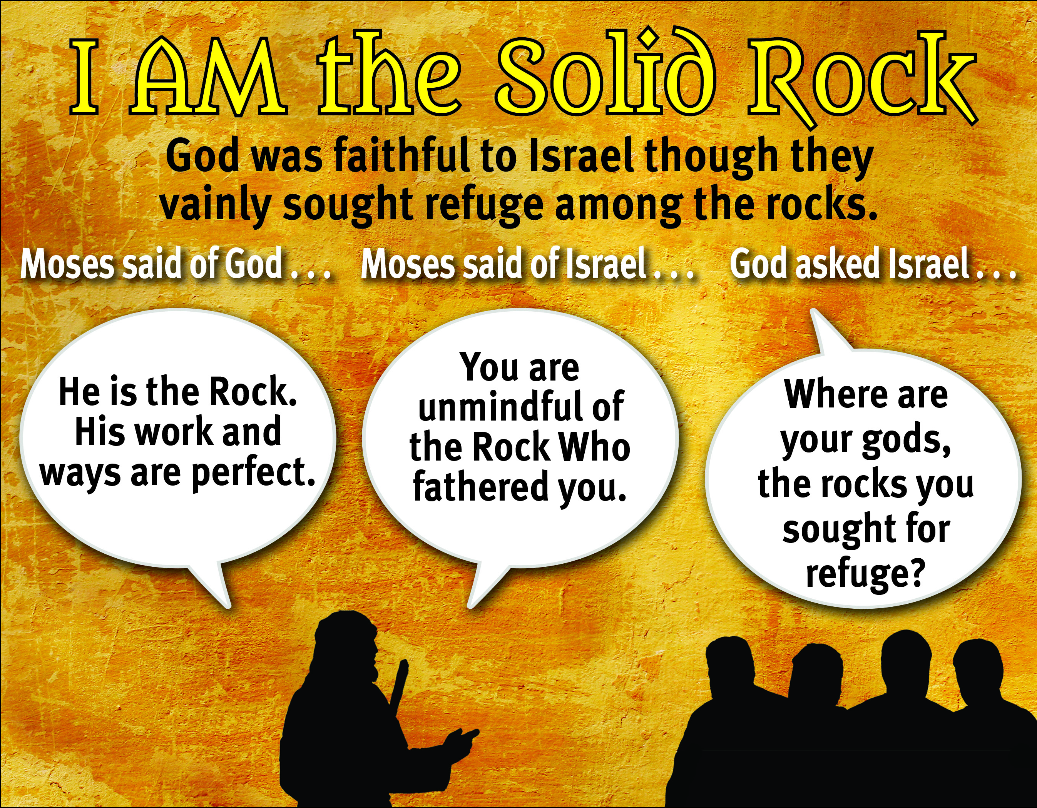

Slide 4
II. Moses’ Application (32:44–52)

Slide 5
III. Moses’ Blessing (Deut. 33)
A. Introduction of the blessing (33:1–5)
B. The blessing of the tribes (33:6–25)
C. Conclusion (33:26–29)

Slide 6
IV. Moses’ Death (Deut. 34)

Slide 7
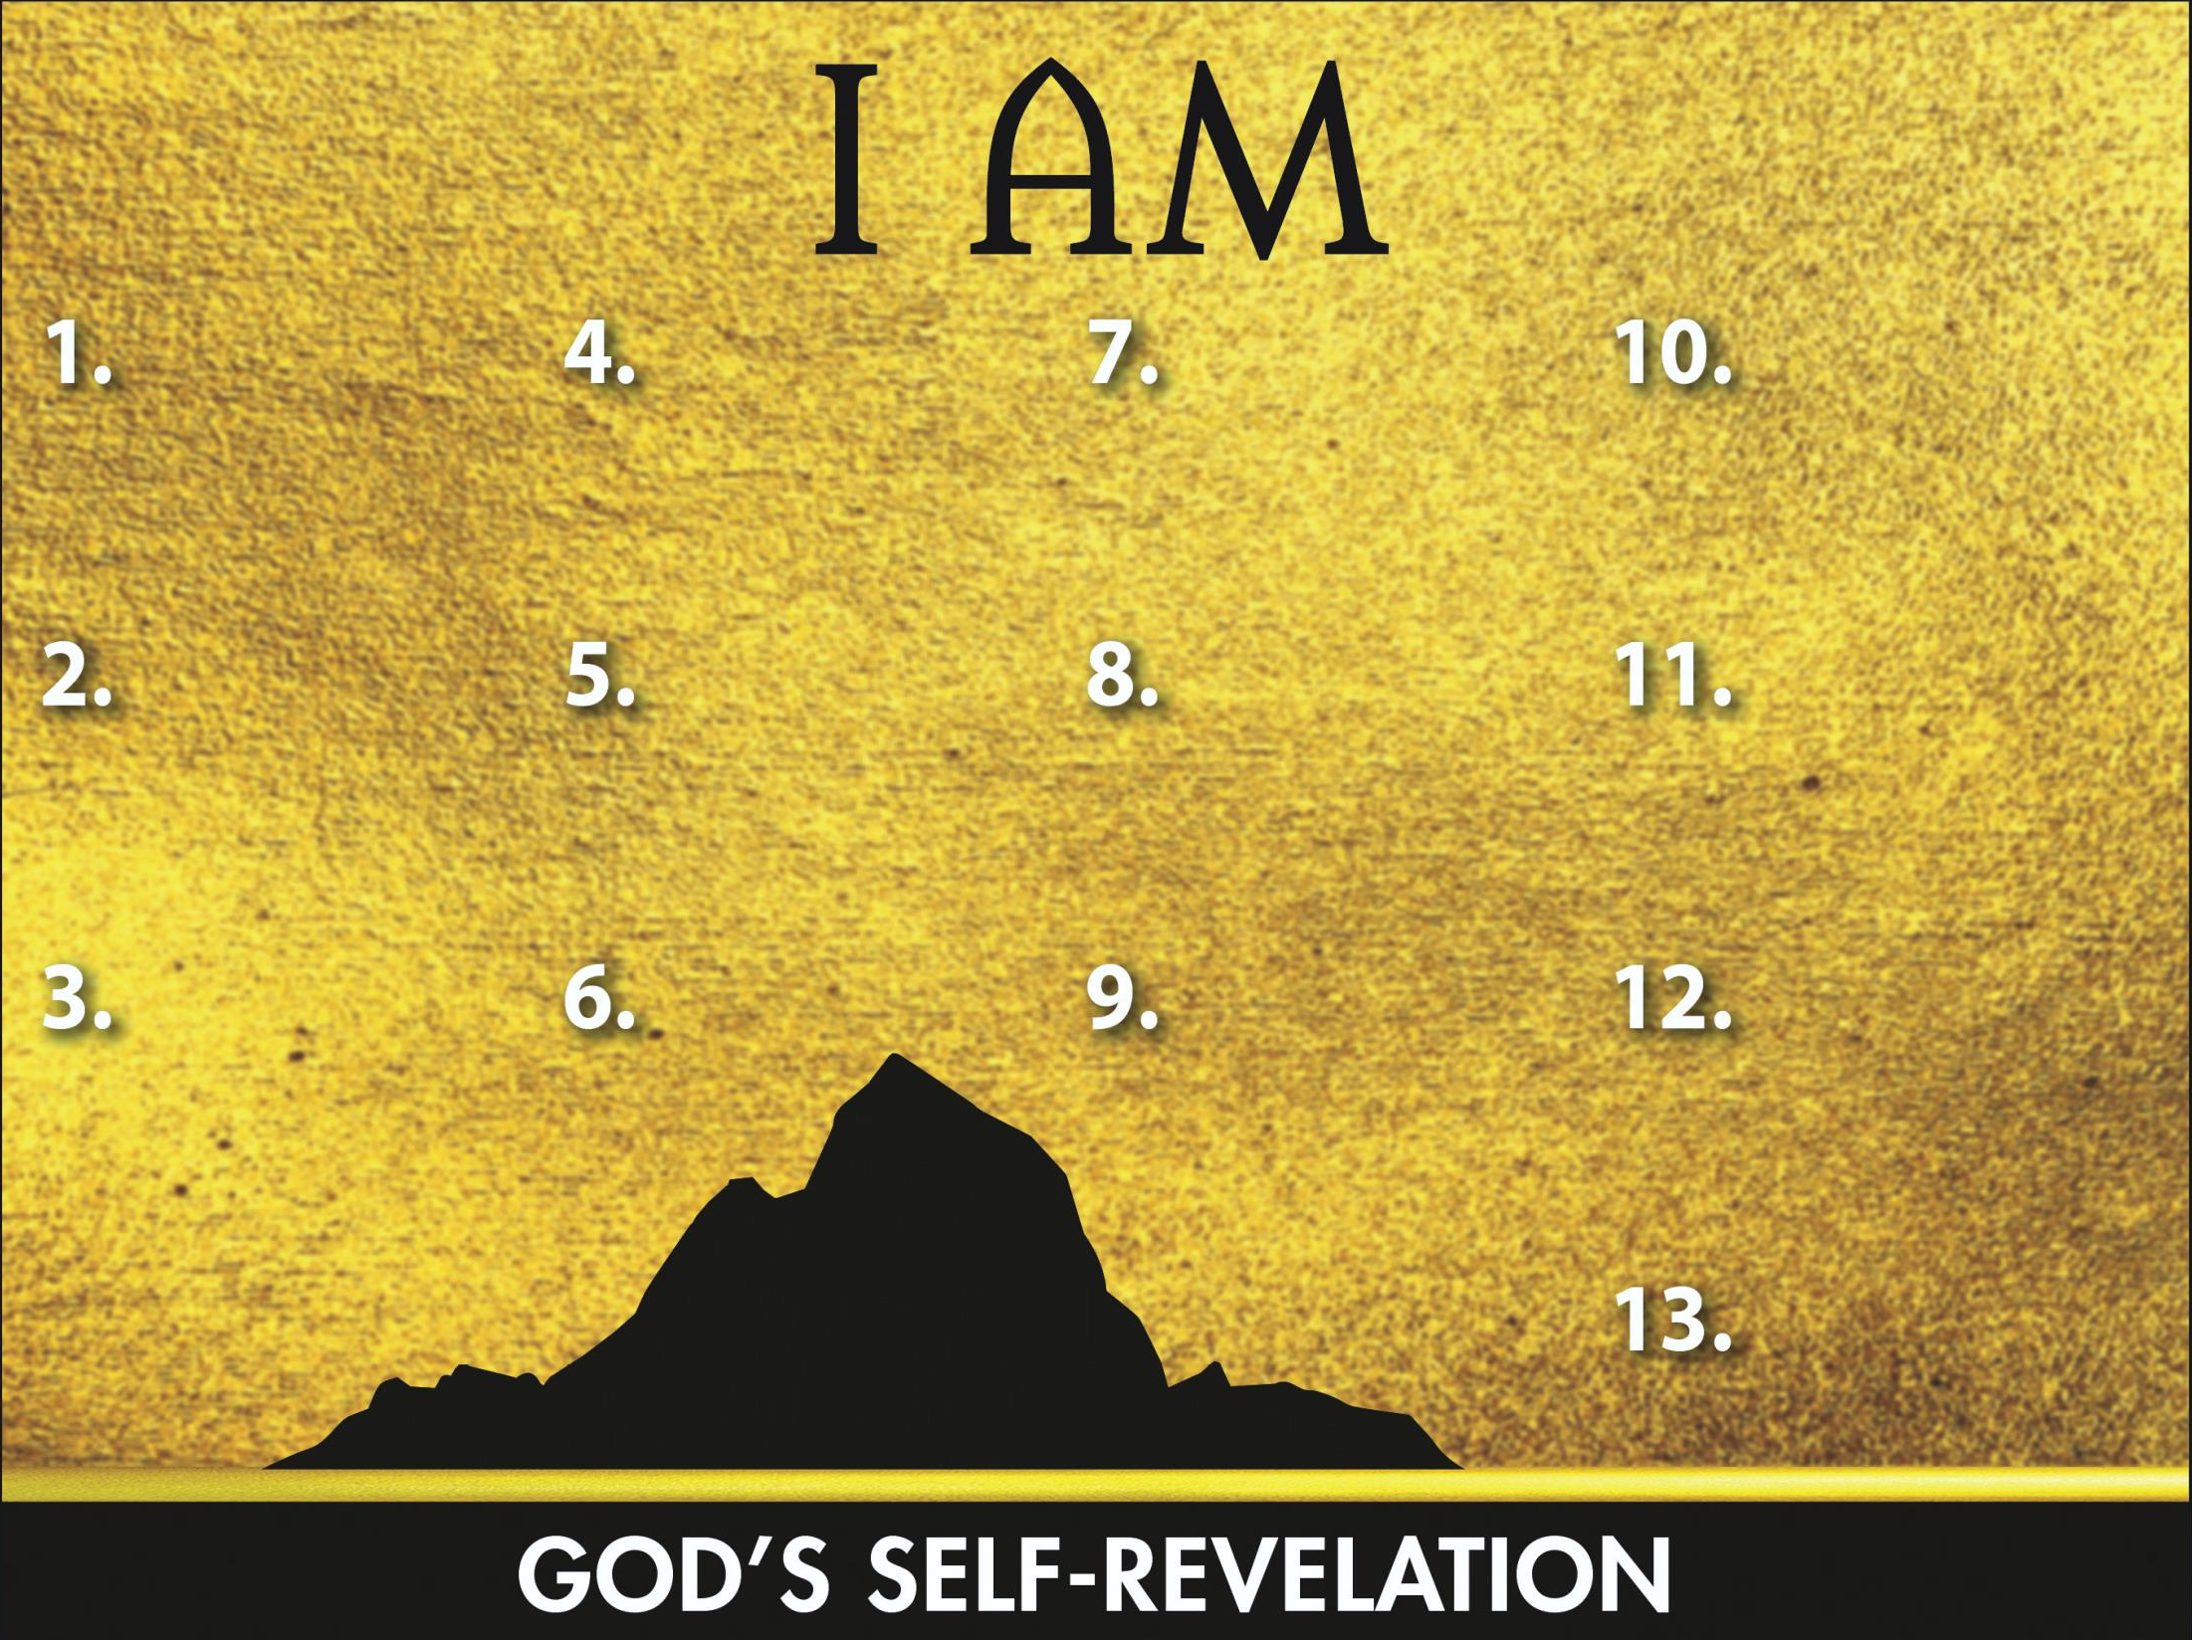
Sovereign
Redeemer
Instructor
Gracious Giver
Transcen-
dent Helper
Leader
Glorious God
Powerful Proclaimer
Promise Keeper
Provider
Atoner
Loving Lord
The Solid Rock

