Slide 1


Slide 2
I. God’s Love for Israel (Deut. 1:1—7:11)

Slide 3
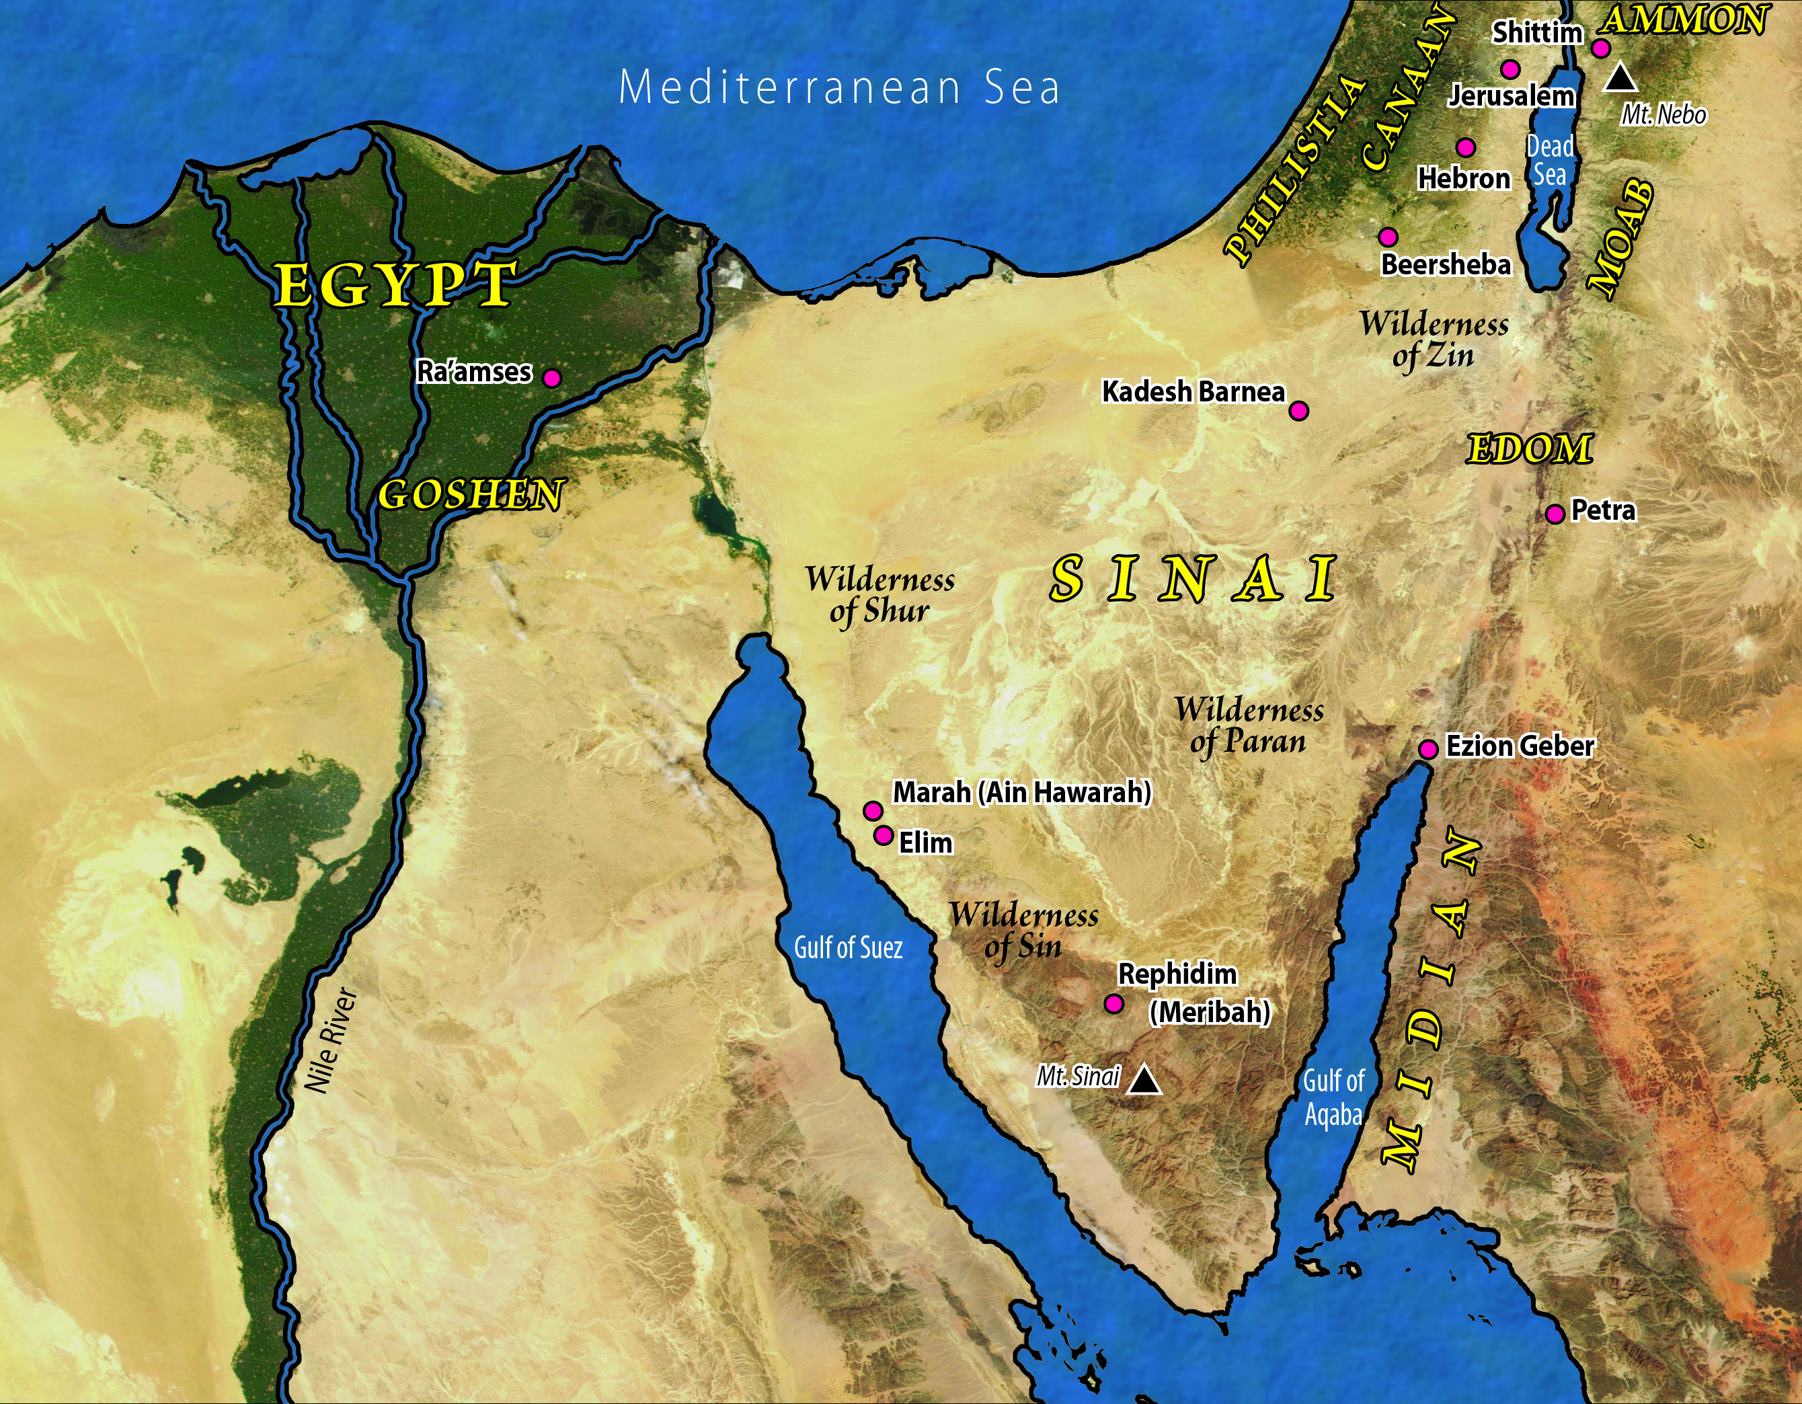

Slide 4
II. Israel’s Love for God (Deut. 6:4–25)
A. The extent of Israel’s love (6:4–9)
B. Threats to Israel’s love for God (Deut. 6:10–19)
1. The threat of prosperity (6:10–12)
2. The threat of pluralism (6:13–15)
3. The threat of doubt (6:16–19)
C. Israel’s motivation to love God (Deut. 6:20–25)

Slide 5
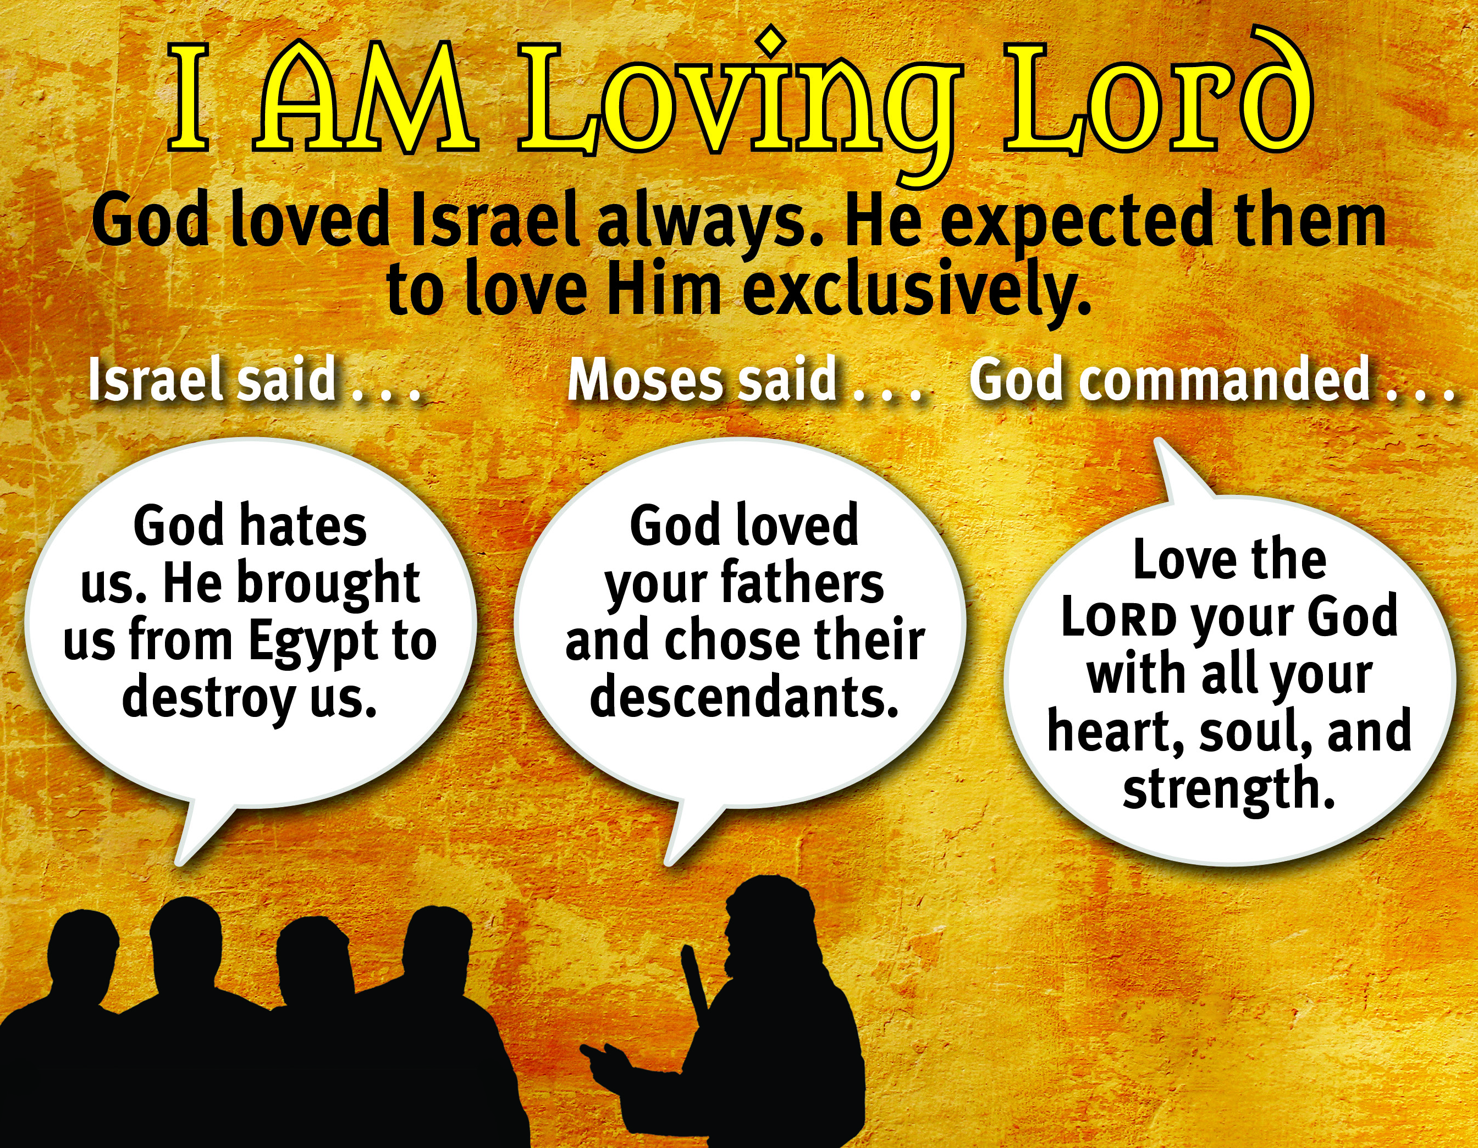

Slide 6
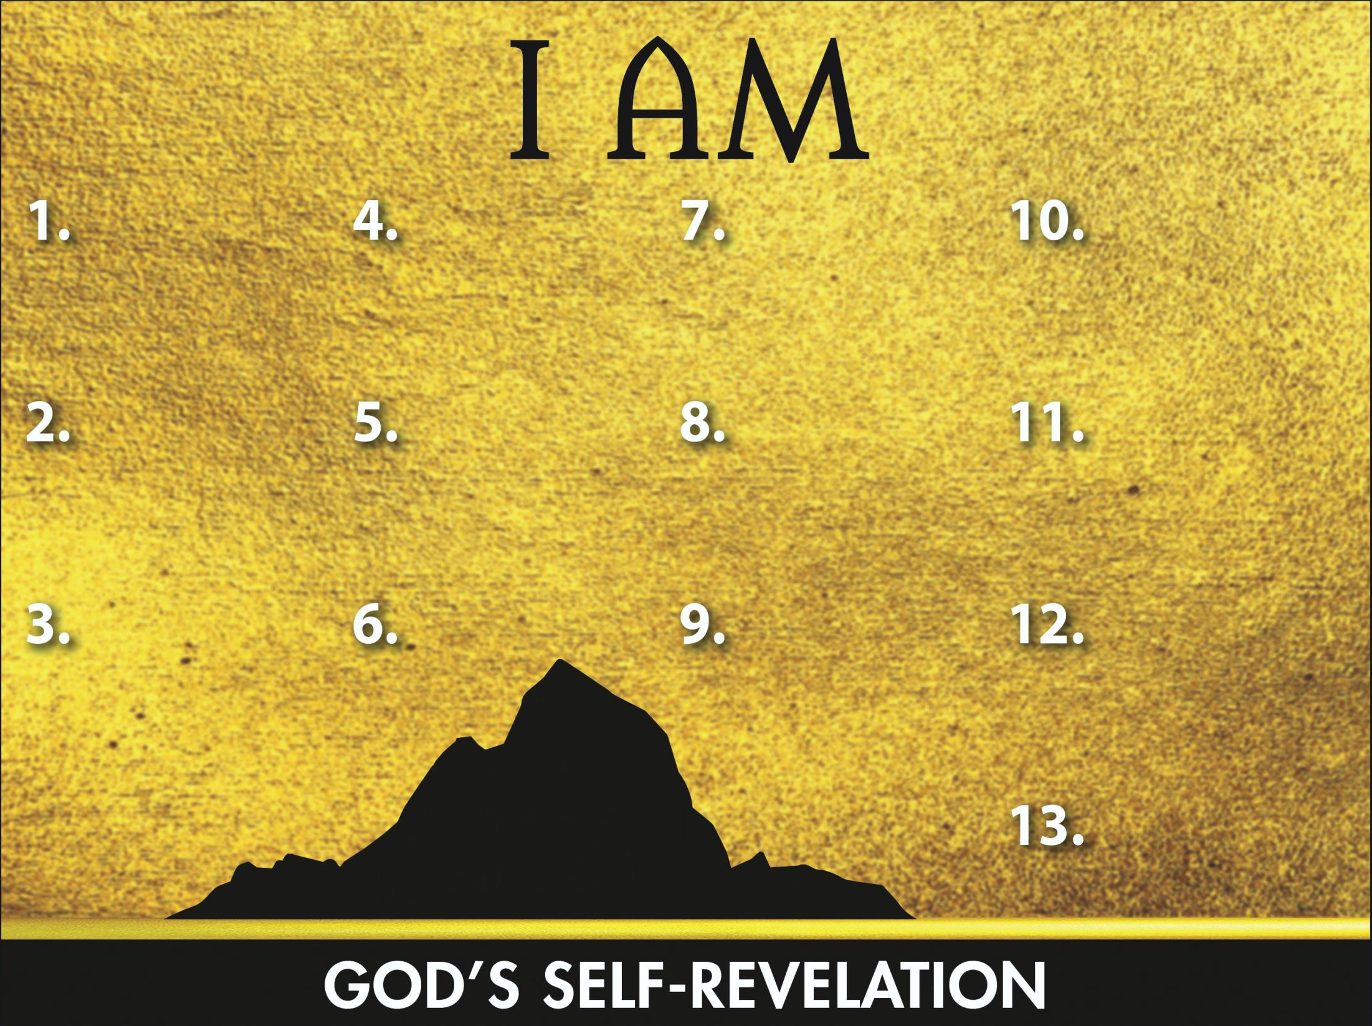
Sovereign
Redeemer
Instructor
Gracious Giver
Transcen-
dent Helper
Leader
Glorious God
Powerful Proclaimer
Promise Keeper
Provider
Atoner
Loving Lord

