Slide 1


Slide 2
I. Israel’s Rebellions (Num. 14:39—17:13)
A. Attempting to enter the Promised Land (14:39—15:31)

Slide 3
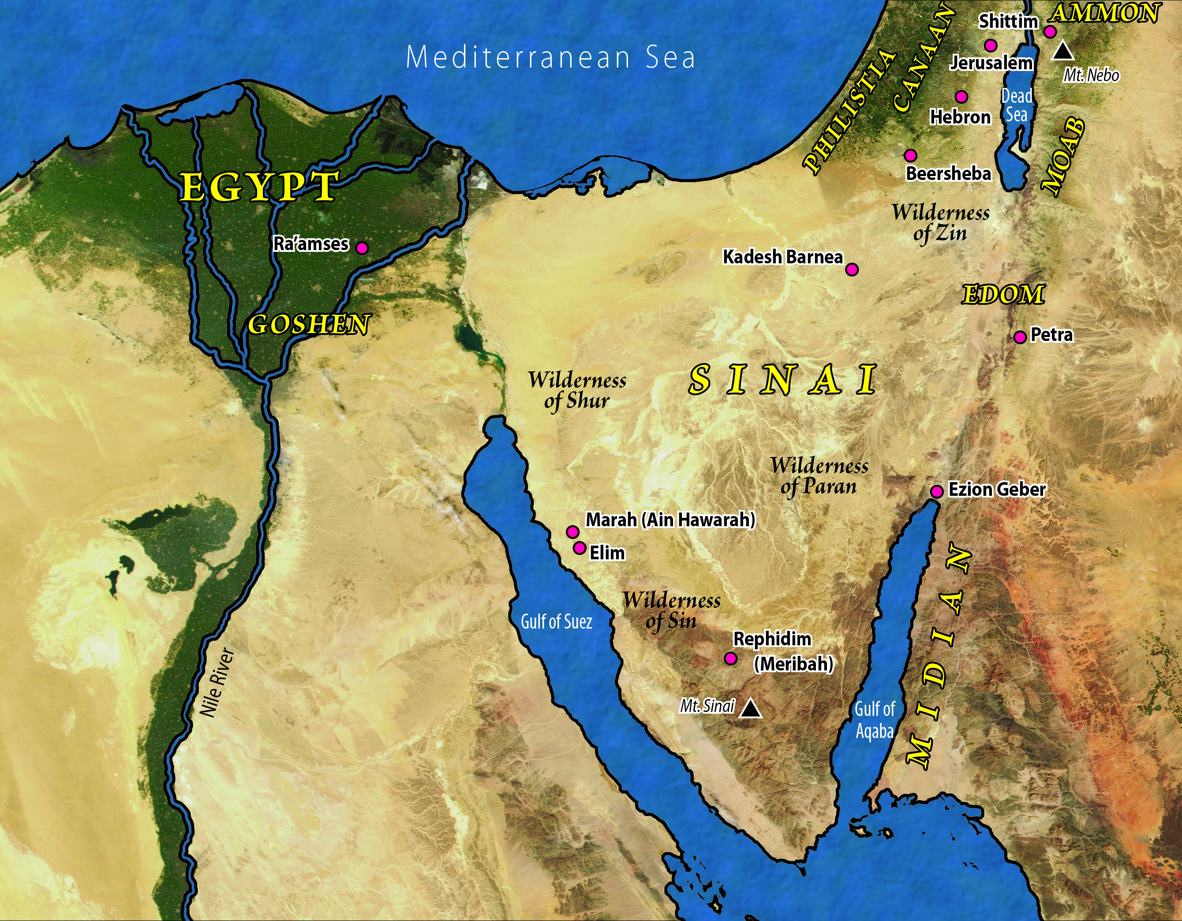

Slide 4
I. Israel’s Rebellions (Num. 14:39—17:13)
A. Attempting to enter the Promised Land (14:39—15:31)
B. Breaking the Sabbath (15:32–41)
C. Rebelling against Moses and Aaron (16; 17)

Slide 5
II. Moses’ Rebellion (Num. 20)

Slide 6
III. Balaam’s Futility (Num. 22:1––24:25)
A. Balak’s summons (22:1–22)

Slide 7
Israel’s Camp

Slide 8
III. Balaam’s Futility (Num. 22:1––24:25)
A. Balak’s summons (22:1–22)
B. Balaam’s arrival (22:23–40)
C. Balaam’s oracles (22:41—24:25)
1. Balaam’s first oracle (22:41—23:12)
2. Balaam’s second oracle (23:13–26)
3. Balaam’s third oracle (23:27—24:25)

Slide 9
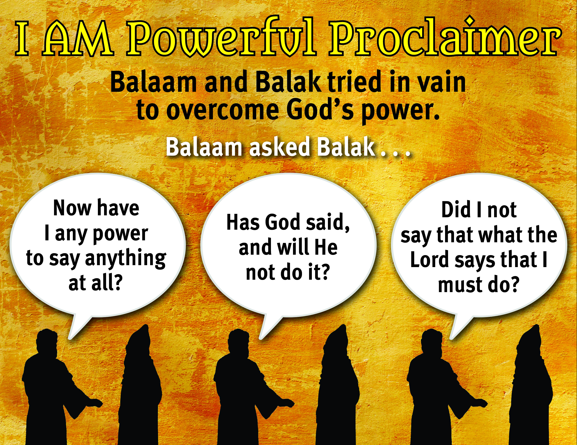

Slide 10
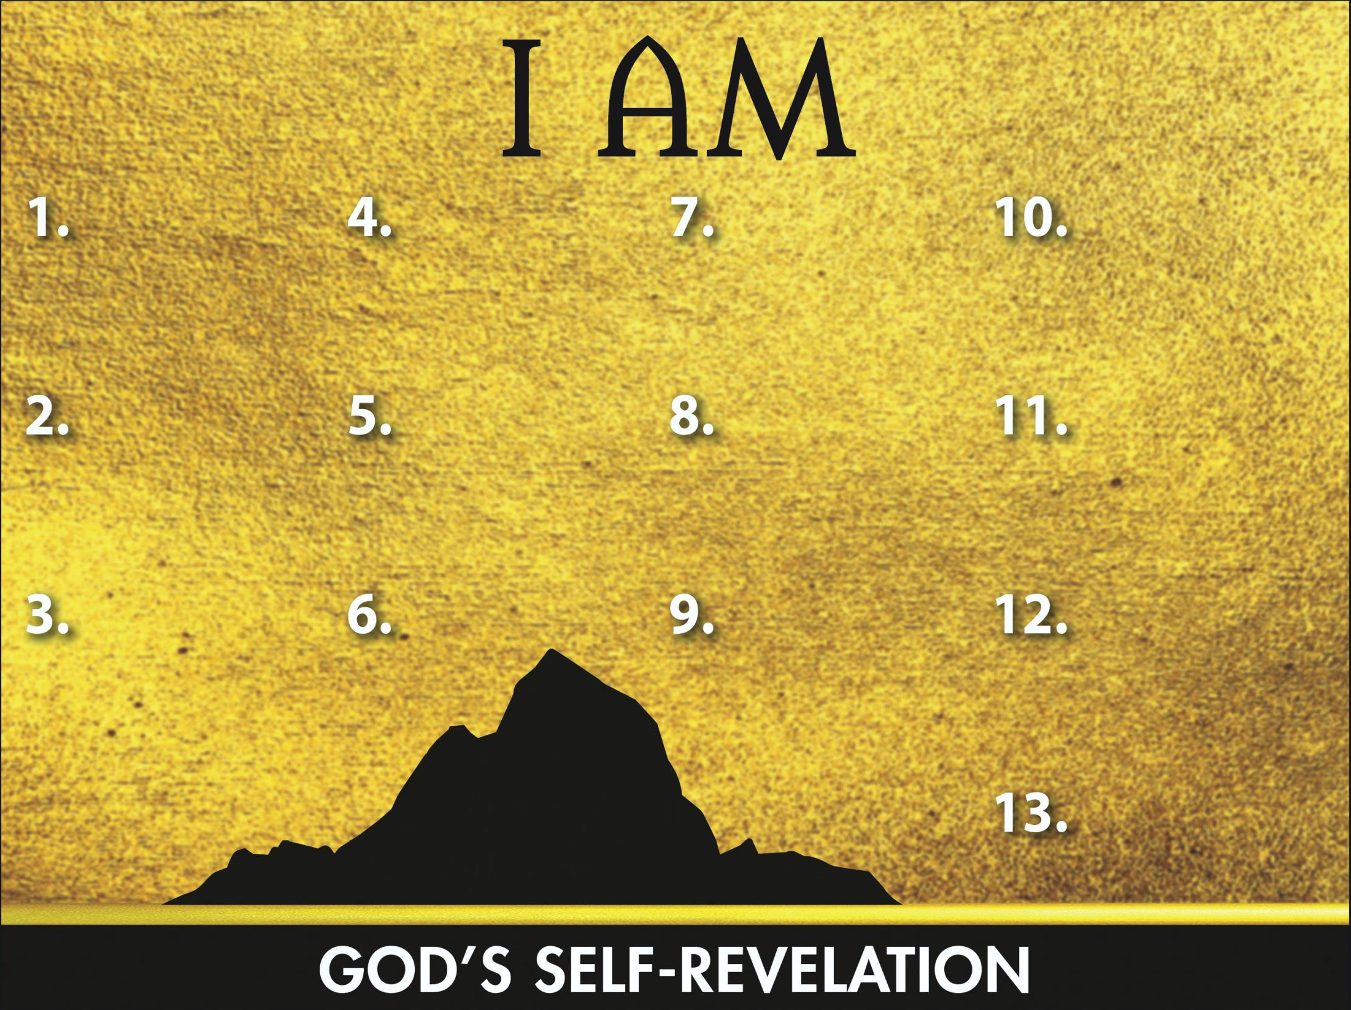
Sovereign
Redeemer
Instructor
Gracious Giver
Transcen-
dent Helper
Leader
Glorious God
Powerful Proclaimer
Promise Keeper
Provider
Atoner

