Slide 1


Slide 2
I. God Provided for Israel (Num. 1—11)
A. God’s blessing on Israel (1:1—6:21; 7—11)
B. God’s prayer for Israel (6:22–27)

Slide 3
II. Israel Complained (Num. 11:1–3)

Slide 4
III. Israel Craved Meat (Num. 11:4–35)
A. Israel’s dissatisfaction (11:4–9)
B. Moses’ complaint (11:10–15)
C. God’s response and judgment (11:16–35)

Slide 5
IV. Miriam and Aaron Criticized Moses (Num. 12)

Slide 6
V. Israel Rejected God (Num. 13; 14)
A. Spying out the land (13:1–24)

Slide 7
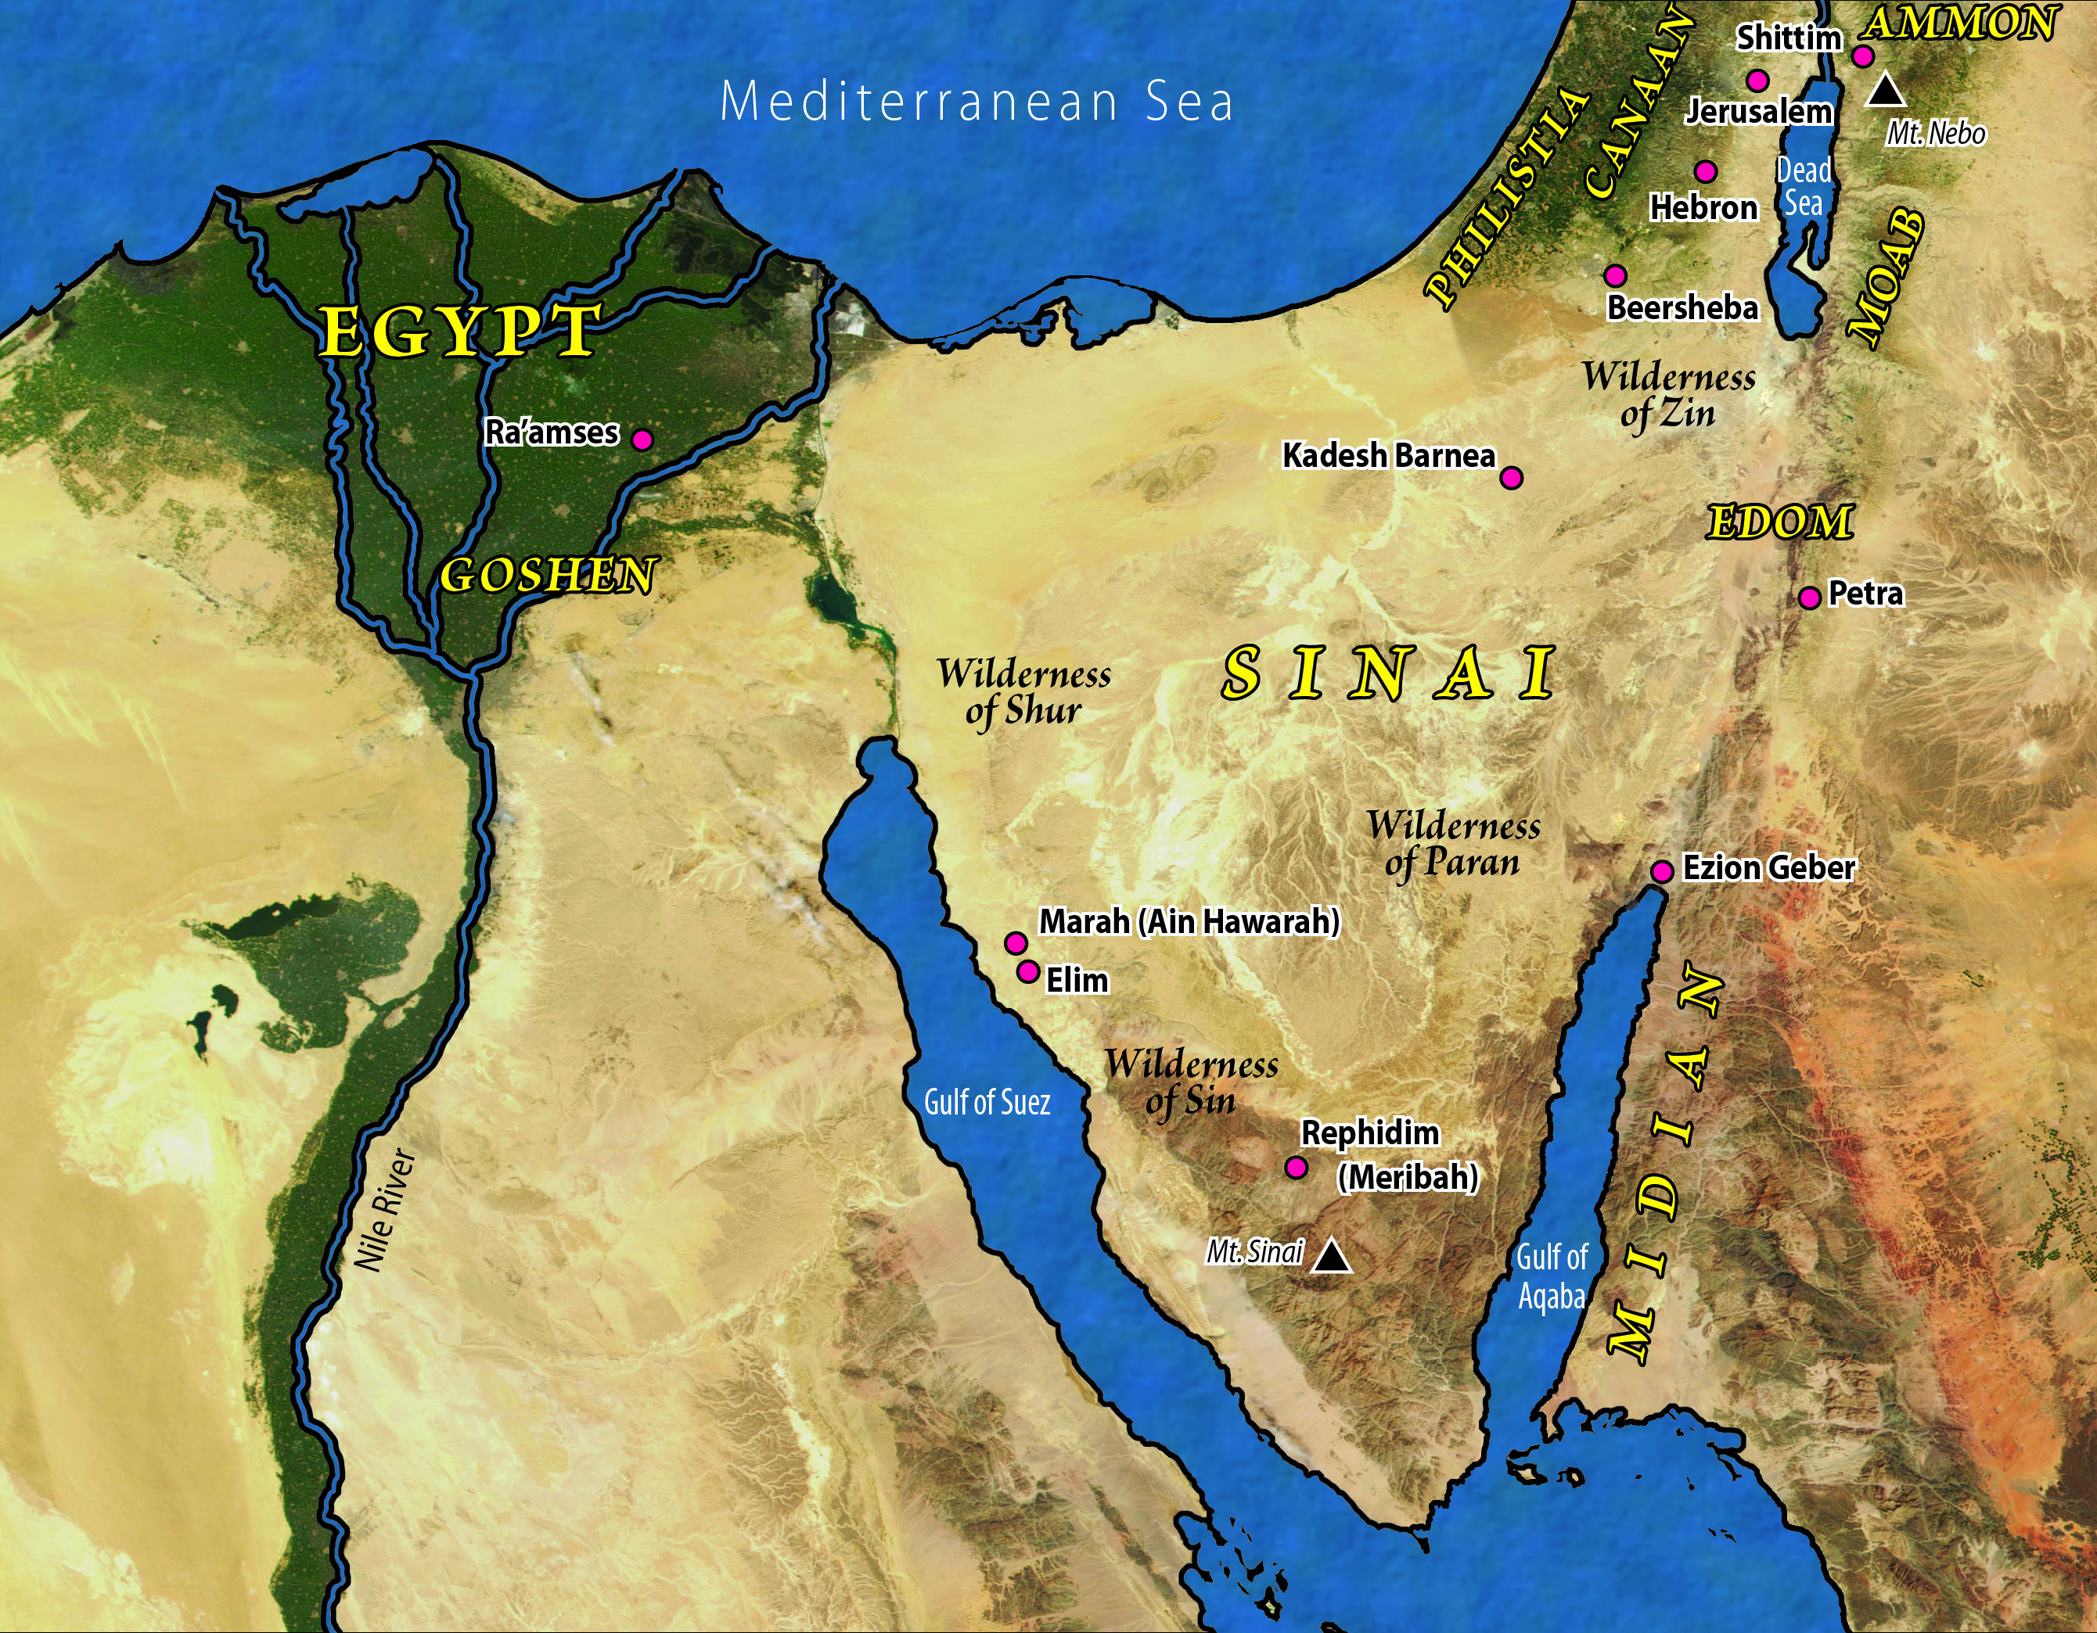

Slide 8
V. Israel Rejected God (Num. 13; 14)
A. Spying out the land (13:1–24)
B. Refusing the land (13:25—14:38)

Slide 9
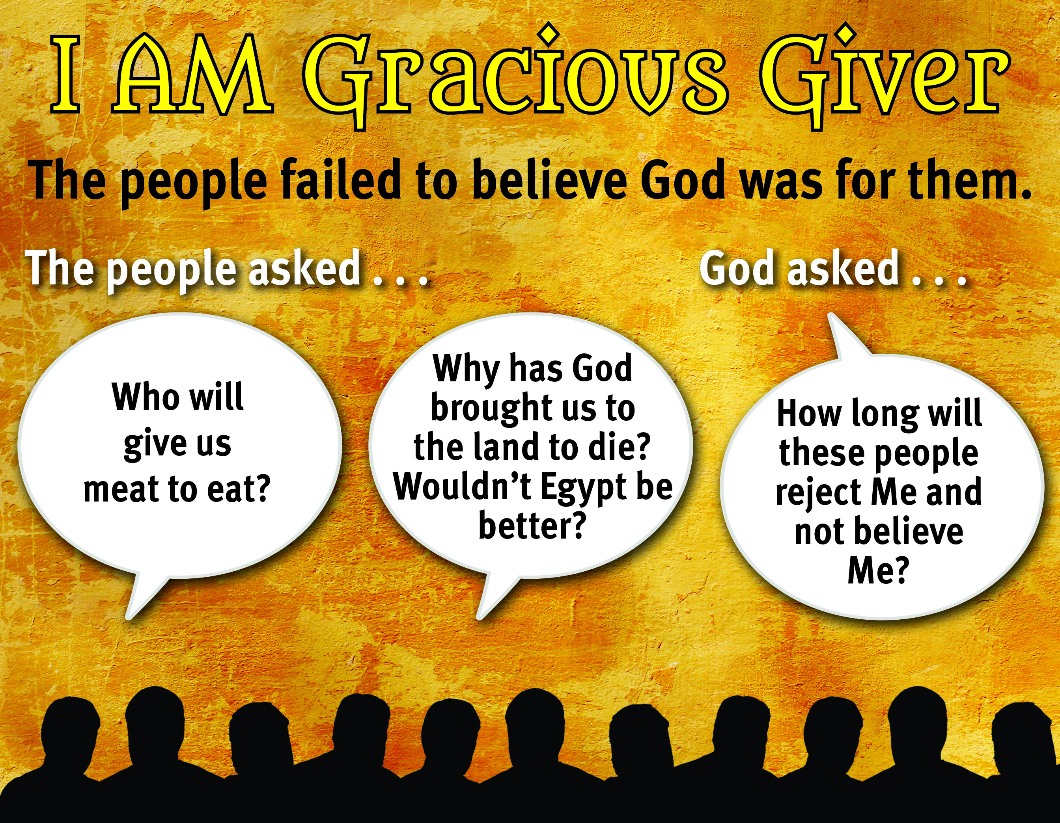

Slide 10
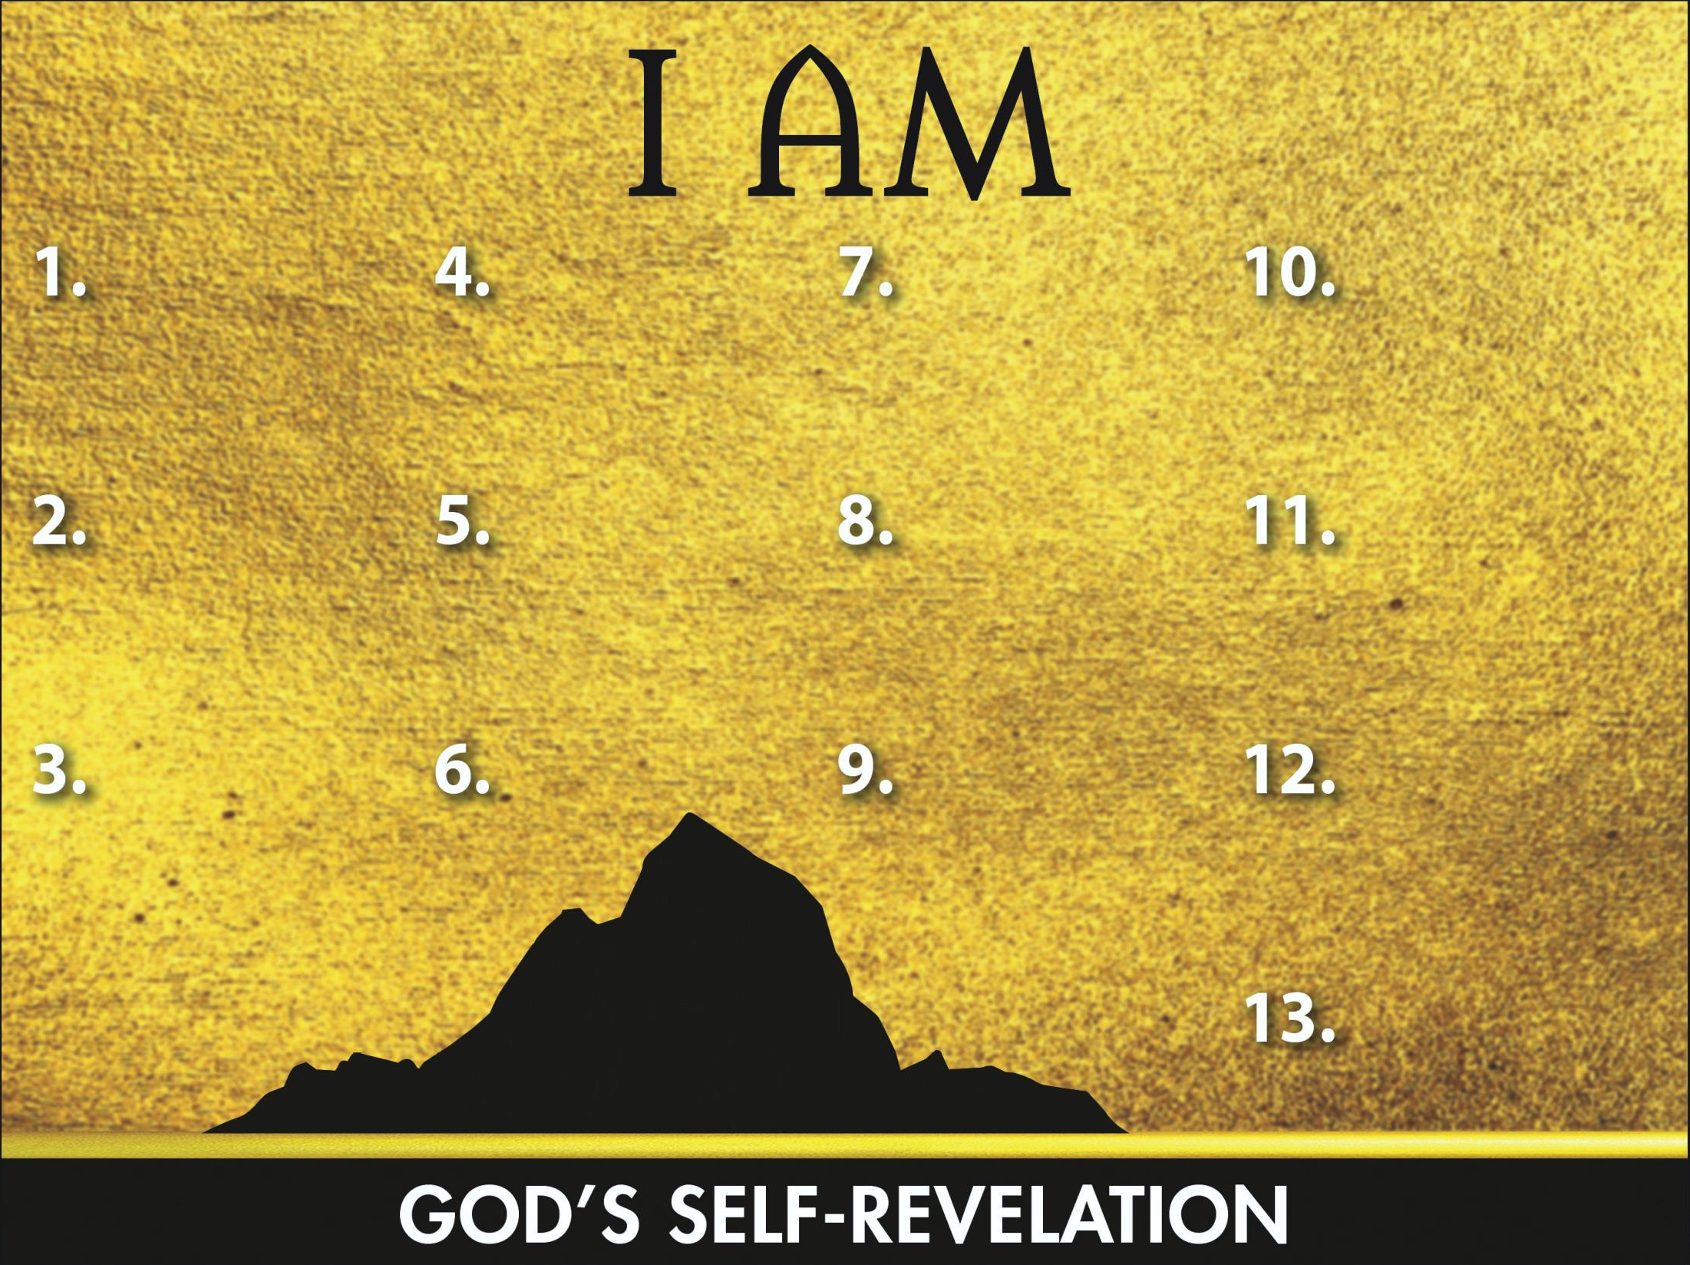
Sovereign
Redeemer
Instructor
Gracious Giver
Transcen-
dent Helper
Leader
Glorious God
Promise Keeper
Provider
Atoner

