Slide 1


Slide 2
I. God’s Covenant with Israel (Exod. 19:1–8)

Slide 3
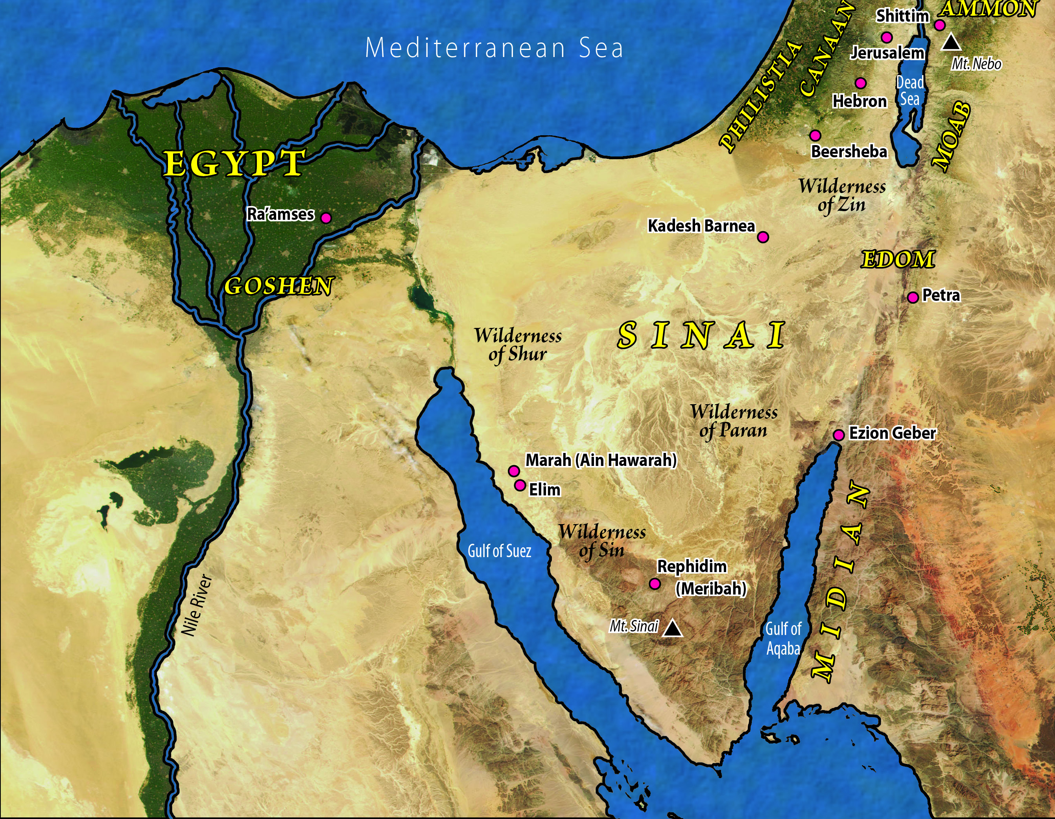

Slide 4
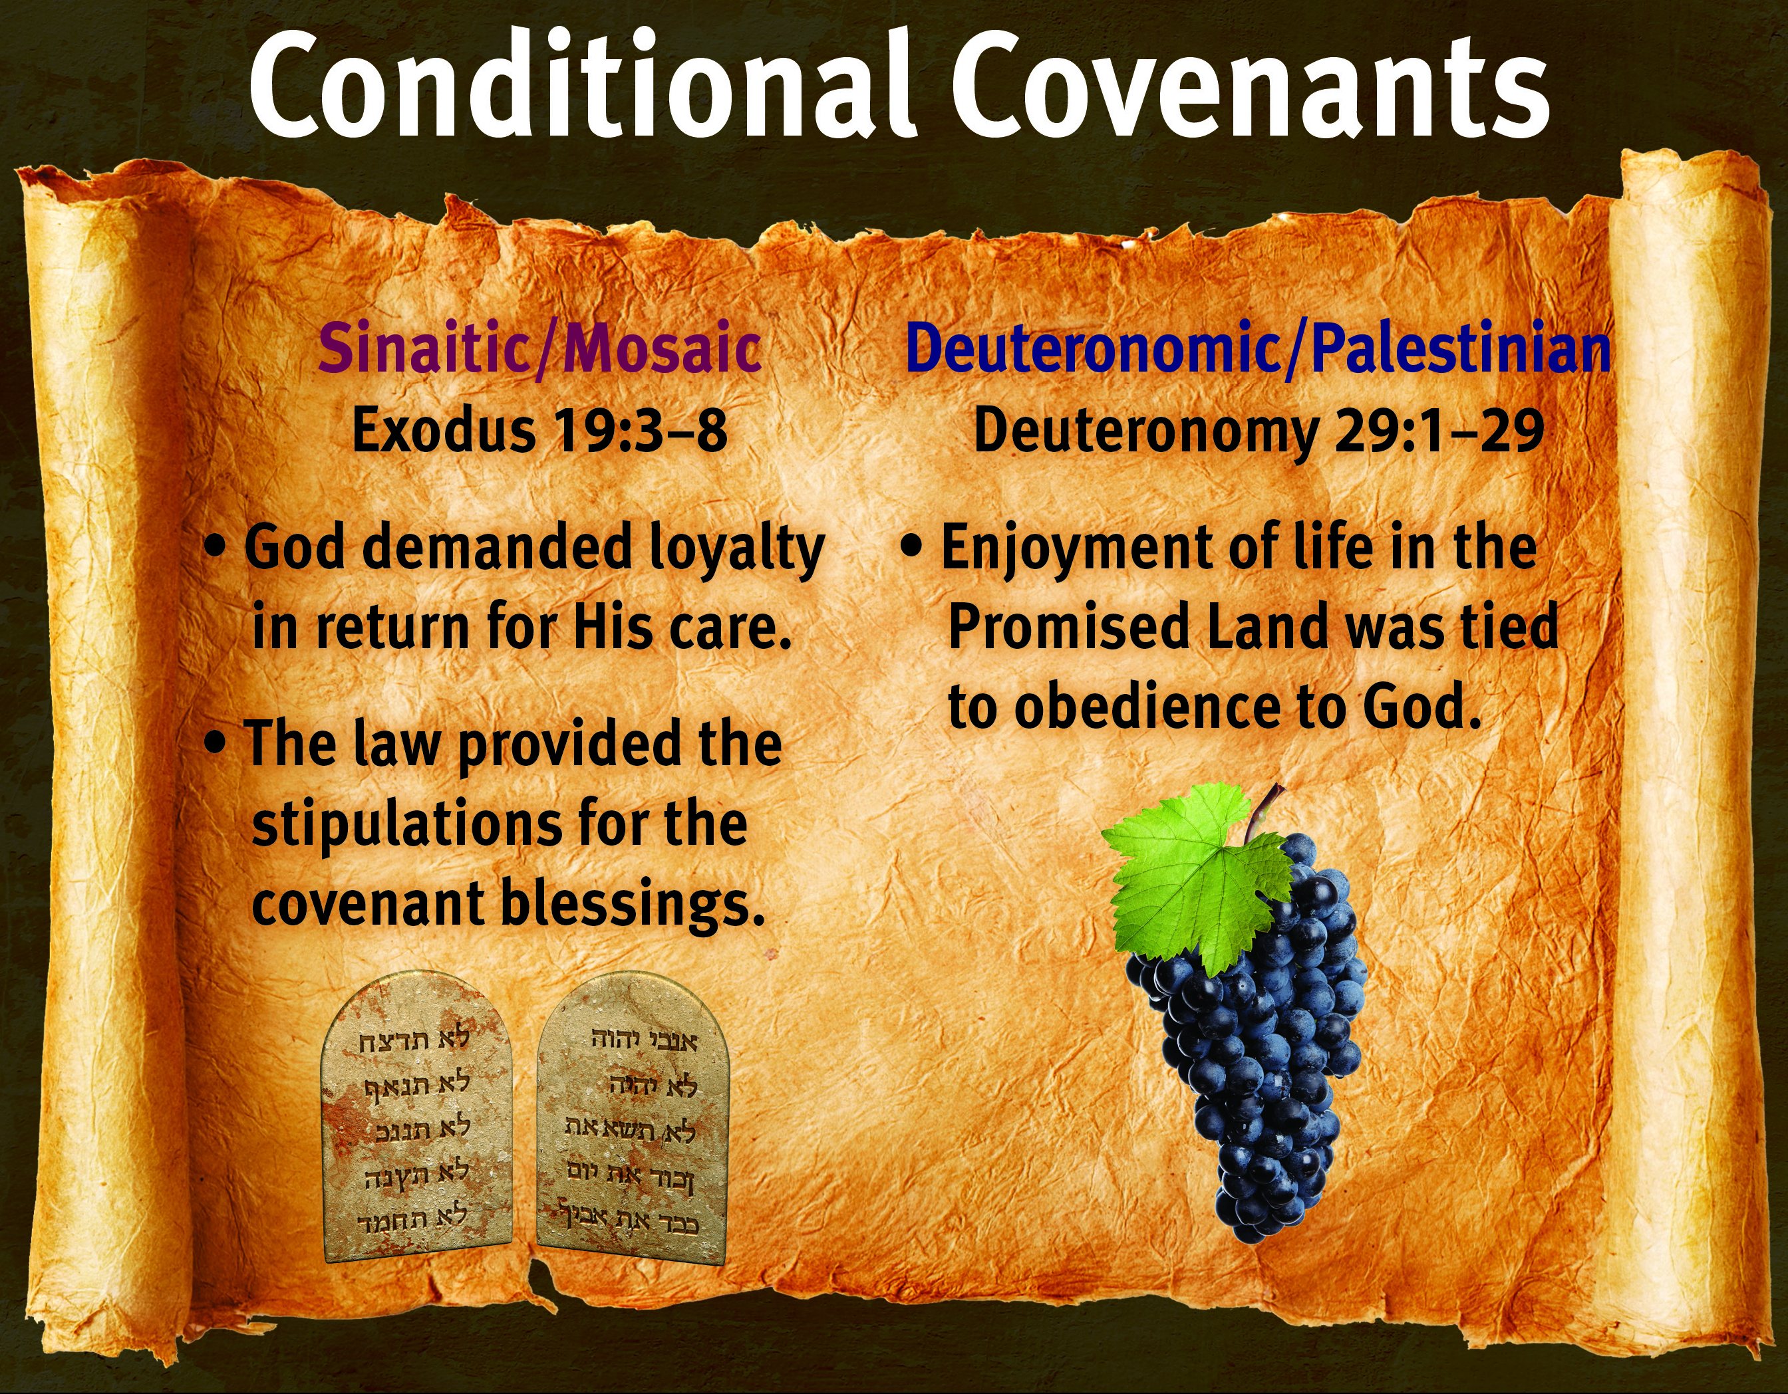

Slide 5
I. God’s Covenant with Israel (Exod. 19:1–8)
A. God’s leadership (19:1–4)
B. God’s conditions and blessings (19:5, 6)
C. Israel’s response (19:7, 8)

Slide 6
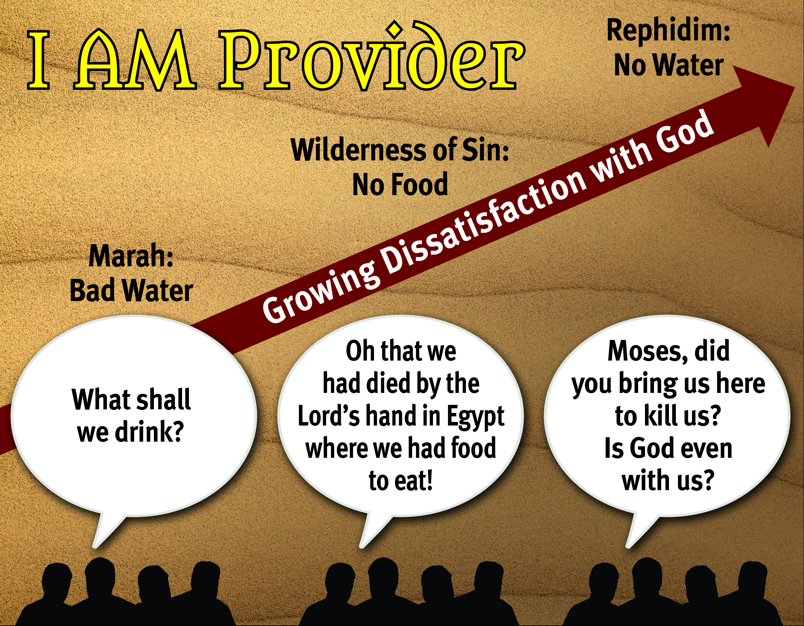

Slide 7
II. God’s Stipulations for Covenant Blessing
(Exod. 19:9—20:17)
A. Israel’s preparation (19:10–15)
B. God’s arrival and warning (19:16–25; 20:18–21)
C. God’s law (20:1–17)
1. Israel’s relationship with God (20:1–11)
2. Israel’s relationship with others (20:12–17)

Slide 8

Sovereign
Redeemer
Instructor
Transcen-
dent Helper
Leader
Promise Keeper
Provider

