Slide 1


Slide 2
I. God’s Place of Worship (Exod. 35—40)
A. God provided materials and artisans (35—39)
B. Moses constructed the tabernacle (40:1–33)
C. God approved of the tabernacle (40:34–38)

Slide 3
II. God’s Atoning Sacrifices (Lev. 1—7; 16)

Slide 4
III. God’s Consecrated Priesthood (Lev. 8; 9)

Slide 5
IV. God’s Demand for Holiness (Lev. 10:1–11)
A. Nadab and Abihu offered profane fire (10:1)
B. God judged Nadab and Abihu (10:2–5)
C. God instructed the priests (10:6–20)

Slide 6
V. God’s Laws for Holy Living and Worship
(Lev. 11—15; 17—27)

Slide 7
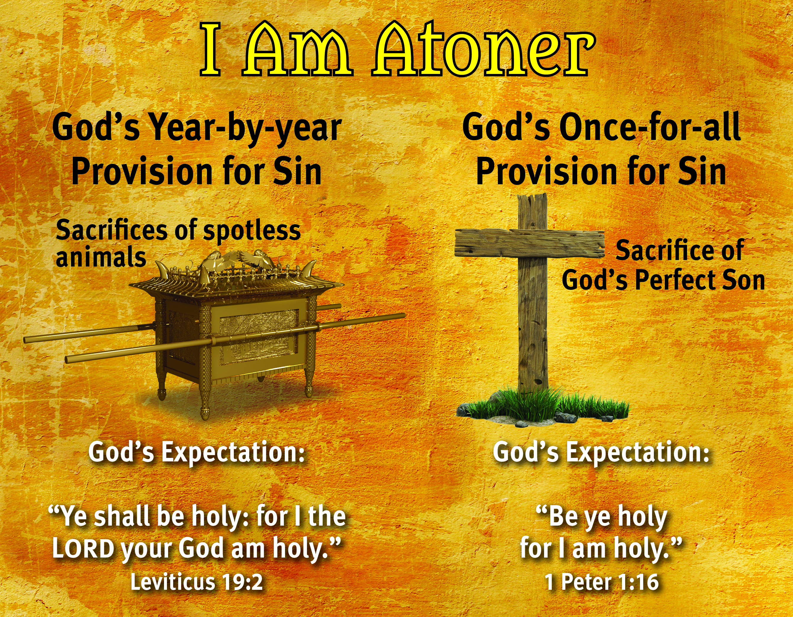

Slide 8
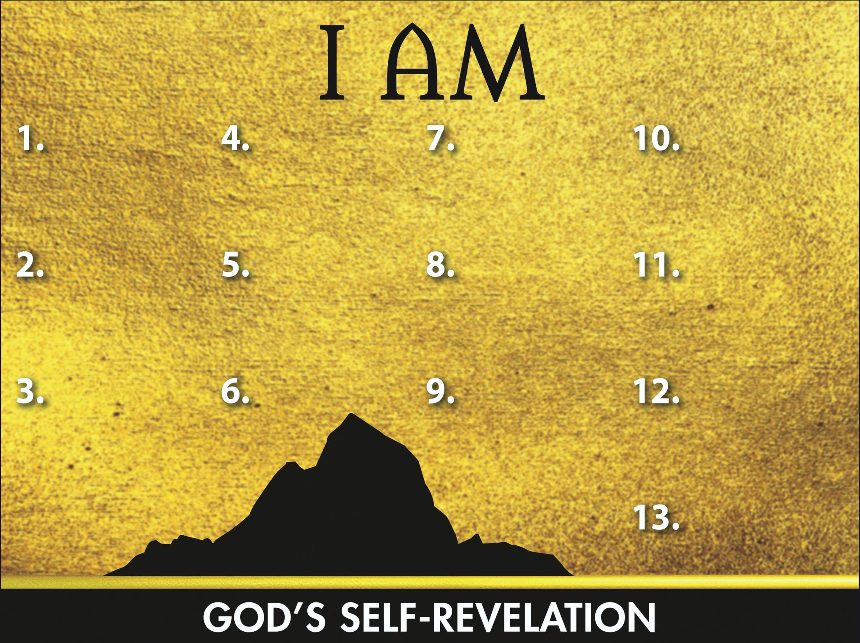
Sovereign
Redeemer
Instructor
Transcen-
dent Helper
Leader
Glorious God
Promise Keeper
Provider
Atoner

