Slide 1


Slide 2
I. Test at Marah (Exod. 15:22–27)

Slide 3
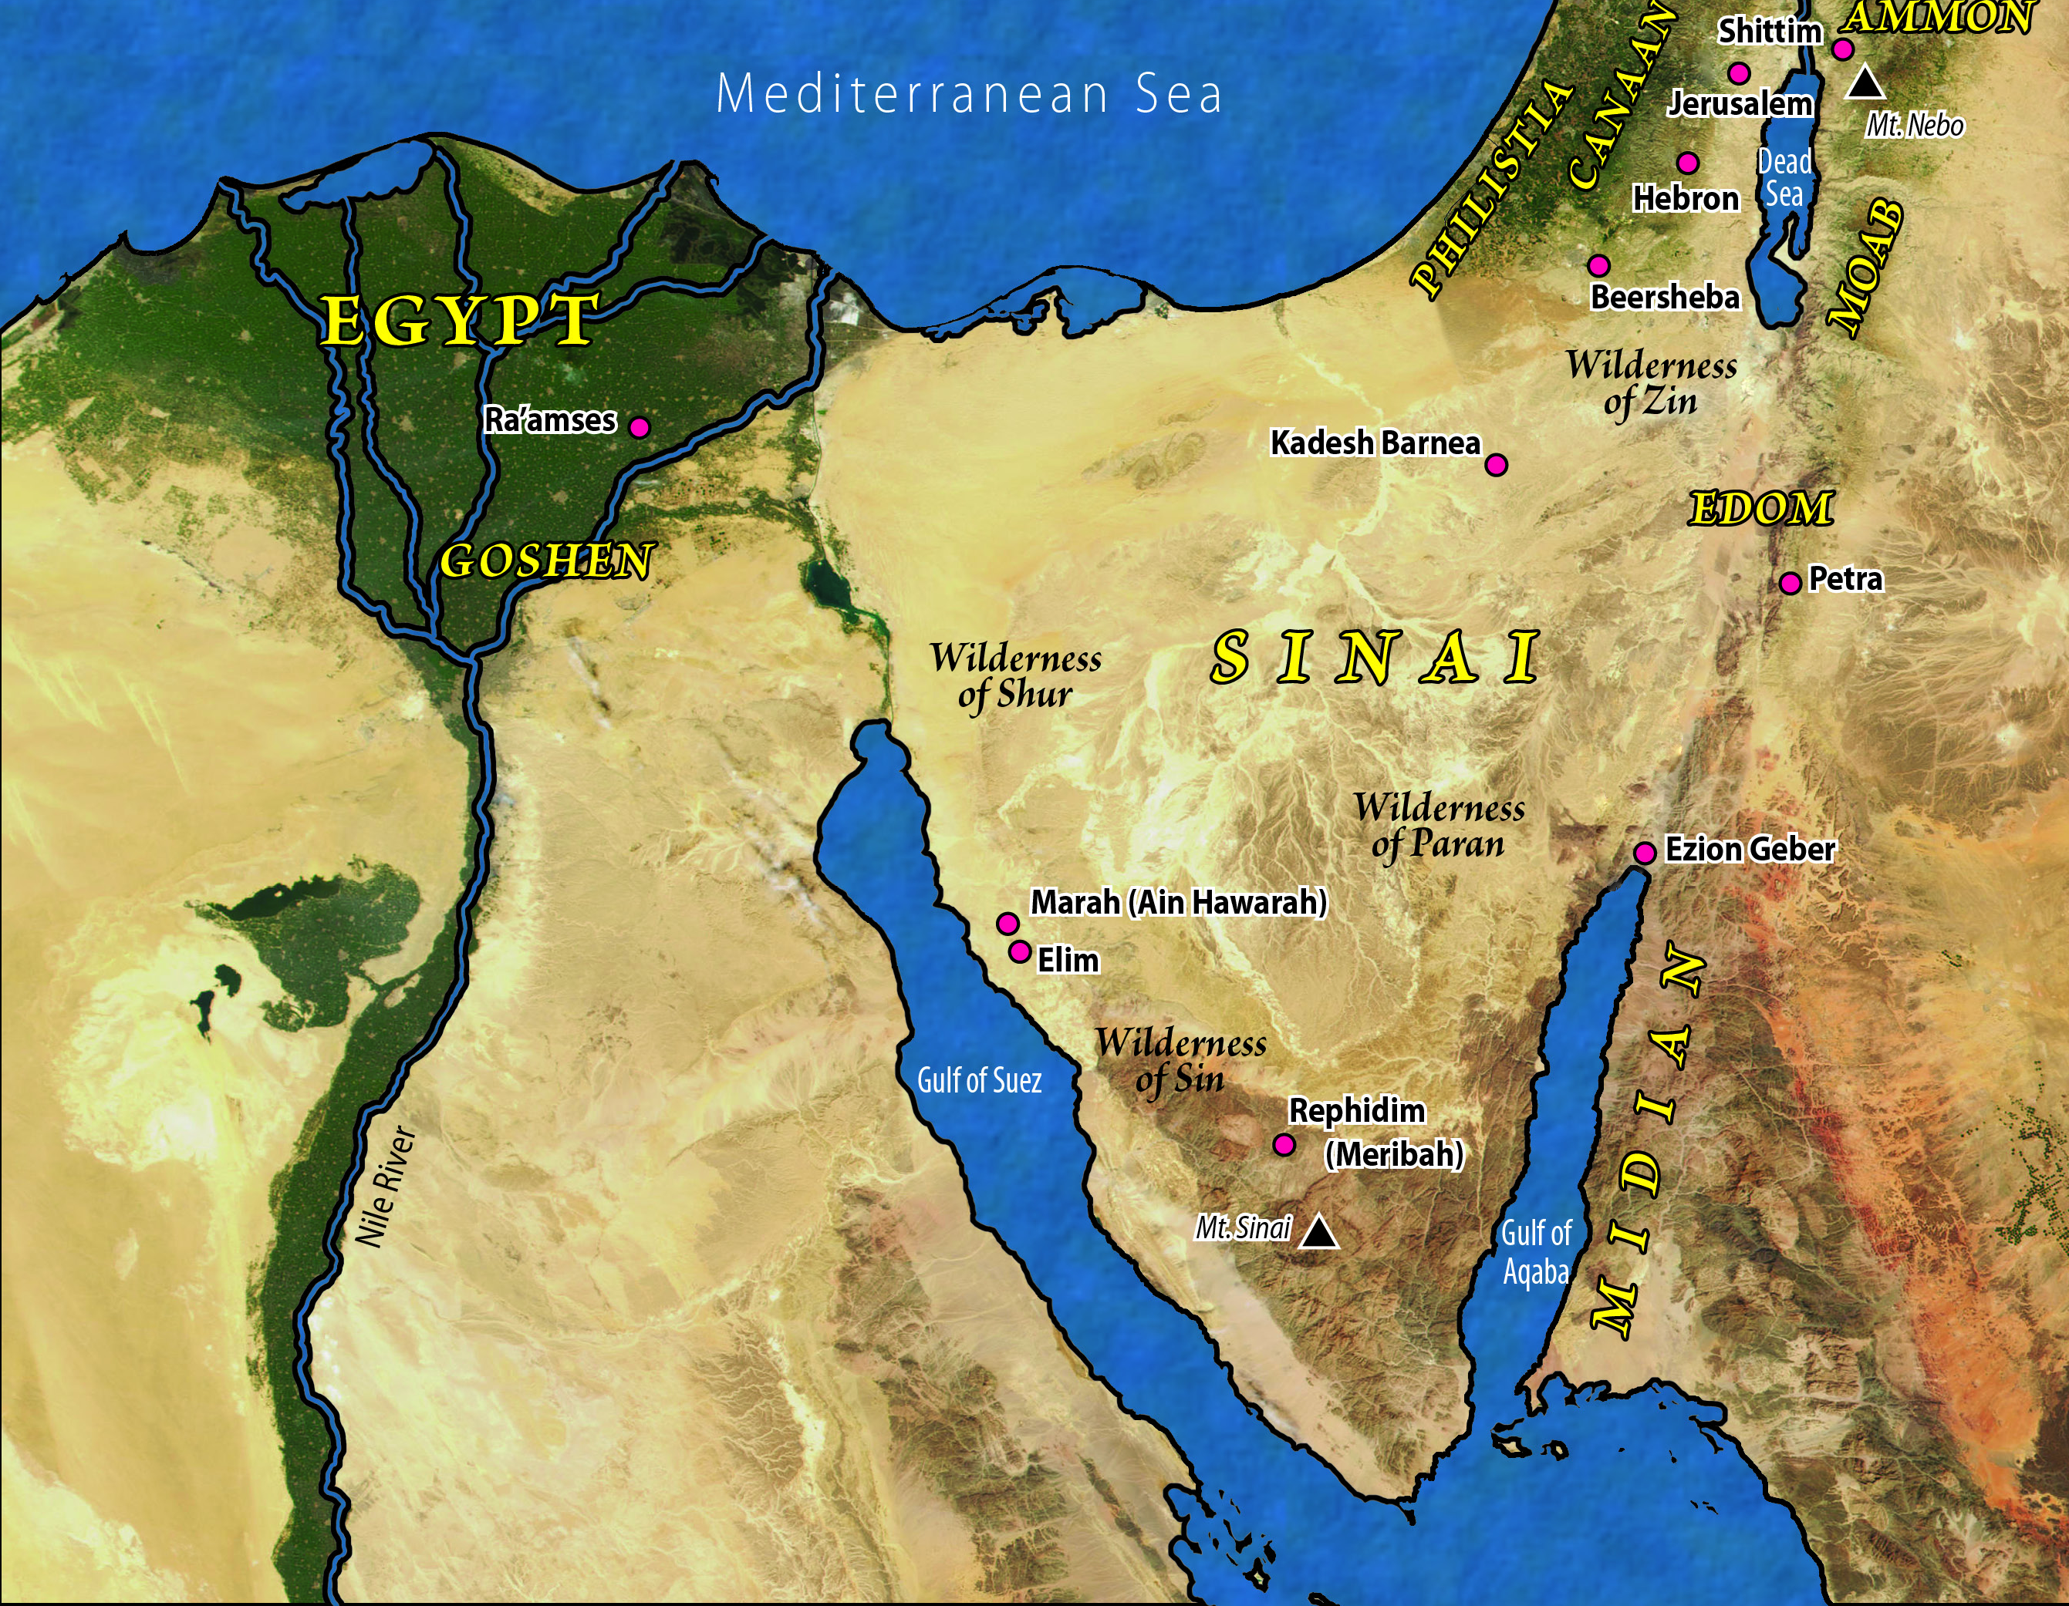

Slide 4
I. Test at Marah (Exod. 15:22–27)
A. Israel complained (15:22–24)
B. God provided a solution (15:25a)
C. God gave an ordinance (15:25b–27)
1. Immediate significance
2. Future significance

Slide 5
II. Test in the Desert of Sin (Exod. 16)

Slide 7
II. Test in the Desert of Sin (Exod. 16)
A. Israel complained (16:1–3)
B. God provided a solution (16:4–15)
C. God gave limitations (16:16–30)
1. Israel disobeyed the regulation concerning left overs (16:16–21)
2. Israel disobeyed the regulation concerning the Sabbath (16:22–30)
D. God provided a witness (16:31–36)

Slide 8
III. Test at Rephidim (Exod. 17:1–7)

Slide 10
III. Test at Rephidim (Exod. 17:1–7)
A. Israel complained (17:1–4)
B. God provided a solution (17:5–7)

Slide 11
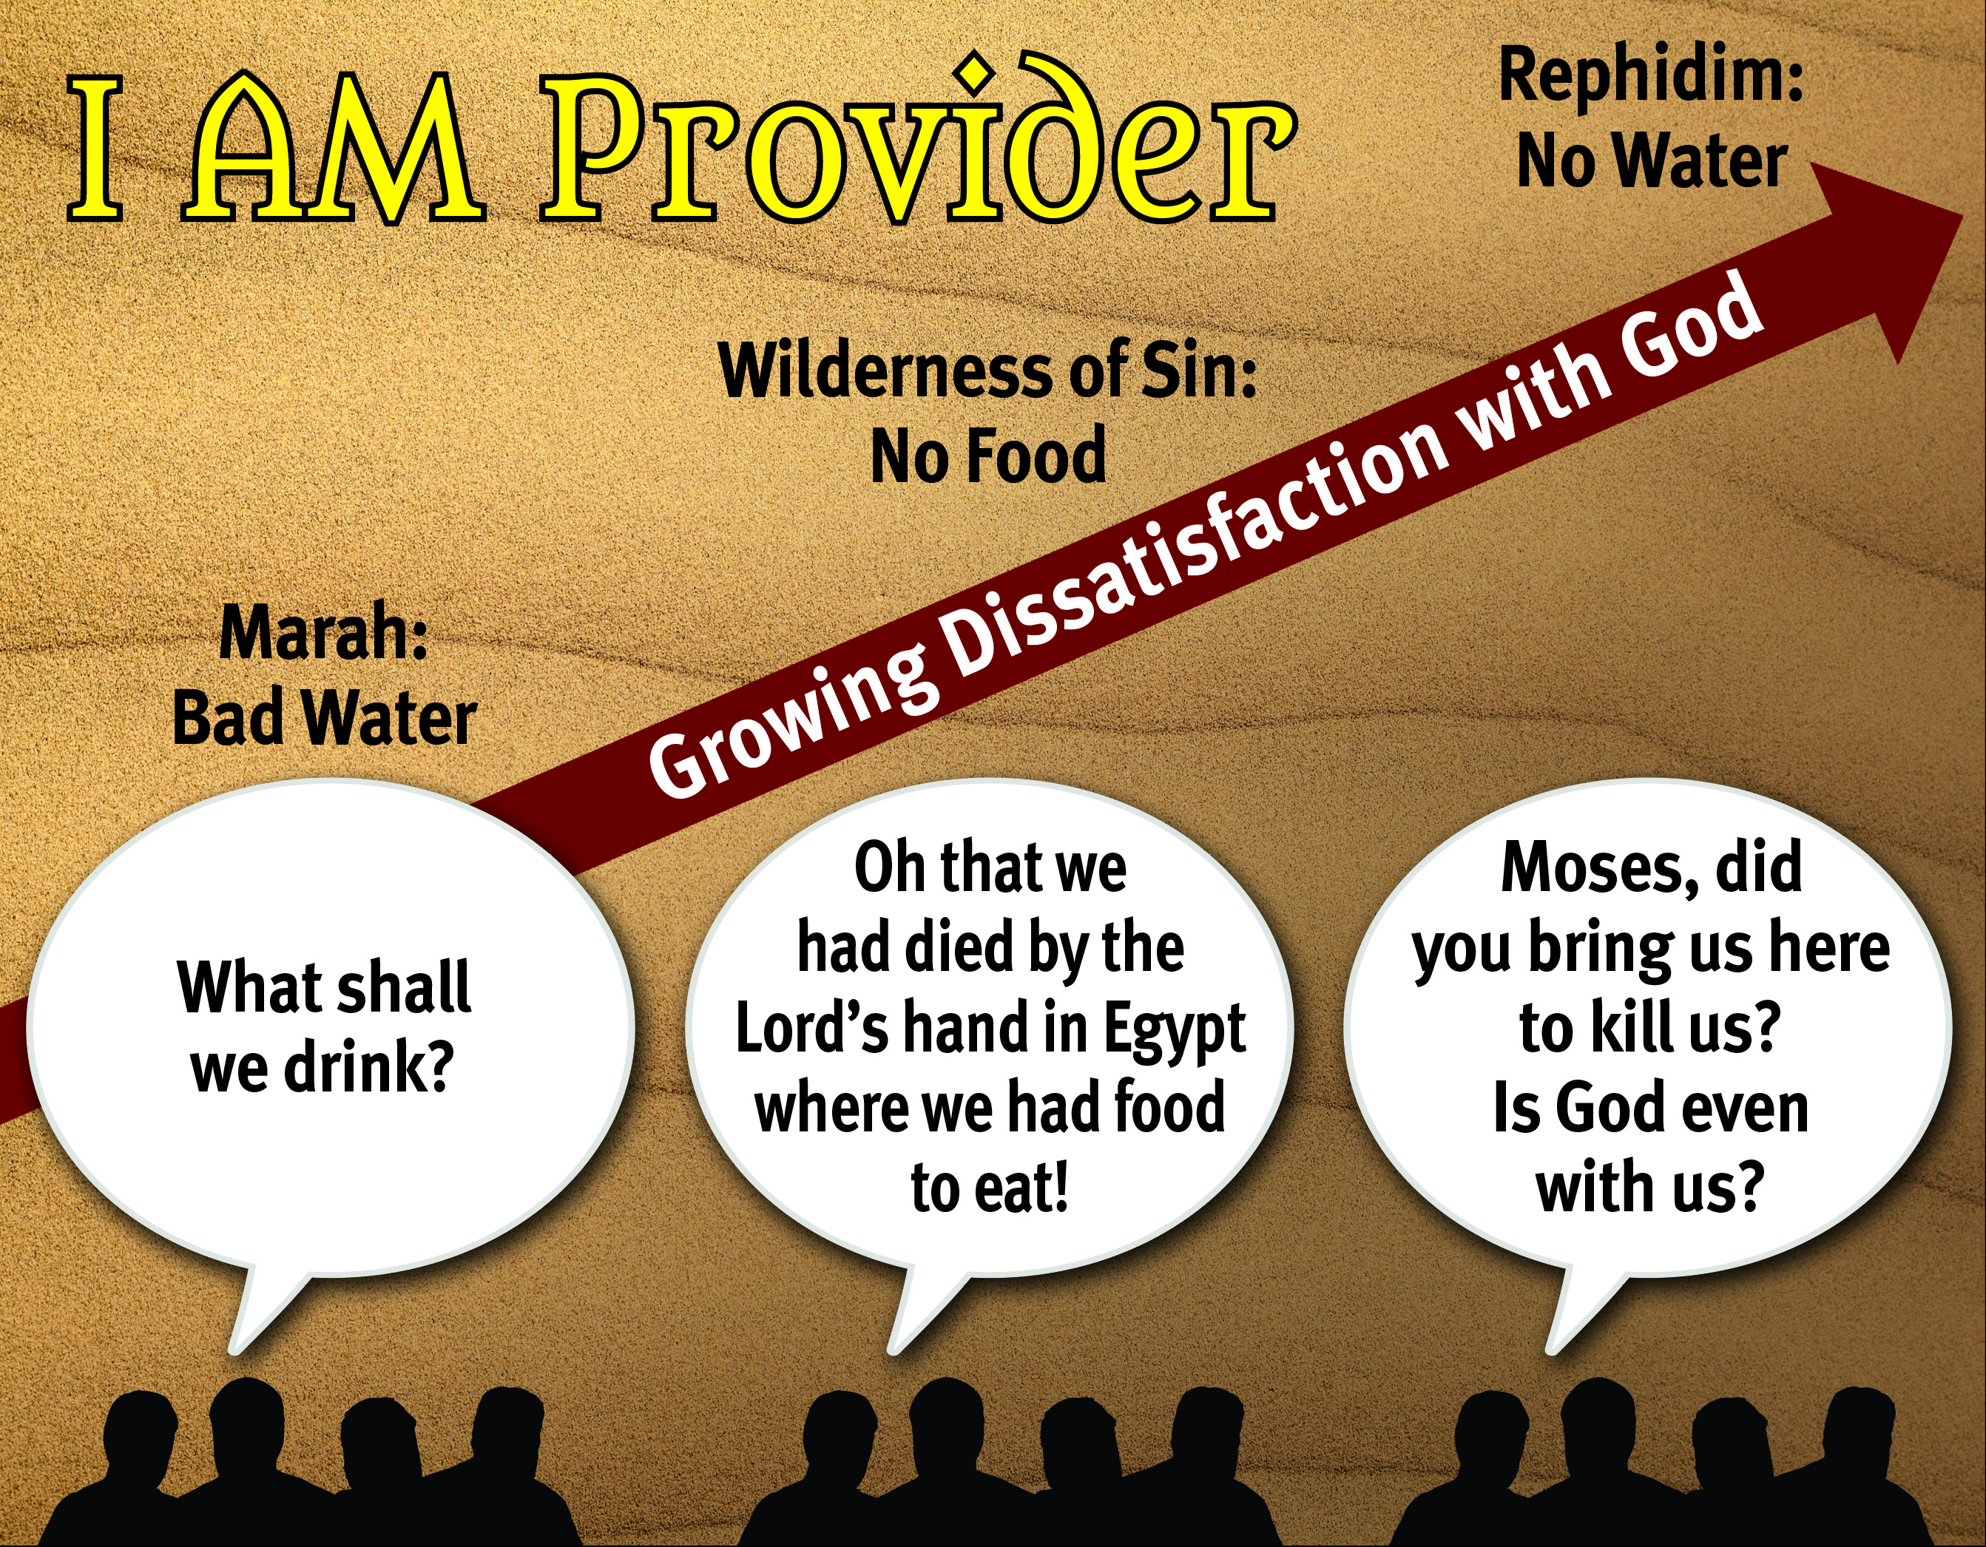

Slide 12
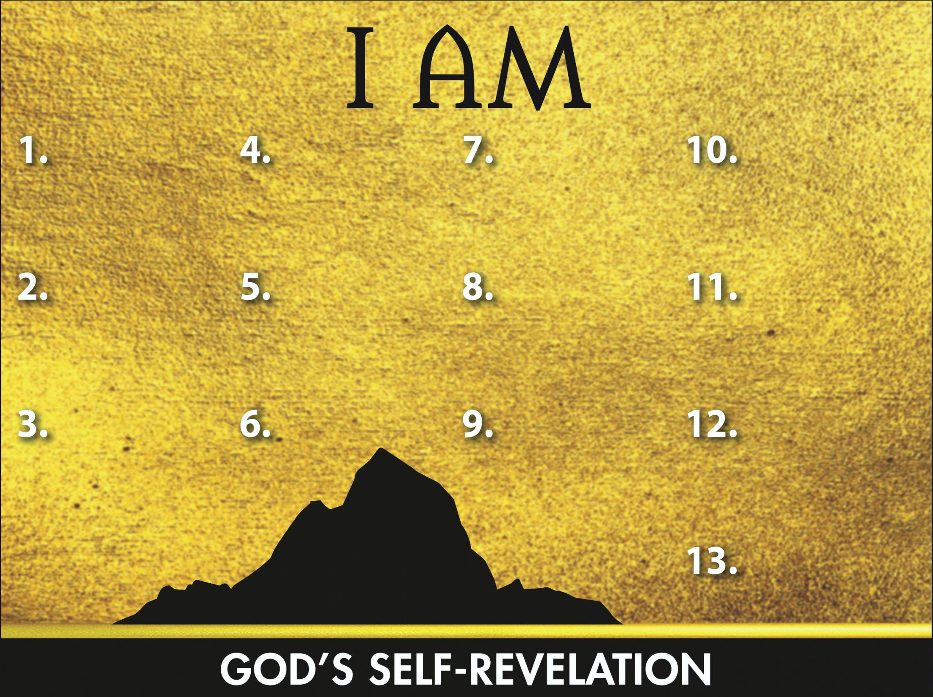
Sovereign
Redeemer
Transcen-
dent Helper
Leader
Promise Keeper
Provider

