Slide 1


Slide 2
I. God Led Israel (Exod. 13:17—14:31)
A. With wisdom (13:17–22)
B. With purpose (14:1–18)

Slide 3
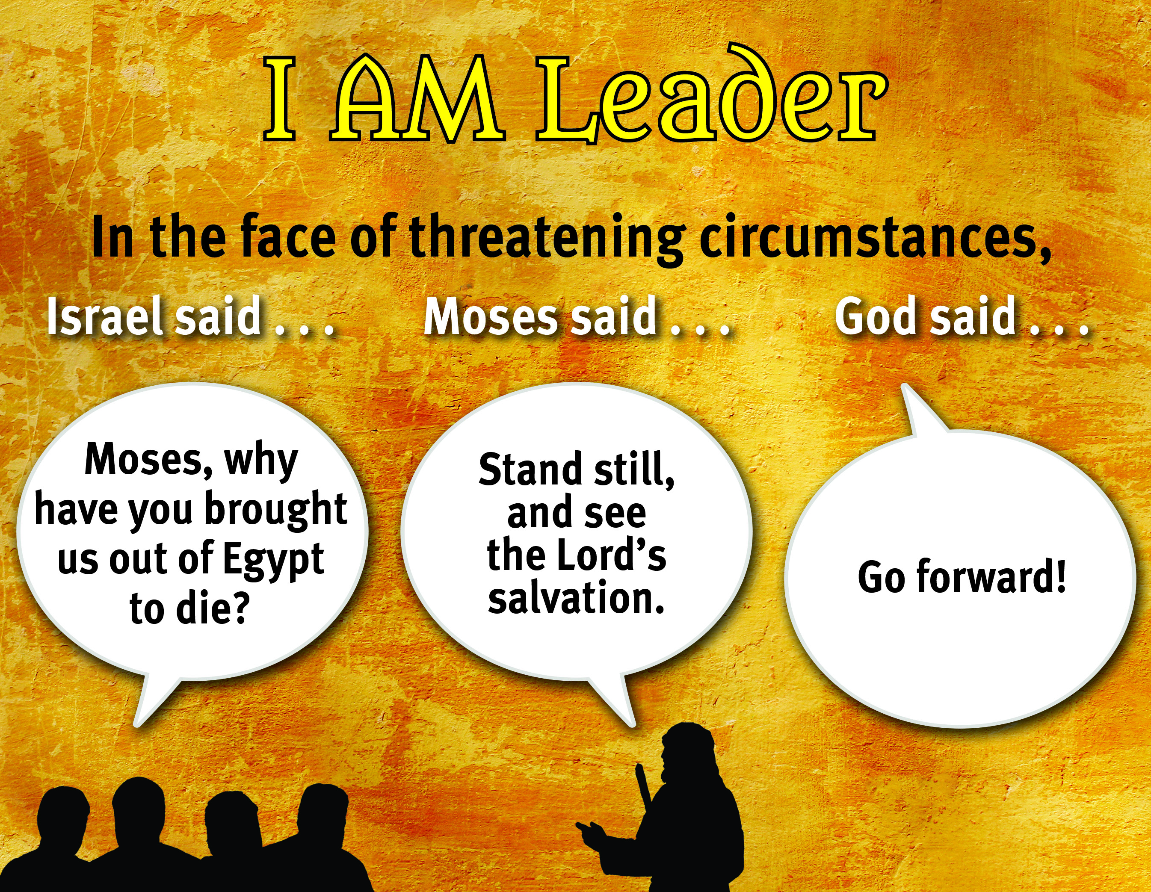

Slide 4
I. God Led Israel (Exod. 13:17—14:31)
A. With wisdom (13:17–22)
B. With purpose (14:1–18)
C. With power (14:19–31)
1. Protective power (14:19, 20)
2. Providing power (14:21–31)

Slide 5
II. Israel Learned about God (Exod. 15:1–21)
A. He is strong and unmatched (15:1–12)
B. He is able to fulfill His promises (15:13–21)

Slide 6
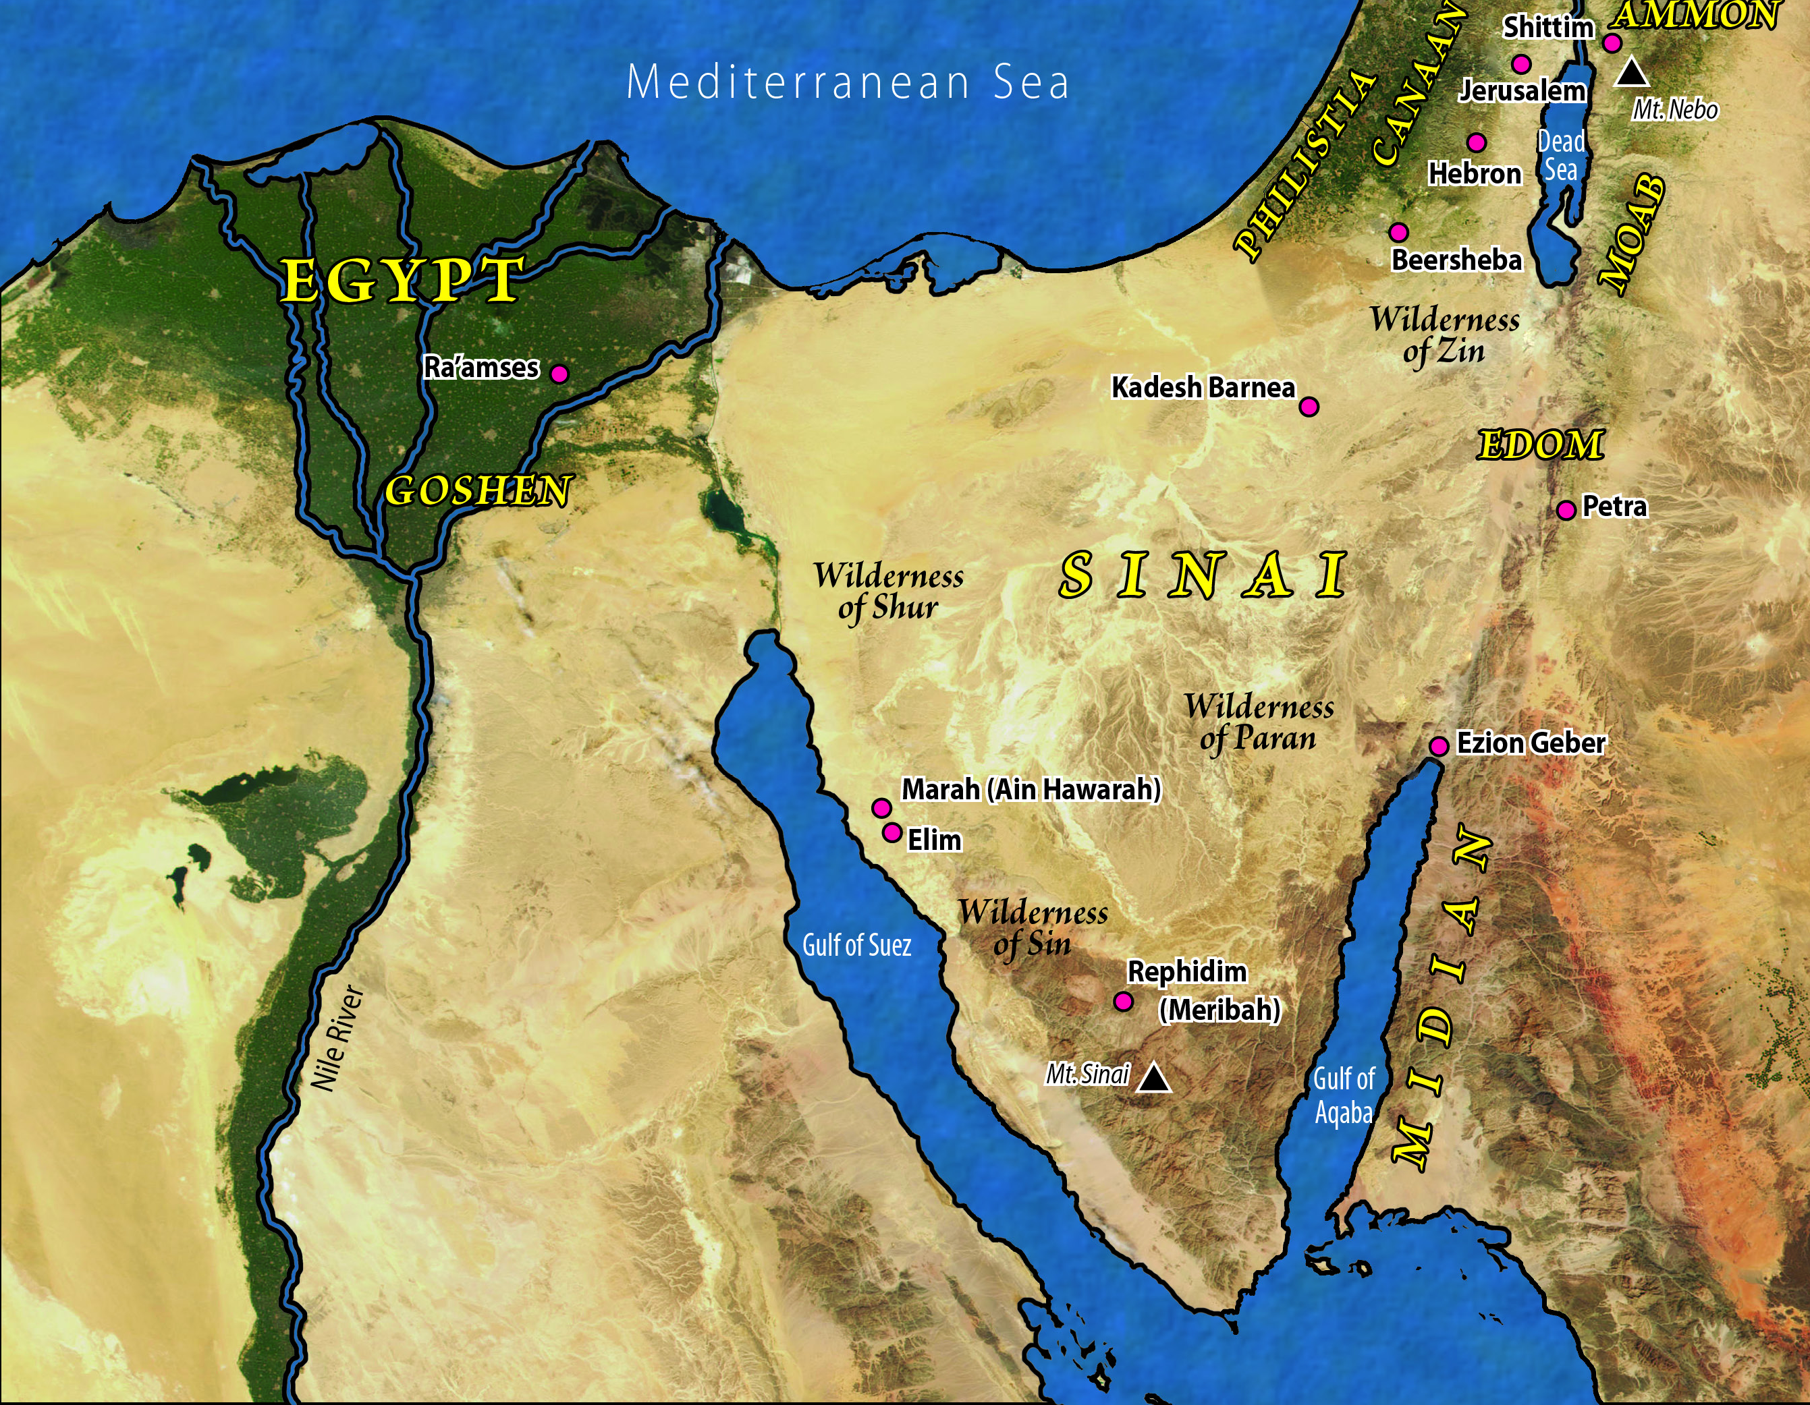

Slide 7
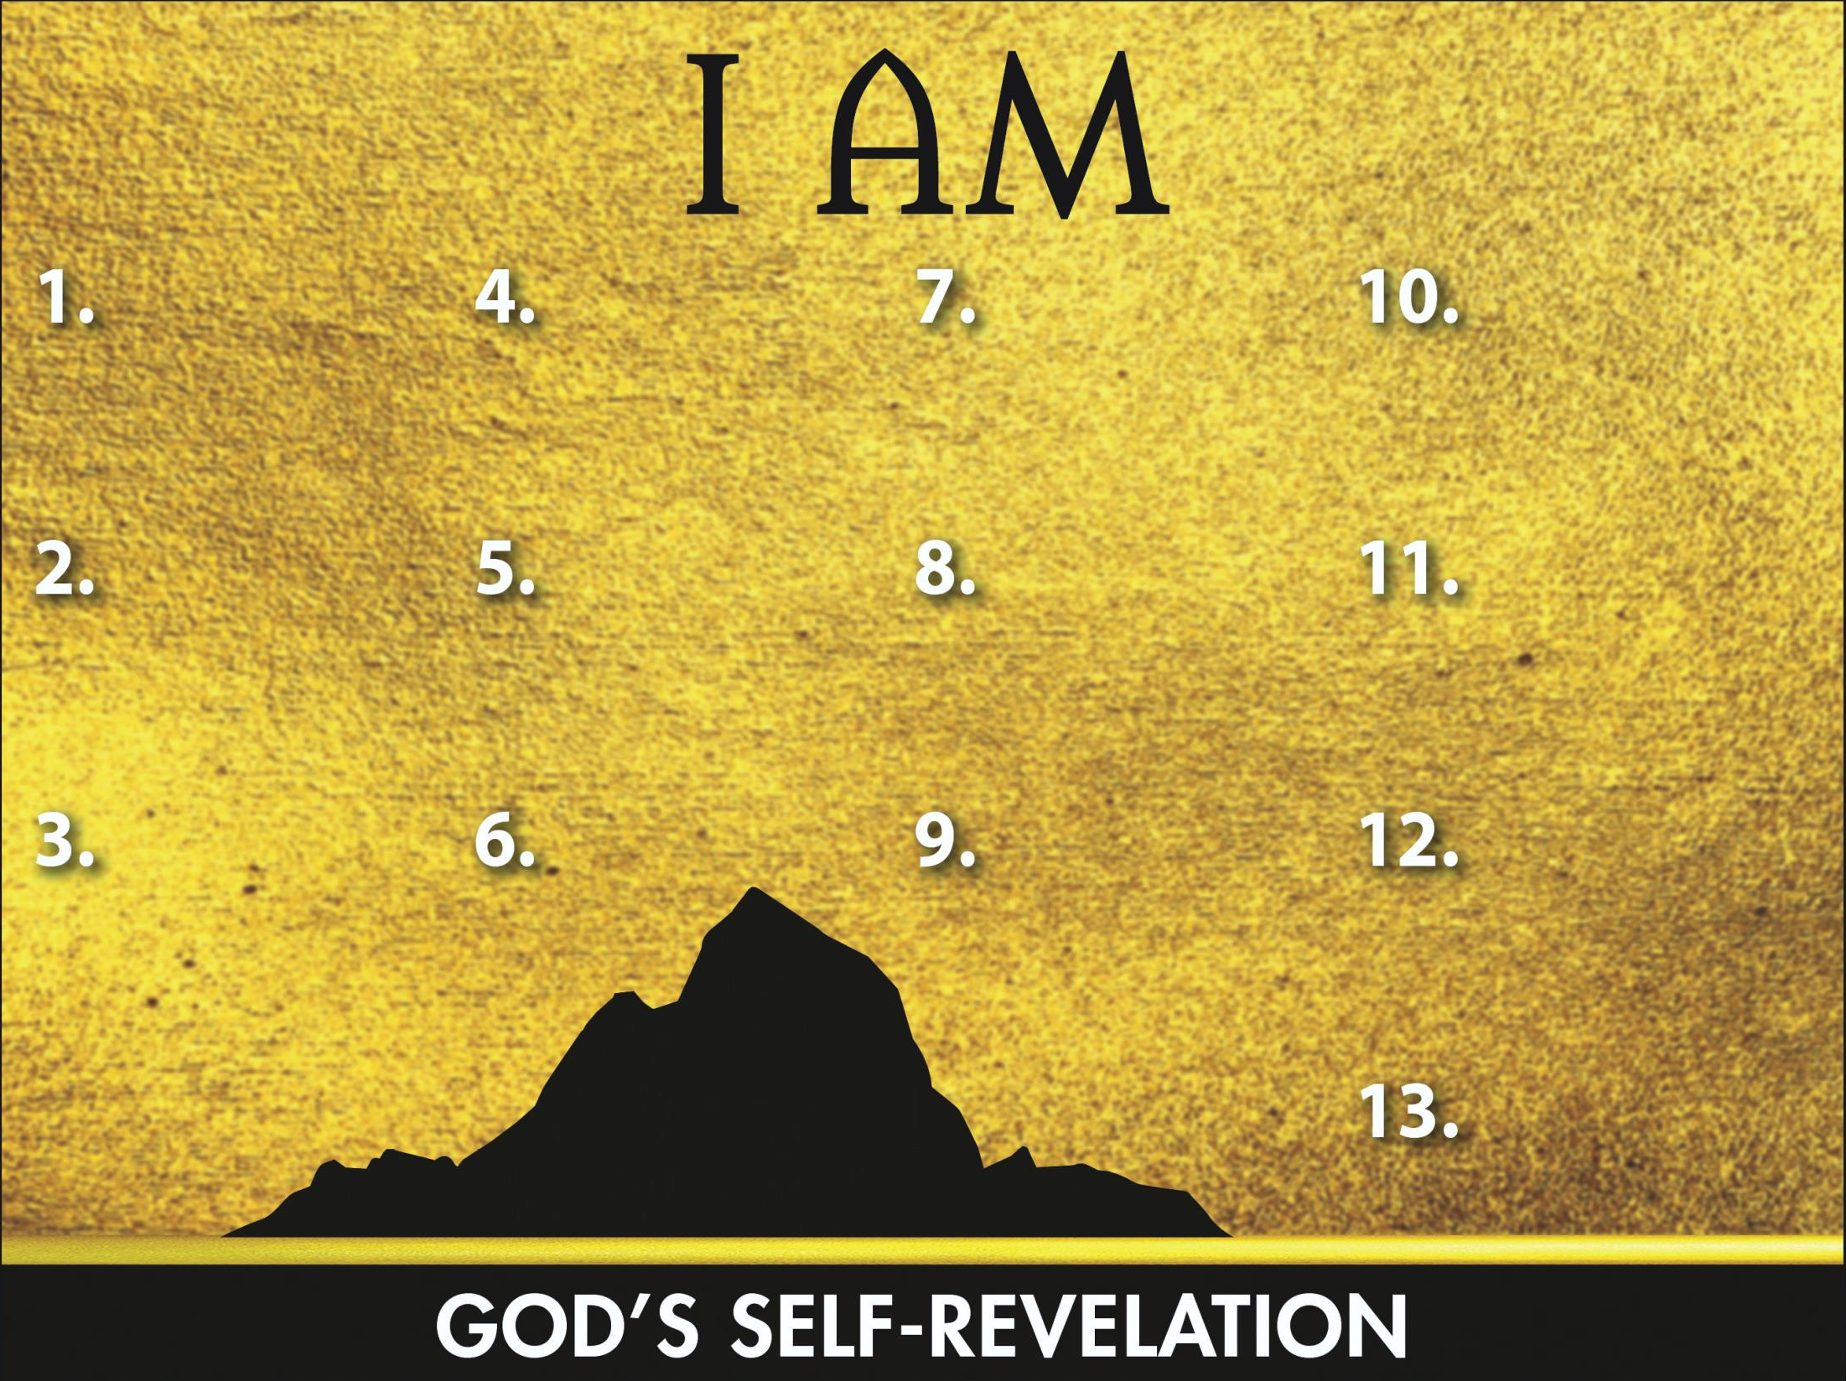
Sovereign
Redeemer
Transcen-
dent Helper
Leader
Promise Keeper

