Slide 1


Slide 2
I. God Proved His Power (Exod. 7:14—8:19)
A. First triplet of plagues (7:14—8:19)
1. The purpose (7:14–17a)

Slide 3
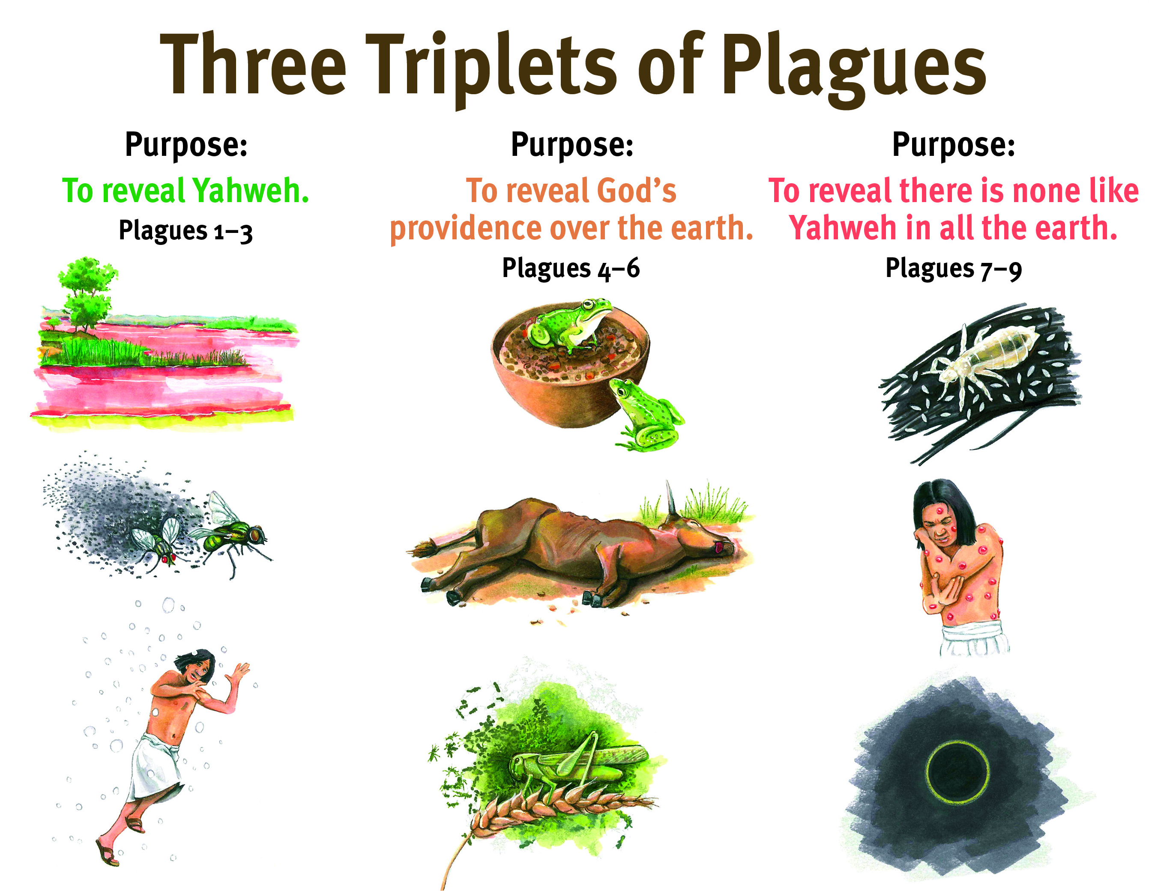

Slide 4
I. God Proved His Power (Exod. 7:14—8:19)
A. First triplet of plagues (7:14—8:19)
1. The purpose (7:14–17a)
2. The plagues (7:17b—8:19)

Slide 8
I. God Proved His Power (Exod. 7:14—8:19)
A. First triplet of plagues (7:14—8:19)
1. The purpose (7:14–17a)
2. The plagues (7:17b—8:19)
B. Second triplet of plagues (8:20—9:12)
1. The purpose (8:22)

Slide 10
I. God Proved His Power (Exod. 7:14—8:19)
A. First triplet of plagues (7:14—8:19)
1. The purpose (7:14–17a)
2. The plagues (7:17b—8:19)
B. Second triplet of plagues (8:20—9:12)
1. The purpose (8:22)
2. The plagues (8:20—9:12)

Slide 14
I. God Proved His Power (Exod. 7:14—8:19)
A. First triplet of plagues (7:14—8:19)
1. The purpose (7:14–17a)
2. The plagues (7:17b—8:19)
B. Second triplet of plagues (8:20—9:12)
1. The purpose (8:22)
2. The plagues (8:20—9:12)
C. Third triplet of plagues (9:13—10:29)
1. The purpose (9:13–16)

Slide 16
I. God Proved His Power (Exod. 7:14—8:19)
A. First triplet of plagues (7:14—8:19)
1. The purpose (7:14–17a)
2. The plagues (7:17b—8:19)
B. Second triplet of plagues (8:20—9:12)
1. The purpose (8:22)
2. The plagues (8:20—9:12)
C. Third triplet of plagues (9:13—10:29)
1. The purpose (9:13–16)
2. The plagues (9:17—10:29)

Slide 20
II. God Provided Redemption (Exod. 11:1—12:42)
A. Announcement of the final plague (11:1–10)
B. Institution of the Passover (12:1–20)
C. The deliverance from Egypt (12:21–42)

Slide 21

Sovereign
Redeemer
Transcen-
dent Helper
Promise Keeper

