Slide 1


Slide 2
I. God Declared His Plan for Israel and Humanity
(Gen. 12:1–3; 49:8–12)
A. God’s covenant promises to Abraham (12:1–3)
B. Jacob’s blessing of Judah (49:8–12)

Slide 3
II. God Worked His Plan (Exod. 1)
A. God grew His nation (1:1–7)
B. God thwarted Pharaoh’s plans (1:8–22)
1. Pharaoh’s plan A (1:8–12)

Slide 4
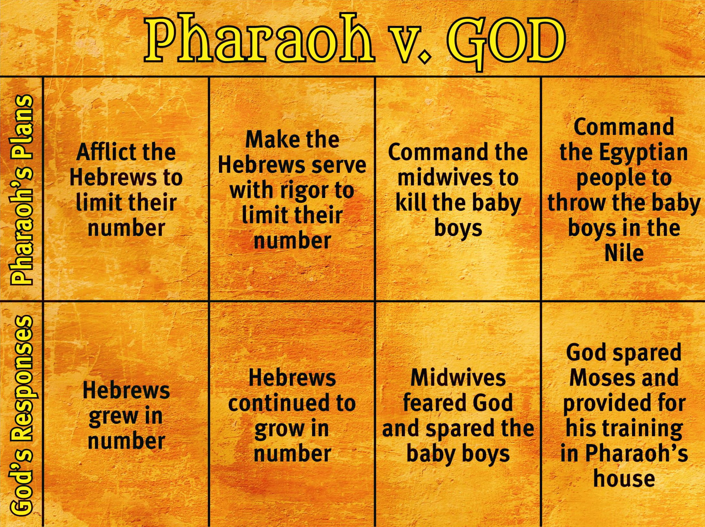

Slide 6
II. God Worked His Plan (Exod. 1)
A. God grew His nation (1:1–7)
B. God thwarted Pharaoh’s plans (1:8–22)
1. Pharaoh’s plan A (1:8–12)
2. Pharaoh’s plan B (1:13, 14)

Slide 9
II. God Worked His Plan (Exod. 1)
A. God grew His nation (1:1–7)
B. God thwarted Pharaoh’s plans (1:8–22)
1. Pharaoh’s plan A (1:8–12)
2. Pharaoh’s plan B (1:13, 14)
3. Pharaoh’s plan C (1:15–21)

Slide 12
II. God Worked His Plan (Exod. 1)
A. God grew His nation (1:1–7)
B. God thwarted Pharaoh’s plans (1:8–22)
1. Pharaoh’s plan A (1:8–12)
2. Pharaoh’s plan B (1:13, 14)
3. Pharaoh’s plan C (1:15–21)
4. Pharaoh’s plan D (1:22)

Slide 15
III. God Prepared His Leader (Exod. 2:1–22)
A. God’s protective hand (2:1–4)
B. God’s providential hand (2:5–22)
1. Moses’ training in his parents’ house (2:5–9)
2. Moses’ training in Pharaoh’s house (2:10)
3. Moses’ training in the wilderness (2:11–22)

Slide 16
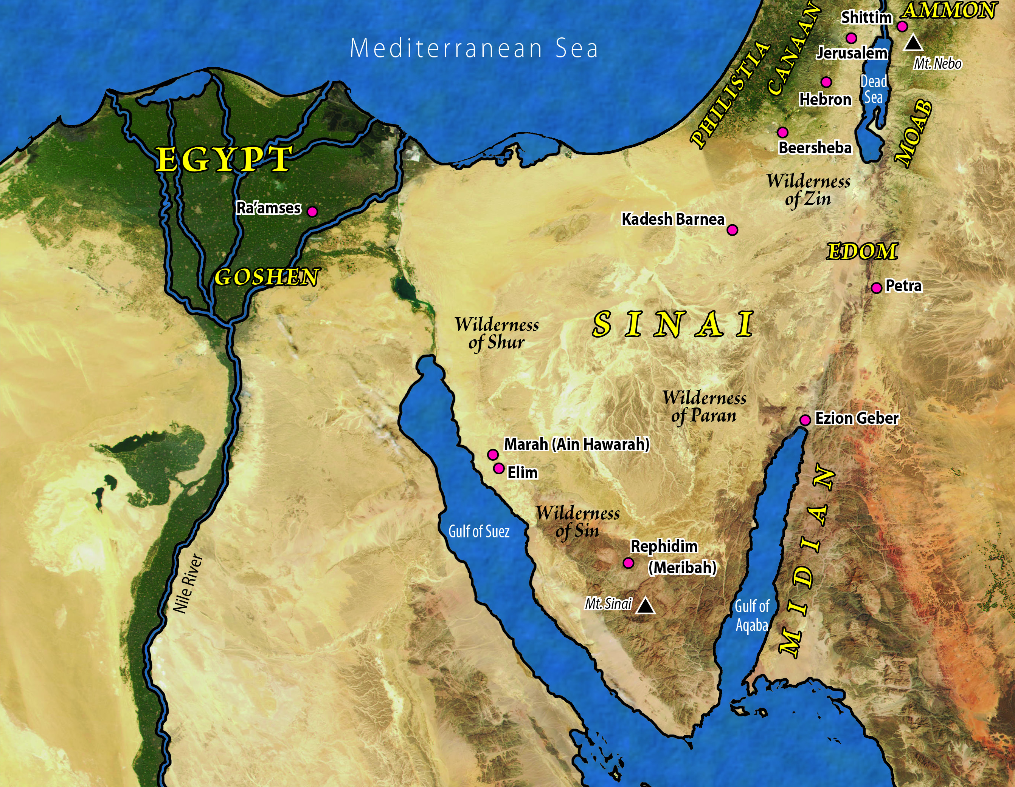

Slide 17

Sovereign

