Slide 1


Slide 2
I. God Stated His Commitment to Israel (Exod. 4:18–31)
A. God personalized His commitment to Israel (4:18–23)
B. God demanded commitment from Moses (4:24–26)
C. Israel worshiped God for His commitment to them (4:27–31)

Slide 3
II. God Allowed Hard Circumstances (Exod. 5)
A. Pharaoh denied God’s request (5:1–18)
B. The people criticized Moses (5:19–21)
C. Moses questioned God (5:22, 23)

Slide 4
III. God Remembered His Covenant (Exod. 6:1—7:2)
A. God made extraordinary promises (6:1–9)
B. God used ordinary people (6:10—7:2)

Slide 5
IV. God Restated His Command (7:3–13)
A. God gave reasons for His command (7:3–5)
B. Moses obeyed God’s command (7:6–13)

Slide 6
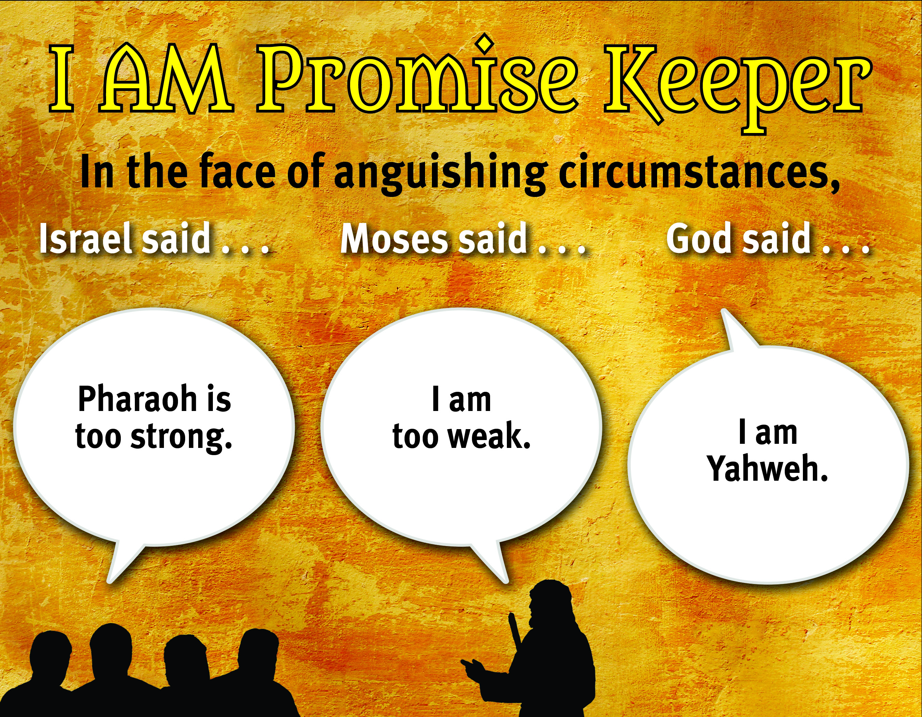

Slide 7
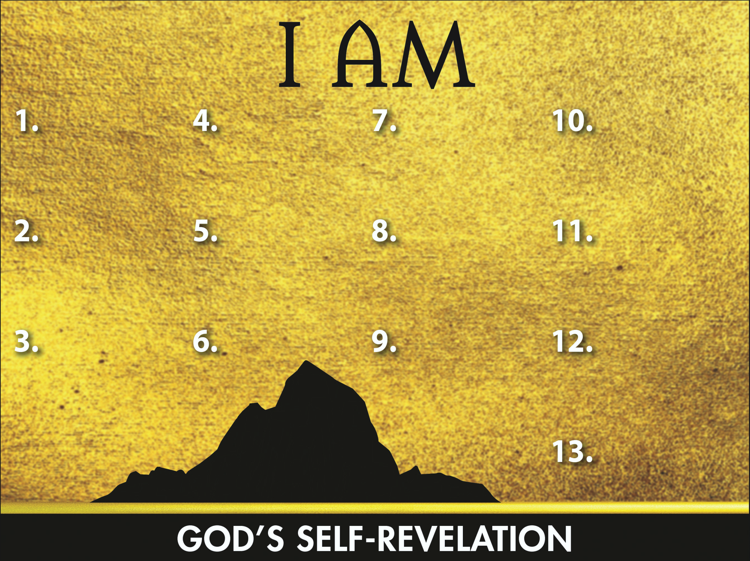
Sovereign
Transcen-
dent Helper
Promise Keeper

