Slide 1


Slide 2
I. God Continued His Plan for Israel (Exod. 2:23–25)
A. God on high heard Israel’s cry (2:23, 24a)
B. God on high loved Israel (2:24b, 25)

Slide 3
II. God Continued His Preparation of Moses (Exod. 3:1–9)
A. God came down to Moses (3:1–4)

Slide 4
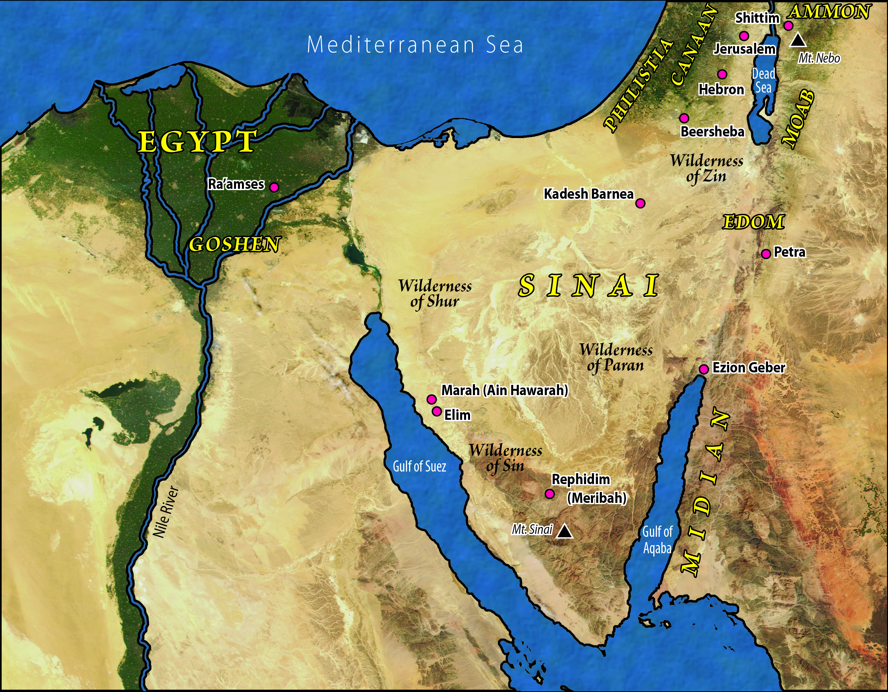

Slide 5
II. God Continued His Preparation of Moses (Exod. 3:1–9)
A. God came down to Moses (3:1–4)
B. God commanded separation (3:5–9)

Slide 6
III. God Commissioned Moses (Exod. 3:10–15)
A. God assured Moses of His presence (3:10–12)
B. God revealed His transcendence (3:13–15)

Slide 7
IV. God Instructed Moses (Exod. 3:16–22)
A. God’s message to Israel (3:16–18a)
B. God’s message to Pharaoh (3:18b)
C. God’s message of deliverance (3:19–22)

Slide 8
V. God Answered Moses (Exod. 4:1–17)
A. God’s demonstrated His power (4:1–9)
B. God’s promised His presence (4:10–17)

Slide 9
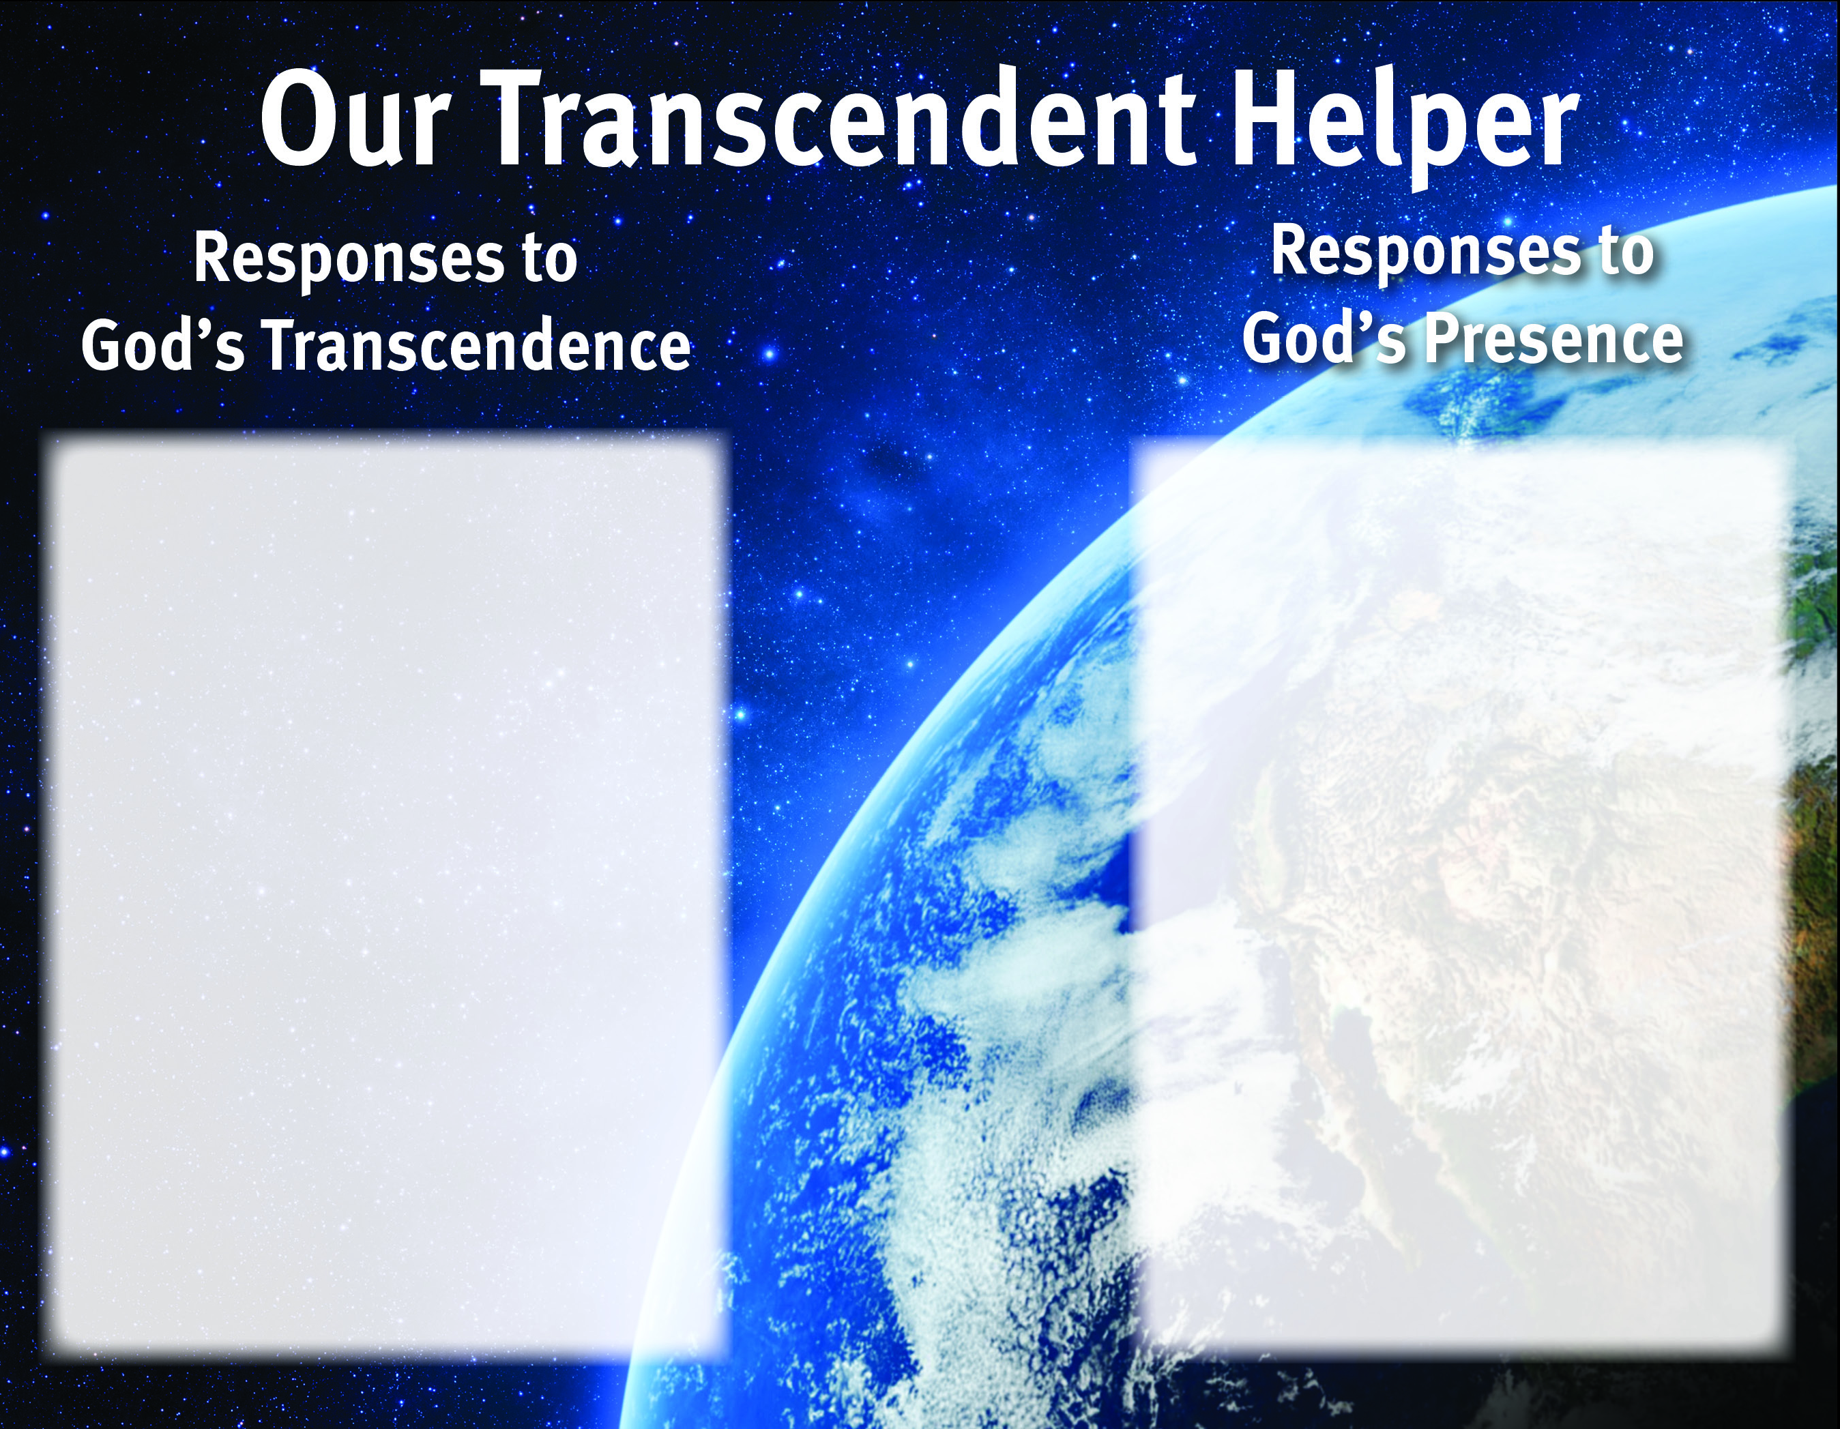
Praise Him for His perfection.
Be aware of His perfect knowledge of us.
Have confidence in His power.
Show respect for His position.
Express gratitude that He is near in times of need.
Trust in His abilities.
Depend on Him for strength.
Desire to be holy as He is holy.
Depend on Him for guidance.

Slide 10
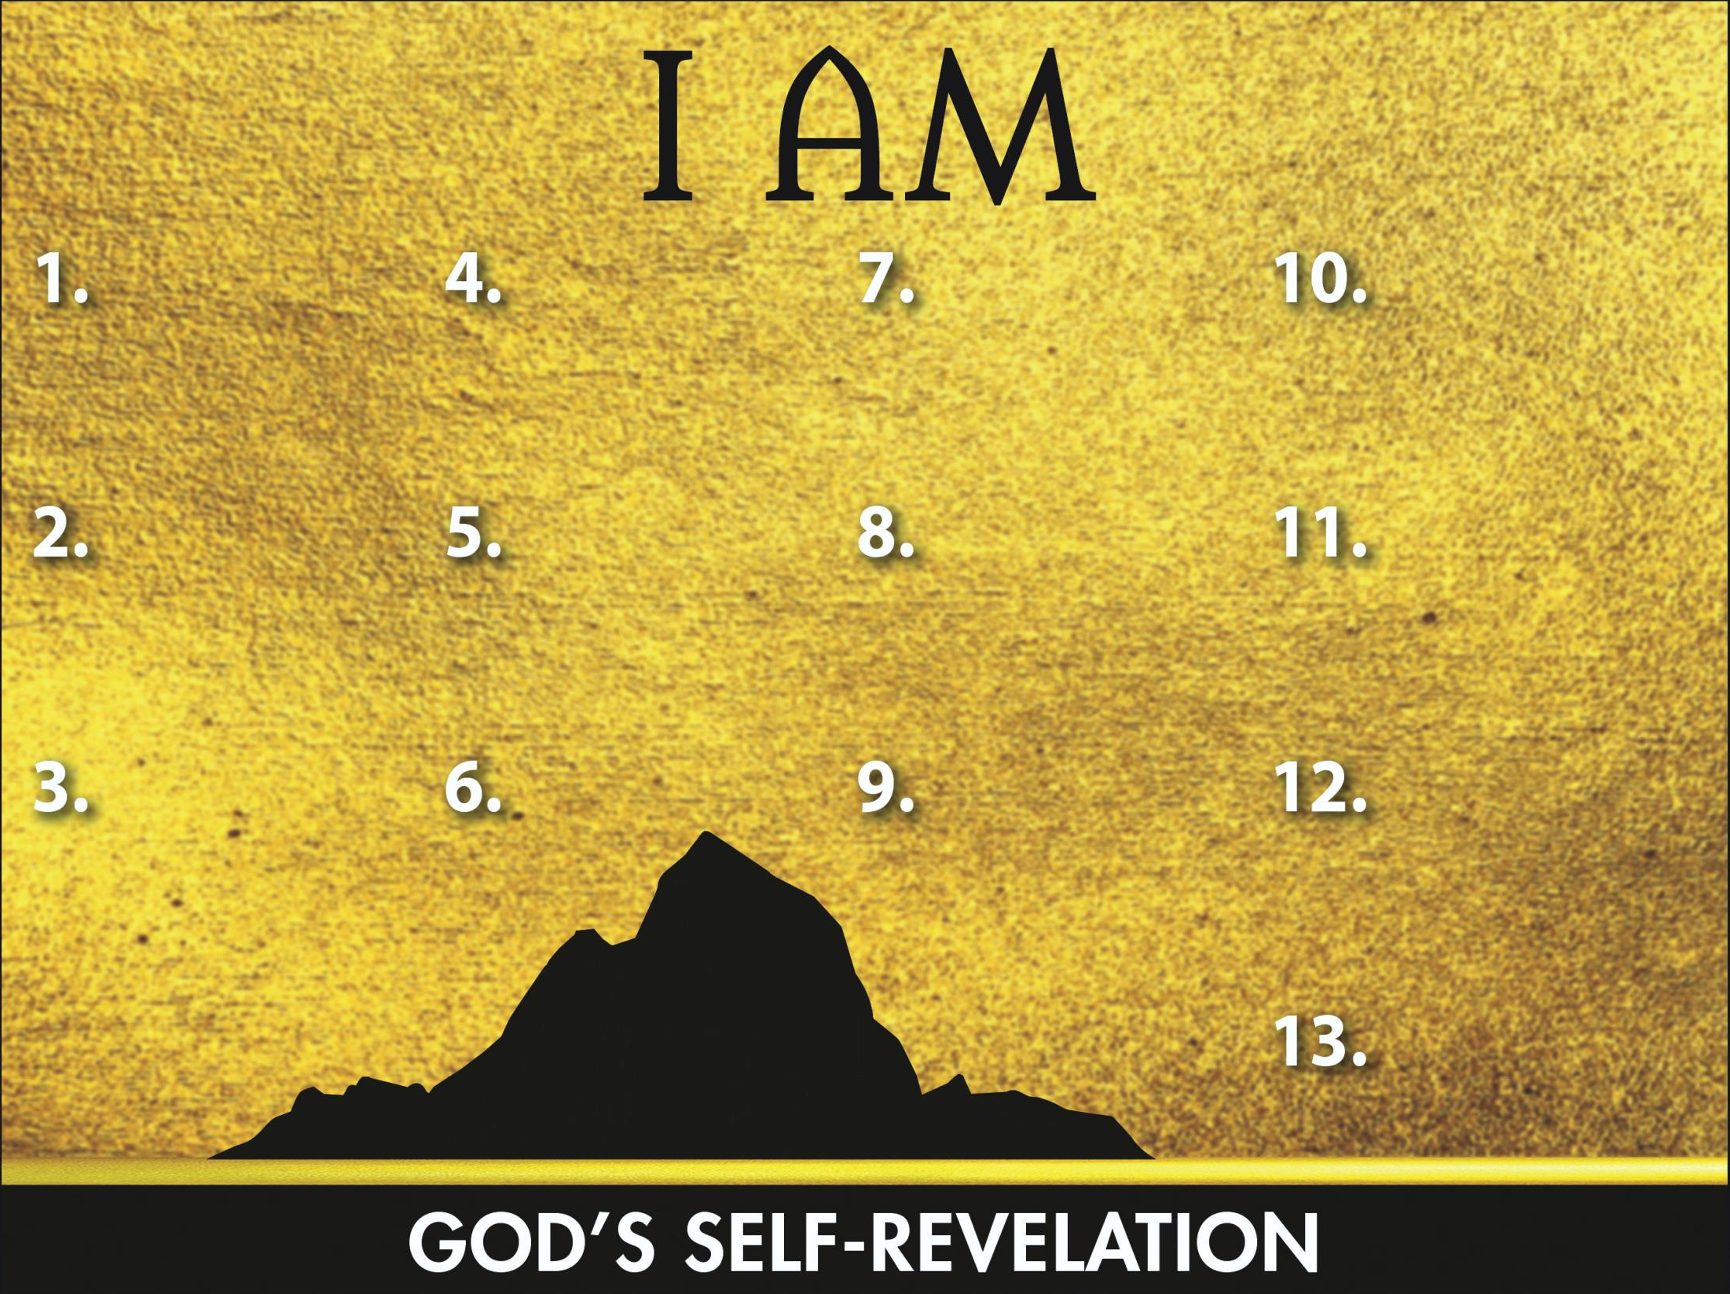
Sovereign
Transcen-
dent Helper

