Slide 1
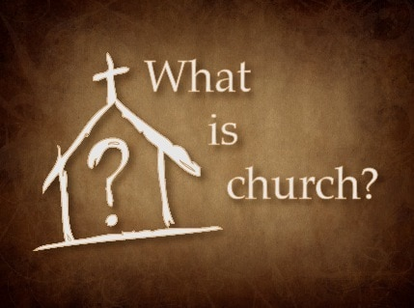

Slide 3
The Church is a Family
MAIN POINT
When we are born again in Christ, we are born into a new family that transcends race, culture, and creed.

