Slide 1


Supreme
Putting Christ First: Colossians

Slide 2
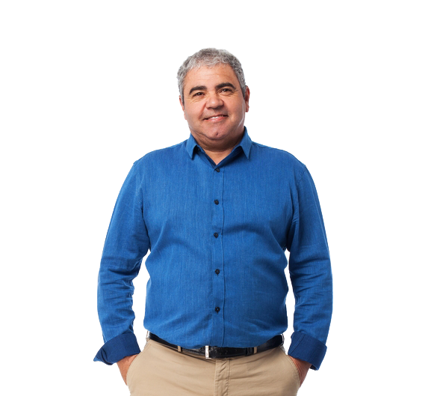
I. Friends Depend on One Another (Col. 4:7, 8)

Slide 3
II. Friends See Potential in One Another (Col. 4:9)

Slide 4
III. Friends Endure with One Another (Col. 4:10a)

Slide 5


Slide 6
III. Friends Endure with One Another (Col. 4:10a)

Slide 7
IV. Friends Seek Reconciliation (Col. 4:10b, 11)

Slide 8
V. Friends Pray for One Another (Col. 4:12–16)

Slide 9
VI. Friends Encourage One Another (Col. 4:17, 18)

