Slide 1


Supreme
Putting Christ First: Colossians

Slide 2

I. The Believer’s Prayer Life (Col. 4:2–4)
A. Constant (4:2a)

Slide 3

I. The Believer’s Prayer Life (Col. 4:2–4)
A. Constant (4:2a)
B. Alert (4:2b)

Slide 4
I. The Believer’s Prayer Life (Col. 4:2–4)
A. Constant (4:2a)
B. Alert (4:2b)
C. Thankful (4:2c)

Slide 5
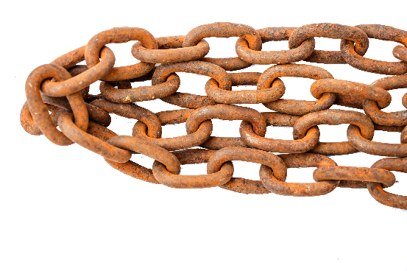
I. The Believer’s Prayer Life (Col. 4:2–4)
A. Constant (4:2a)
B. Alert (4:2b)
C. Thankful (4:2c)
D. Specific (4:3, 4)

Slide 6
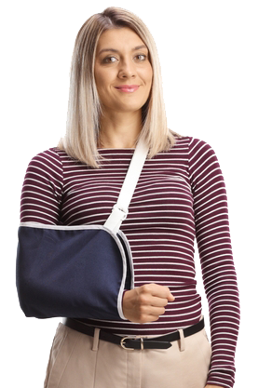
I. The Believer’s Prayer Life (Col. 4:2–4)
A. Constant (4:2a)
B. Alert (4:2b)
C. Thankful (4:2c)
D. Specific (4:3, 4)

Slide 7

II. The Believer’s Public Life (Col. 4:5, 6)
A. Walk wisely (4:5)

Slide 8
II. The Believer’s Public Life (Col. 4:5, 6)
A. Walk wisely (4:5)

Slide 9
II. The Believer’s Public Life (Col. 4:5, 6)
A. Walk wisely (4:5)
B. Talk wisely (4:6)

