Slide 1


Supreme
Putting Christ First: Colossians

Slide 2

I. The Command Regarding Death (Col. 3:5–7)
A. Put sin to death (3:5)

Slide 3

I. The Command Regarding Death (Col. 3:5–7)
A. Put sin to death (3:5)

Slide 4
I. The Command Regarding Death (Col. 3:5–7)
A. Put sin to death (3:5)
B. Take sin seriously (3:6, 7)

Slide 5
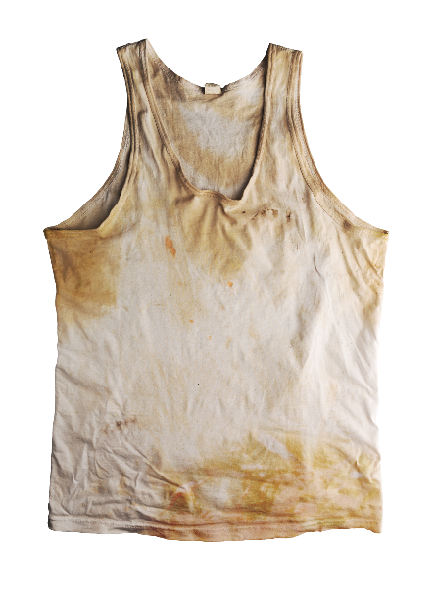
II. The Command Regarding Discards (Col. 3:8–11)
A. Discard old sins (3:8, 9a)

Slide 6

II. The Command Regarding Discards (Col. 3:8–11)
A. Discard old sins (3:8, 9a)

Slide 7
II. The Command Regarding Discards (Col. 3:8–11)
A. Discard old sins (3:8, 9a)
B. Reasons to discard sins (3:9b–11)
1. Believers died to sin (3:9b)

Slide 8

II. The Command Regarding Discards (Col. 3:8–11)
A. Discard old sins (3:8, 9a)
B. Reasons to discard sins (3:9b–11)
1. Believers died to sin (3:9b)
2. Believers are made new (3:10)

Slide 9
II. The Command Regarding Discards (Col. 3:8–11)
A. Discard old sins (3:8, 9a)
B. Reasons to discard sins (3:9b–11)
1. Believers died to sin (3:9b)
2. Believers are made new (3:10)
3. All believers are in Christ (3:11)

