Slide 1


Supreme
Putting Christ First: Colossians

Slide 2
I. Legalism’s Emptiness (Col. 2:16, 17)
A. Explanation

Slide 3
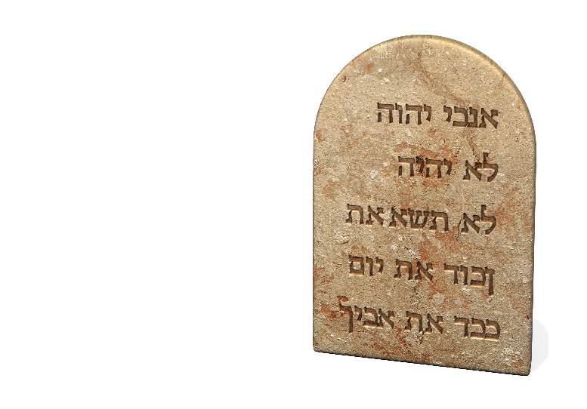
I. Legalism’s Emptiness (Col. 2:16, 17)
A. Explanation
B. Problem: Misuse of the law (2:16, 17a)

Slide 4


Slide 5
I. Legalism’s Emptiness (Col. 2:16, 17)
A. Explanation
B. Problem: Misuse of the law (2:16, 17a)

Slide 6

I. Legalism’s Emptiness (Col. 2:16, 17)
A. Explanation
B. Problem: Misuse of the law (2:16, 17a)
C. Answer: Christ is the substance (2:17b)

Slide 7
II. Mysticism’s Emptiness (Col. 2:18, 19)
A. Explanation

Slide 8

II. Mysticism’s Emptiness (Col. 2:18, 19)
A. Explanation
B. Problem: False humility (2:18)

Slide 9
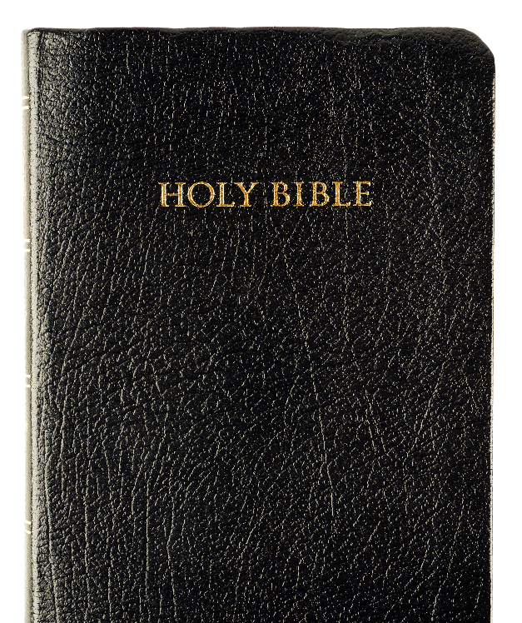
II. Mysticism’s Emptiness (Col. 2:18, 19)
A. Explanation
B. Problem: False humility (2:18)
C. Answer: Christ causes growth (2:19)

Slide 10

III. Asceticism’s Emptiness (Col. 2:20–23)
A. Explanation

Slide 11
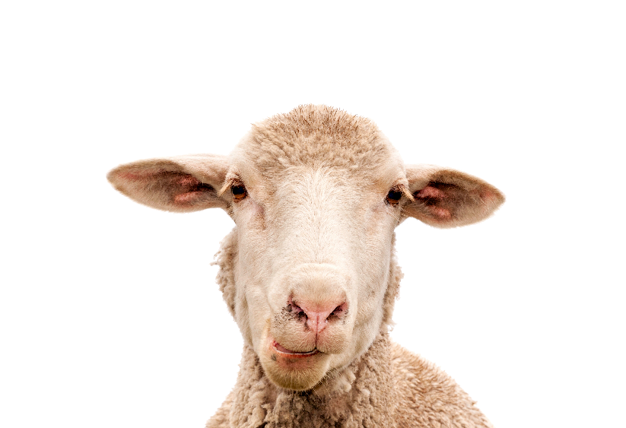
III. Asceticism’s Emptiness (Col. 2:20–23)
A. Explanation
B. Problem: Ineffective restrictions (2:20b–23)

Slide 12
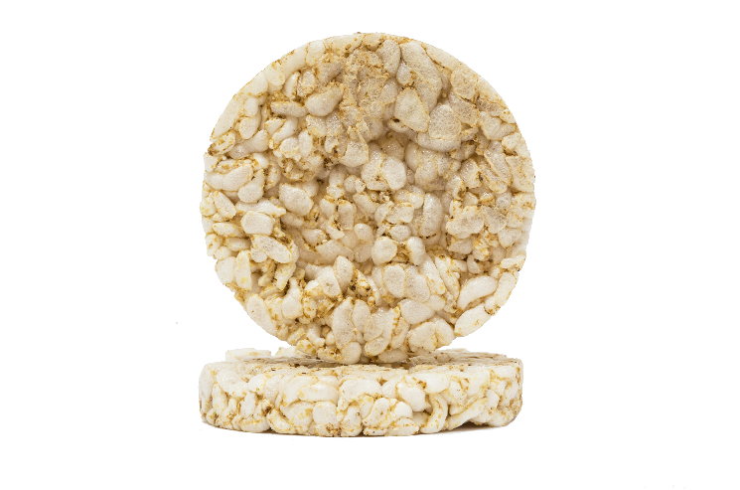
III. Asceticism’s Emptiness (Col. 2:20–23)
A. Explanation
B. Problem: Ineffective restrictions (2:20b–23)

Slide 13

III. Asceticism’s Emptiness (Col. 2:20–23)
A. Explanation
B. Problem: Ineffective restrictions (2:20b–23)
C. Answer: Christ’s sufficient sacrifice (2:20a)

