Slide 1


Supreme
Putting Christ First: Colossians

Slide 2

I. Grasp the Truth (Col. 2:1–3)
A. The concern for truth (2:1)

Slide 3

I. Grasp the Truth (Col. 2:1–3)
A. The concern for truth (2:1)
B. The source of truth (2:2, 3)

Slide 4
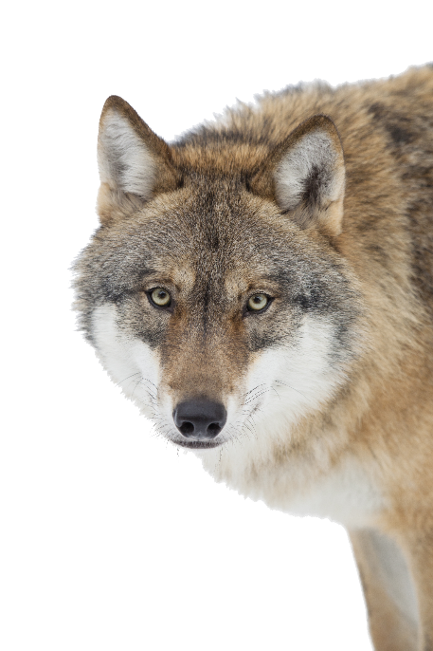
II. Guard the Truth (Col. 2:4, 5)
A. The truth protects (2:4)

Slide 5
II. Guard the Truth (Col. 2:4, 5)
A. The truth protects (2:4)
B. The truth works (2:5)

Slide 6
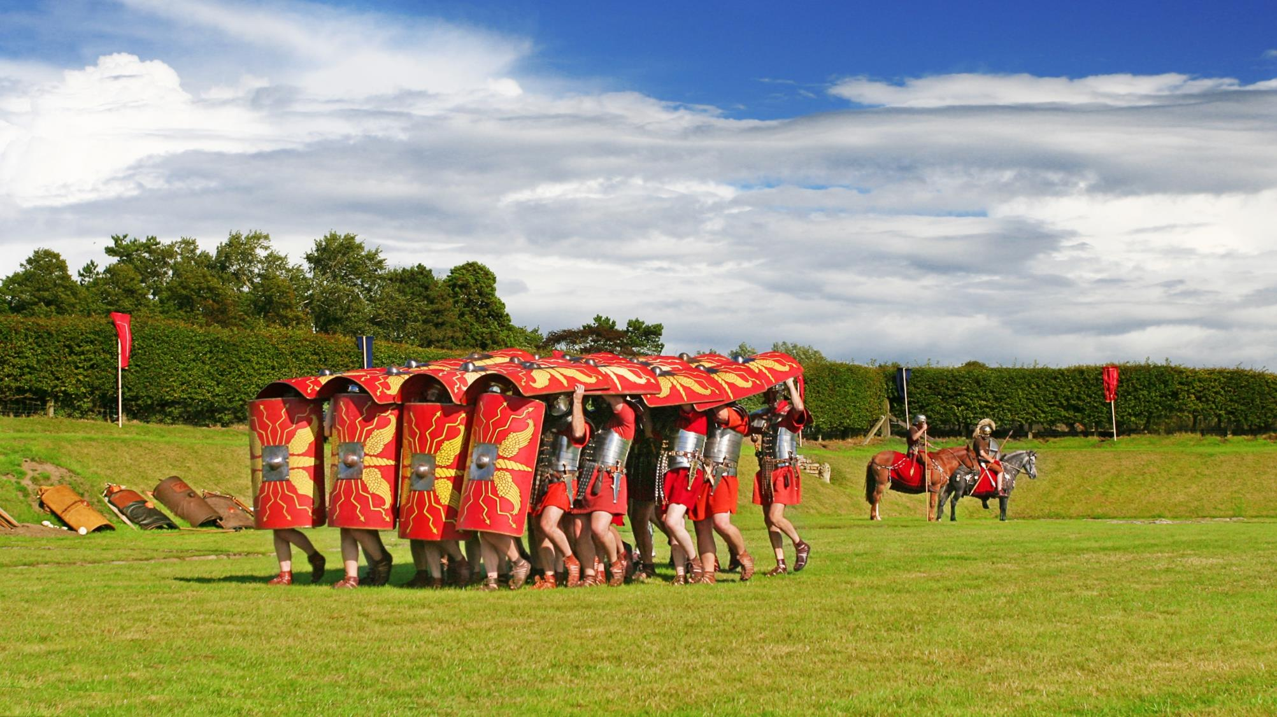

Slide 7
II. Guard the Truth (Col. 2:4, 5)
A. The truth protects (2:4)
B. The truth works (2:5)

Slide 8
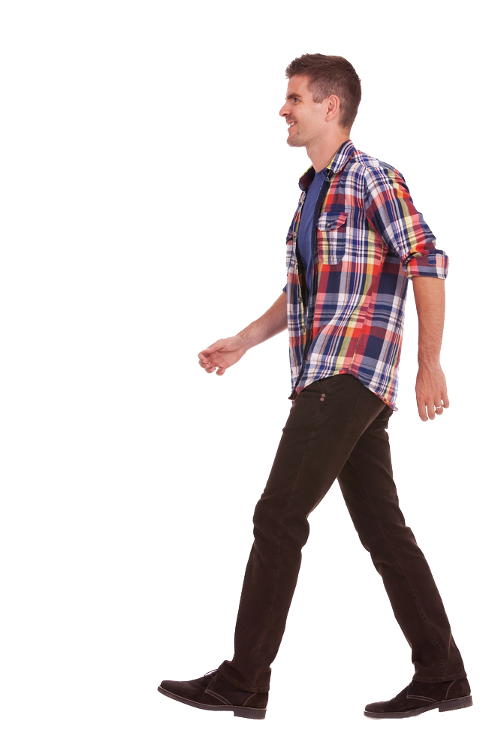
III. Grow in the Truth (Col. 2:6, 7)
A. Walking in Christ (2:6)

Slide 9

III. Grow in the Truth (Col. 2:6, 7)
A. Walking in Christ (2:6)
B. Settled in the faith (2:7a)

Slide 10
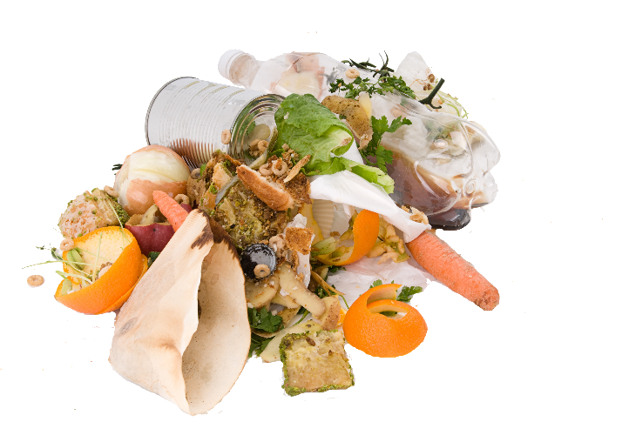
III. Grow in the Truth (Col. 2:6, 7)
A. Walking in Christ (2:6)
B. Settled in the faith (2:7a)
C. Abounding with gratitude (2:7b)

Slide 11
