Slide 1


Supreme
Putting Christ First: Colossians

Slide 2
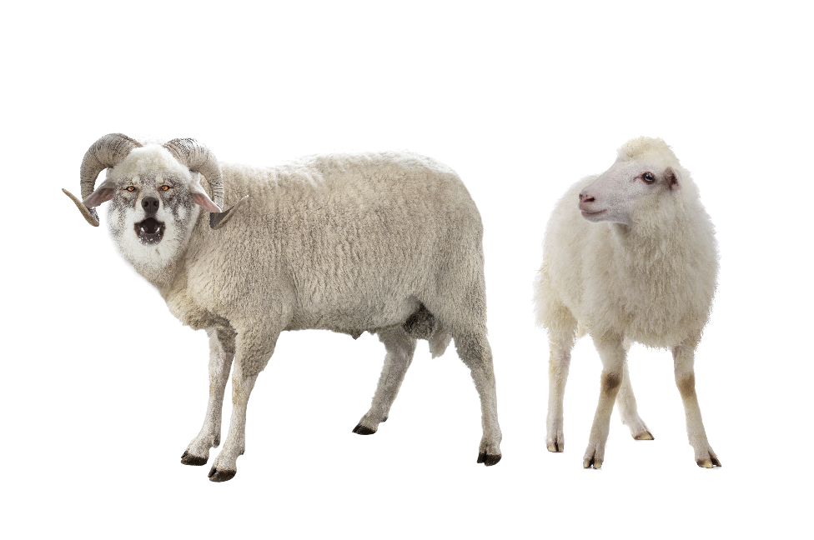
I. Christ Is the Complete Savior (Col. 2:8–10)
A. Christ’s complete doctrine (2:8)

Slide 3
I. Christ Is the Complete Savior (Col. 2:8–10)
A. Christ’s complete doctrine (2:8)
B. Christ’s complete deity (2:9)

Slide 4
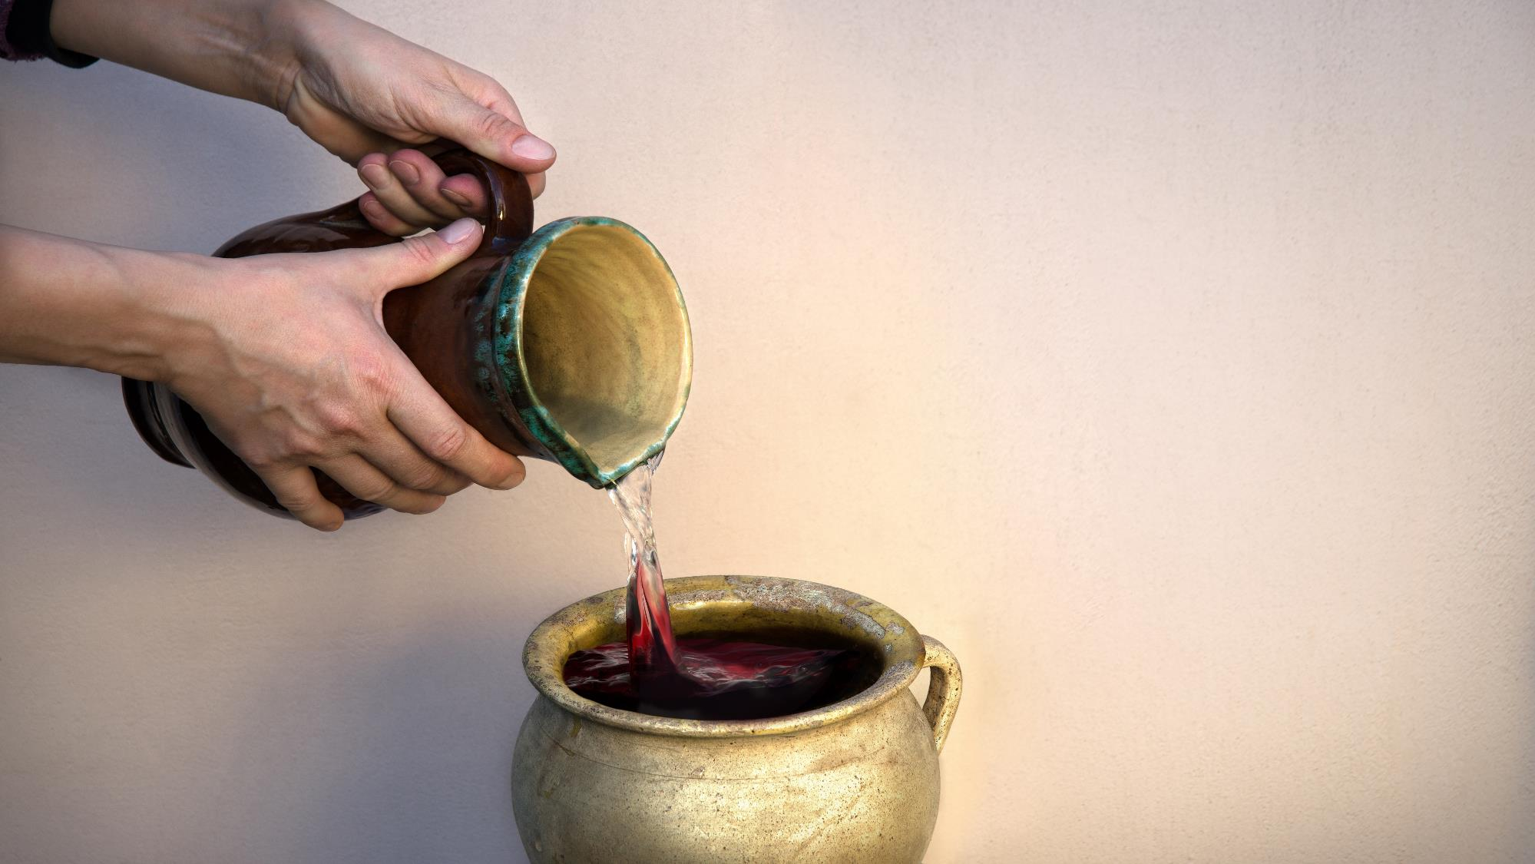
Jesus Turned Water into Wine

Slide 5
I. Christ Is the Complete Savior (Col. 2:8–10)
A. Christ’s complete doctrine (2:8)
B. Christ’s complete deity (2:9)

Slide 6
I. Christ Is the Complete Savior (Col. 2:8–10)
A. Christ’s complete doctrine (2:8)
B. Christ’s complete deity (2:9)
C. Christ’s complete dominion (2:10)

Slide 7

II. Christ Offers Complete Salvation (Col. 2:11–15)
A. Complete acceptance (2:11)

Slide 8

II. Christ Offers Complete Salvation (Col. 2:11–15)
A. Complete acceptance (2:11)
B. Complete identification (2:12, 13a)

Slide 9

II. Christ Offers Complete Salvation (Col. 2:11–15)
A. Complete acceptance (2:11)
B. Complete identification (2:12, 13a)
C. Complete forgiveness (2:13b, 14)

Slide 10
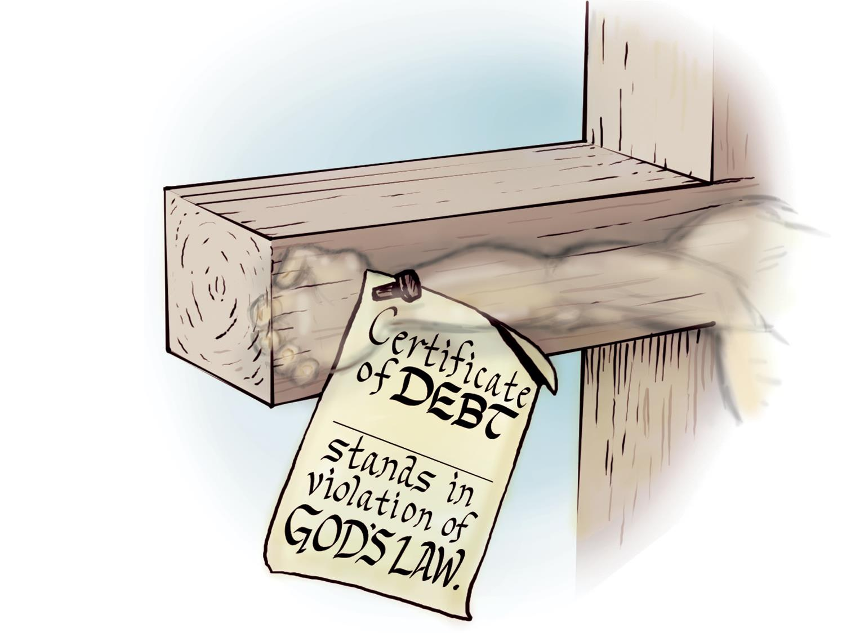

(your name)

Slide 11
II. Christ Offers Complete Salvation (Col. 2:11–15)
A. Complete acceptance (2:11)
B. Complete identification (2:12, 13a)
C. Complete forgiveness (2:13b, 14)
D. Complete victory (2:15)

