Slide 1


Supreme
Putting Christ First: Colossians

Slide 2

I. The Minister’s Sacrifice (Col. 1:24)
A. Suffers for Christ’s Body (1:24)

Slide 3
I. The Minister’s Sacrifice (Col. 1:24)
A. Suffers for Christ’s Body (1:24)
B. Suffers like Christ’s body (1:24)

Slide 4
II. The Minister’s Stewardship (Col. 1:25–28)
A. Fulfillment of God’s Word (1:25, 26)

Slide 5
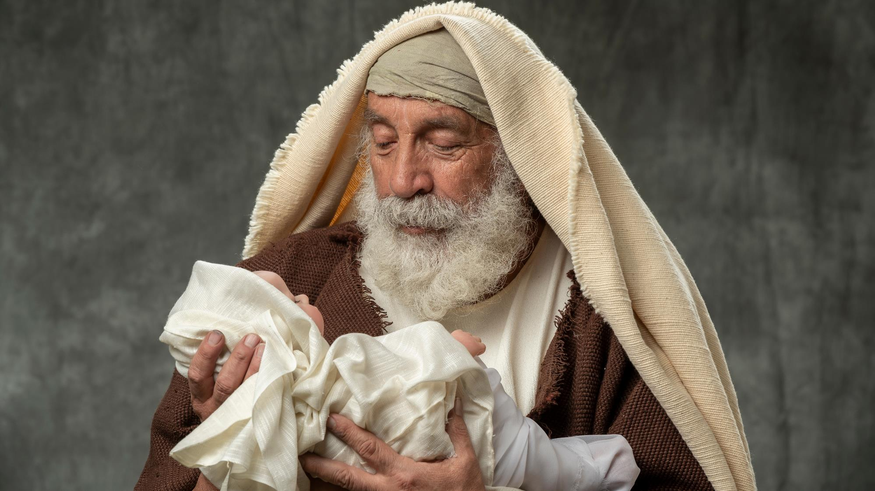

Slide 6
II. The Minister’s Stewardship (Col. 1:25–28)
A. Fulfillment of God’s Word (1:25, 26)
B. Focus on God’s Son (1:27, 28a)

Slide 7

II. The Minister’s Stewardship (Col. 1:25–28)
A. Fulfillment of God’s Word (1:25, 26)
B. Focus on God’s Son (1:27, 28a)
C. Perfection of God’s people (1:28b)

Slide 8
III. The Minister’s Striving (Col. 1:29)
A. Committed to working hard for Christ (1:29)

Slide 9

III. The Minister’s Striving (Col. 1:29)
A. Committed to working hard for Christ (1:29)
B. Counting on Christ’s work (1:29)

