Slide 1
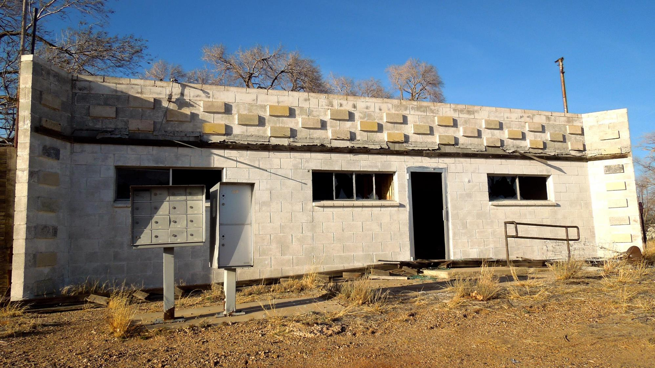
Glenrio Post Office

Slide 2
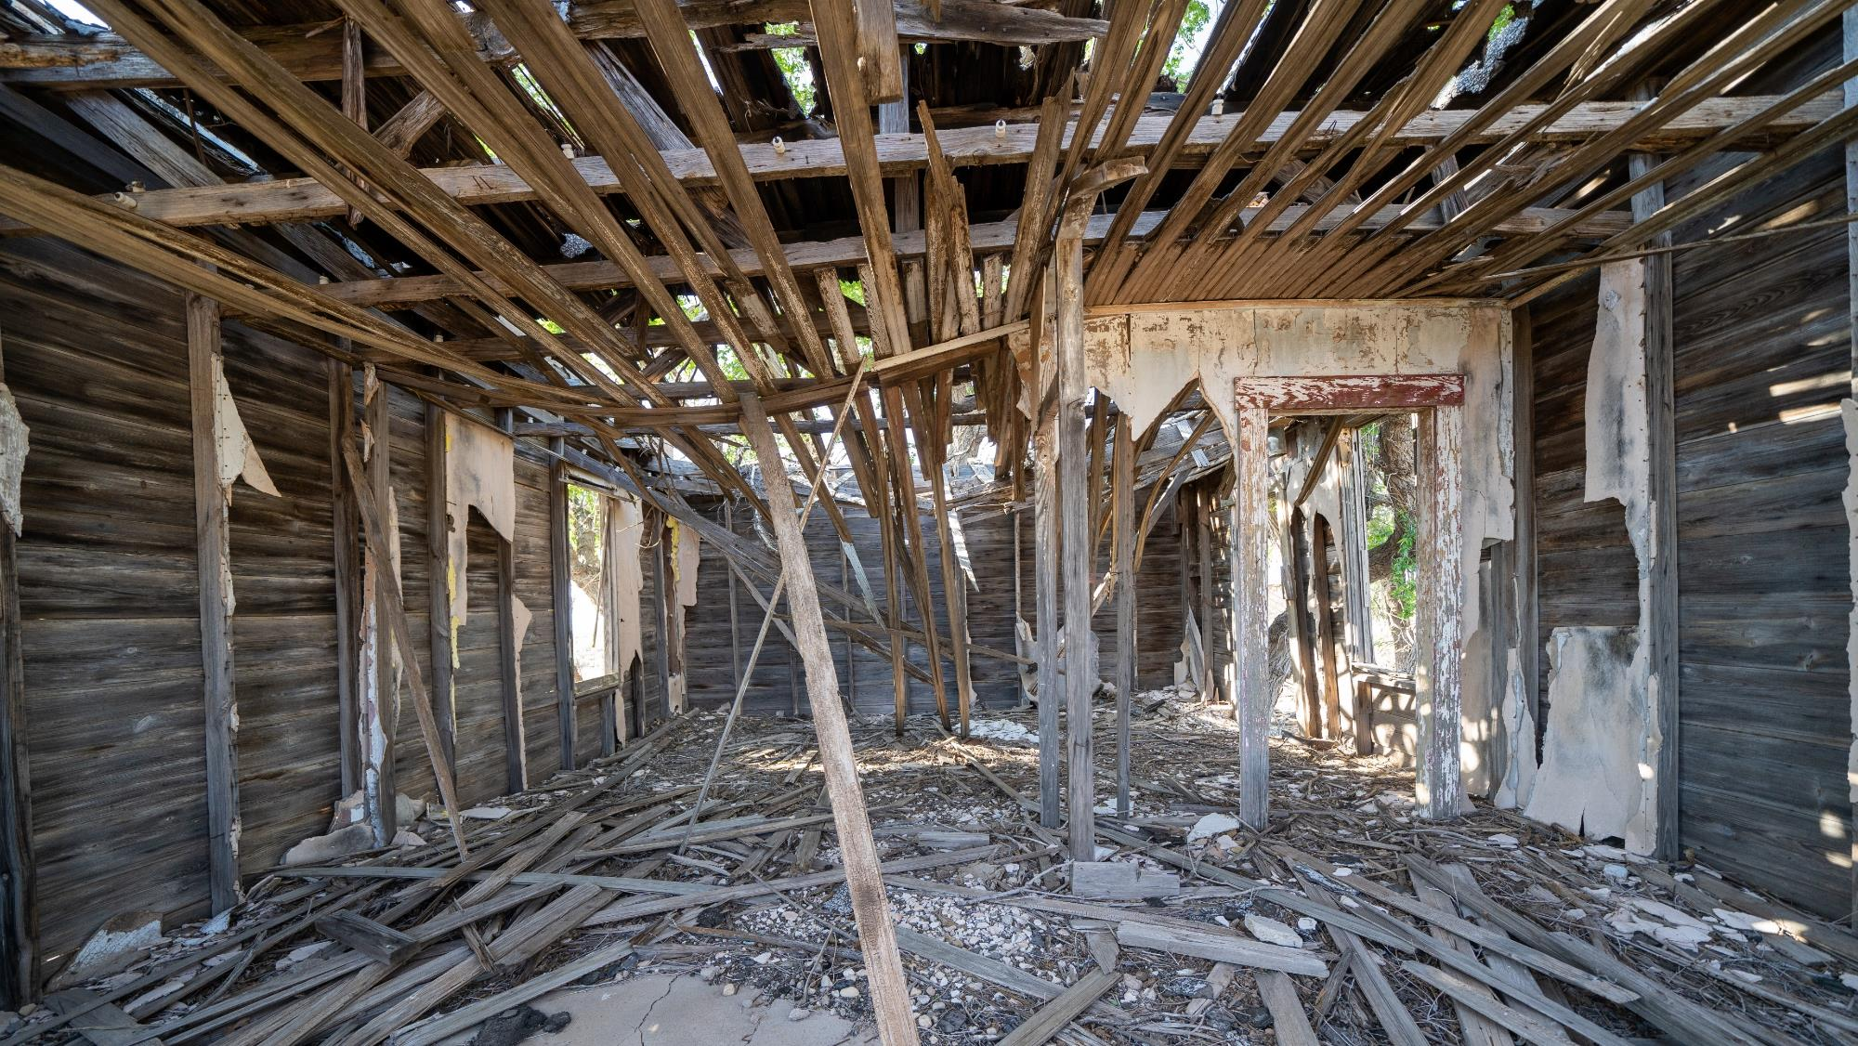
Glenrio Post Office

Slide 3
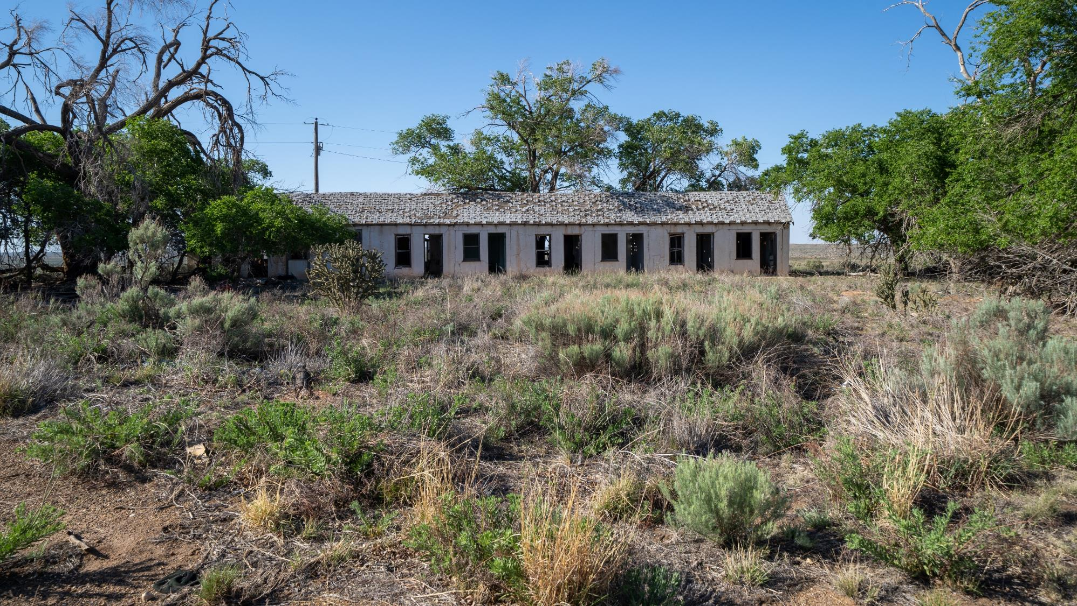
Glenrio Hotel

Slide 4


Supreme
Putting Christ First: Colossians

Slide 5
I. Background of the Epistle (Col. 1:1, 2)
A. The little city

Slide 6
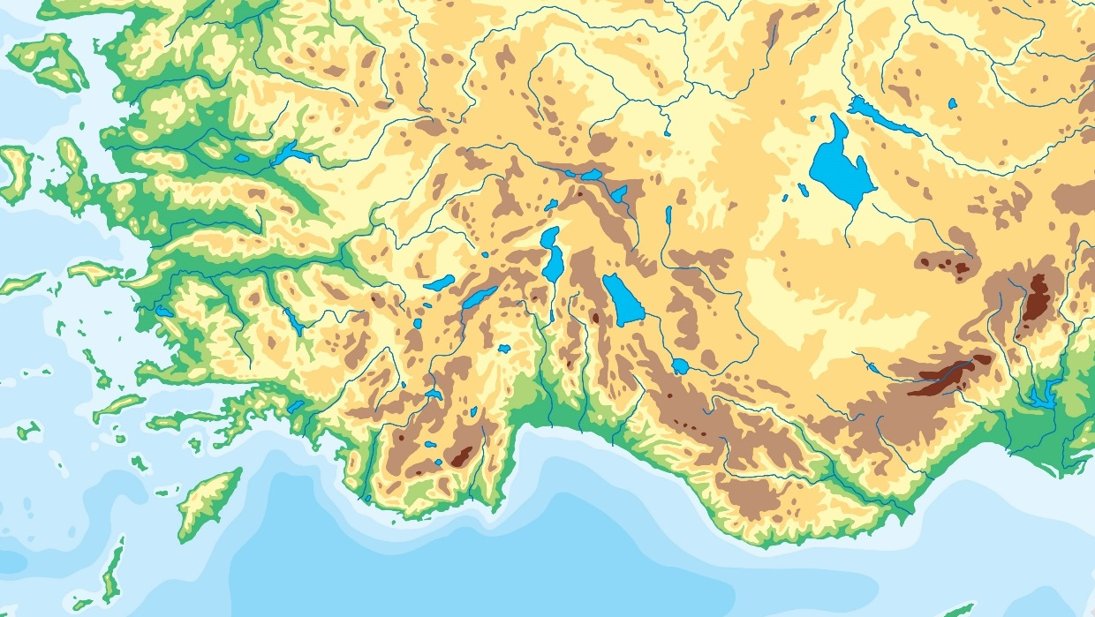
G A L A T I A
A S I A
Smyrna
LYDIA
Hierapolis
Antioch
Ephesus
PHRYGIA
Meander River
PISIDIA
Iconium
Laodicea
Lycus River
Colosse
Lystra
Miletus
CARIA
Derbe
PAMPHYLIA
Tarsus
LYCIA
Rhodes
CILICIA
First Century Asia

Slide 7
I. Background of the Epistle (Col. 1:1, 2)
A. The little city

Slide 8
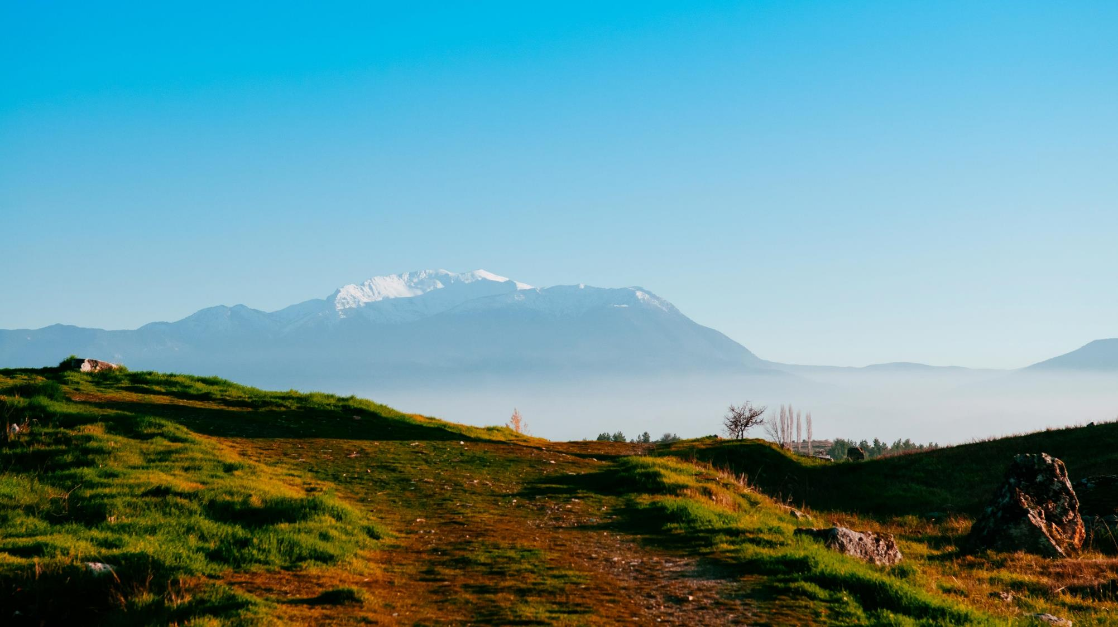
Mount Cadmus from Hierapolis

Slide 9
I. Background of the Epistle (Col. 1:1, 2)
A. The little city
B. The Colosse residents

Slide 10

I. Background of the Epistle (Col. 1:1, 2)
A. The little city
B. The Colosse residents
C. The authoritative writer (1:1)

Slide 11

I. Background of the Epistle (Col. 1:1, 2)
A. The little city
B. The Colosse residents
C. The authoritative writer (1:1)
D. The church in Christ (1:2)

Slide 12
I. Background of the Epistle (Col. 1:1, 2)
A. The little city
B. The Colosse residents
C. The authoritative writer (1:1)
D. The church in Christ (1:2)
E. The threatening heresy
• The heresy denied the teaching that Christ is sufficient.
• The heresy emphasized the need to participate in
Judaistic ceremonialism.
• The heresy introduced angel worship.
• The heresy promoted asceticism, a severe treatment
of the body and abstention from self-indulgence.

Slide 13
II. Confirmation of the Gospel (Col. 1:3–8)
A. The gospel is God’s work (1:3)

Slide 14

II. Confirmation of the Gospel (Col. 1:3–8)
A. The gospel is God’s work (1:3)
B. The gospel changes people (1:4)

Slide 15

II. Confirmation of the Gospel (Col. 1:3–8)
A. The gospel is God’s work (1:3)
B. The gospel changes people (1:4)
C. The gospel gives hope (1:5)

Slide 16
II. Confirmation of the Gospel (Col. 1:3–8)
A. The gospel is God’s work (1:3)
B. The gospel changes people (1:4)
C. The gospel gives hope (1:5)
D. The gospel spreads (1:6)

Slide 17
II. Confirmation of the Gospel (Col. 1:3–8)
A. The gospel is God’s work (1:3)
B. The gospel changes people (1:4)
C. The gospel gives hope (1:5)
D. The gospel spreads (1:6)
E. The gospel is precise (1:7, 8)

