Slide 1
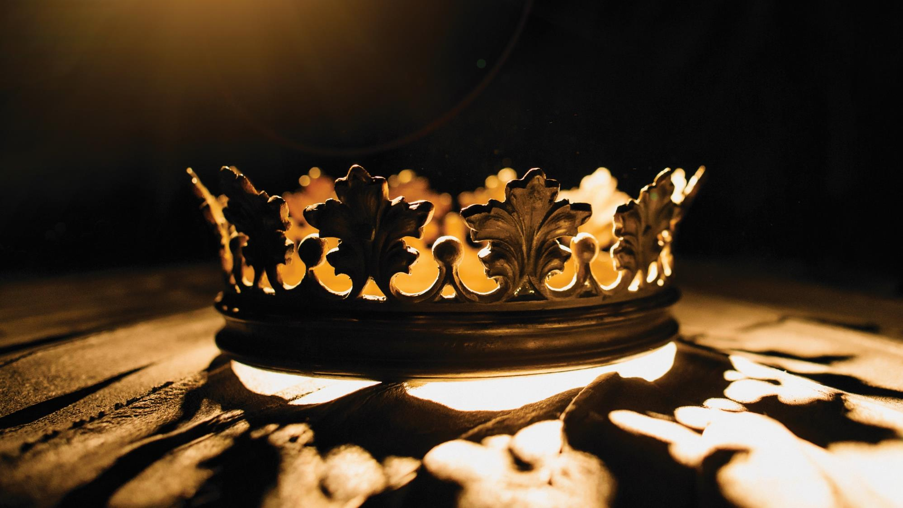

Supreme
Putting Christ First: Colossians

Slide 2
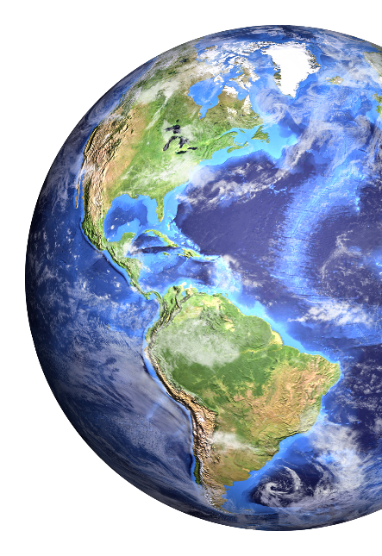
I. Christ’s Preeminence in Creation (Col. 1:15–17)
A. Christ is God over all (1:15)

Slide 3
I. Christ’s Preeminence in Creation (Col. 1:15–17)
A. Christ is God over all (1:15)
B. Christ is Creator of all (1:16)

Slide 4
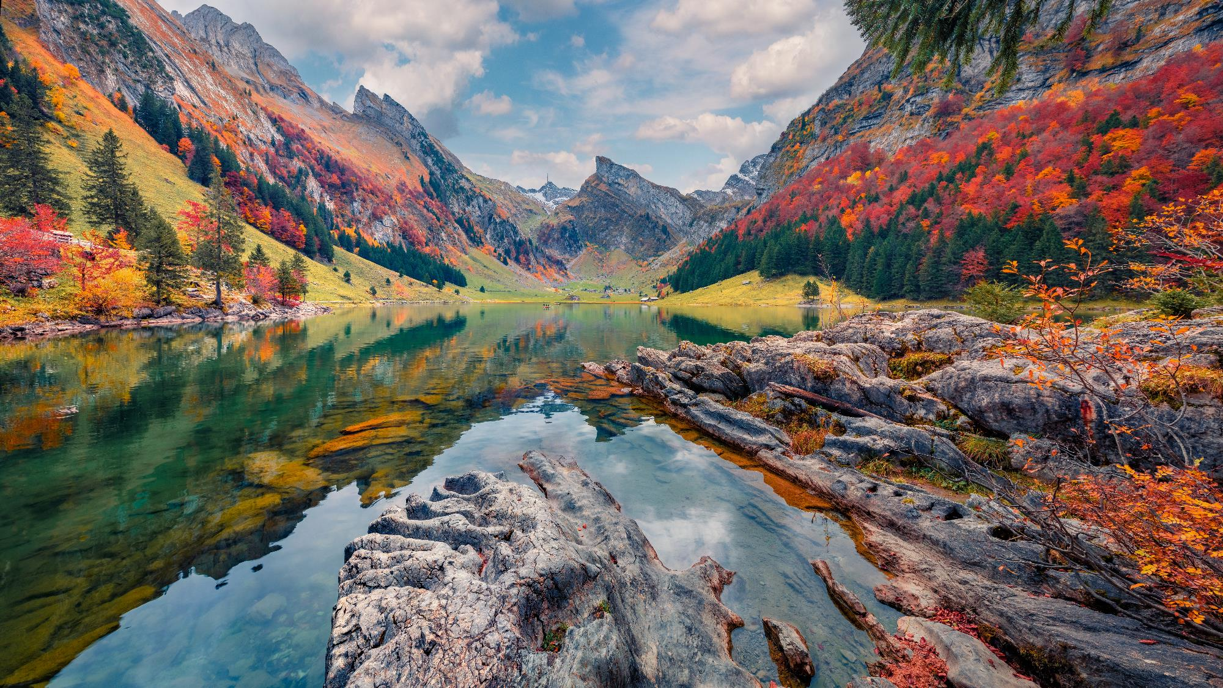
Swiss Alps

Slide 5
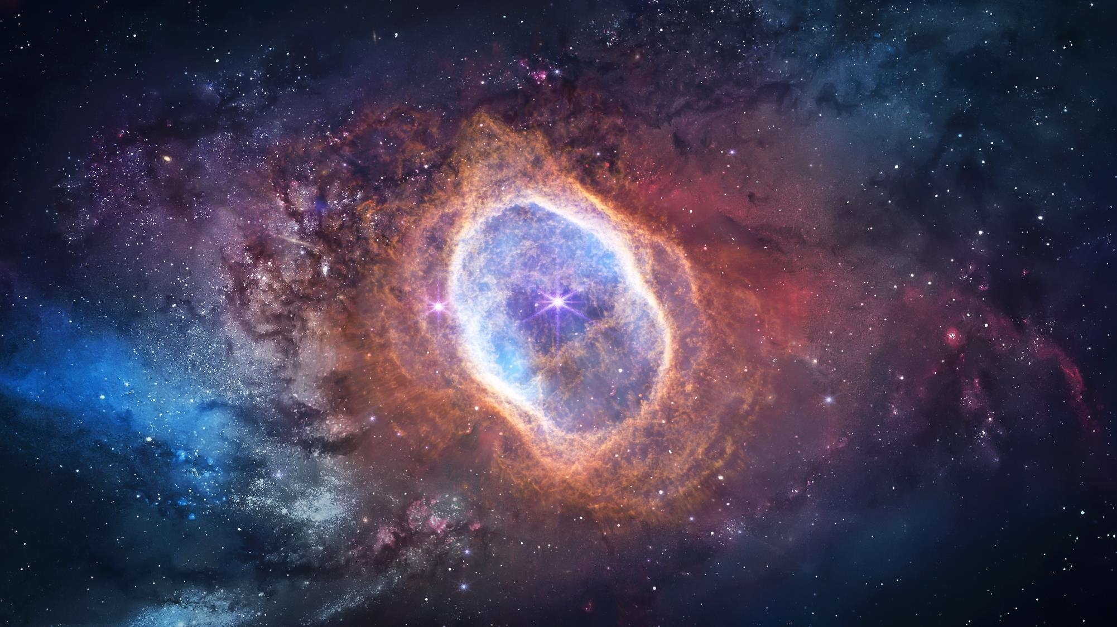
Southern Ring Nebula

Slide 6
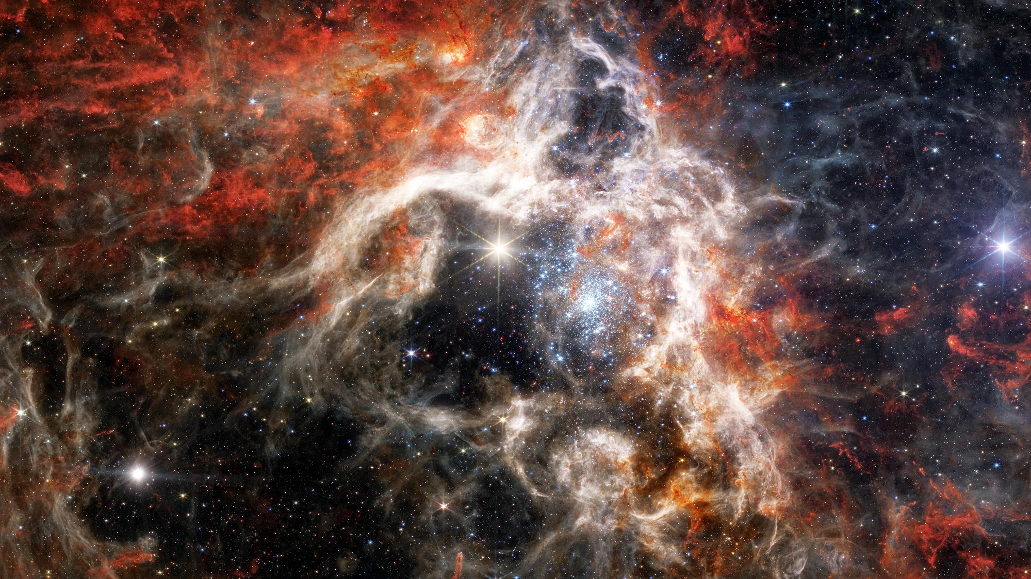
Tarantula Nebula

Slide 7
I. Christ’s Preeminence in Creation (Col. 1:15–17)
A. Christ is God over all (1:15)
B. Christ is Creator of all (1:16)

Slide 8
I. Christ’s Preeminence in Creation (Col. 1:15–17)
A. Christ is God over all (1:15)
B. Christ is Creator of all (1:16)
C. Christ is Sustainer of all (1:17)

Slide 9
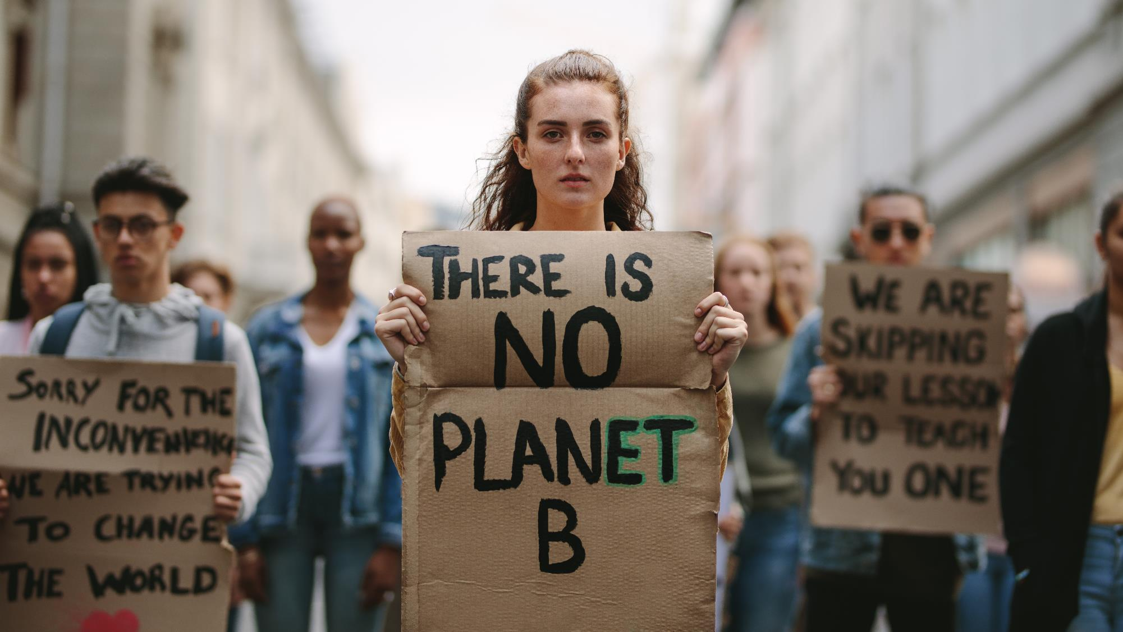
Misinformed Protestors

Slide 10
I. Christ’s Preeminence in Creation (Col. 1:15–17)
A. Christ is God over all (1:15)
B. Christ is Creator of all (1:16)
C. Christ is Sustainer of all (1:17)

Slide 11
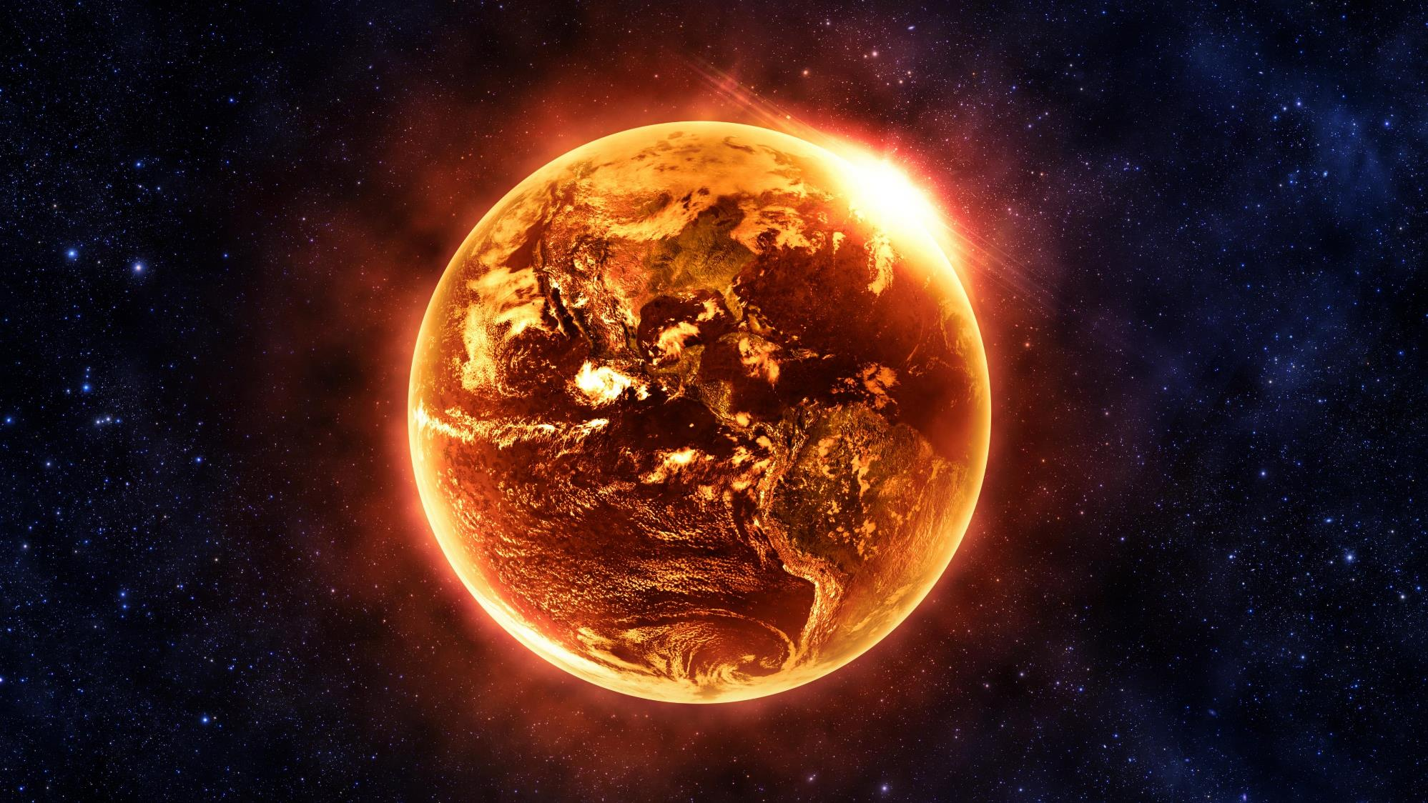
2 Peter 3:10

Slide 12
I. Christ’s Preeminence in Creation (Col. 1:15–17)
A. Christ is God over all (1:15)
B. Christ is Creator of all (1:16)
C. Christ is Sustainer of all (1:17)

Slide 13
II. Christ’s Preeminence in Redemption (Col. 1:18–23)
A. Christ rules the redeemed (1:18)

Slide 14
II. Christ’s Preeminence in Redemption (Col. 1:18–23)
A. Christ rules the redeemed (1:18)
B. Christ represents humanity (1:19)

Slide 15
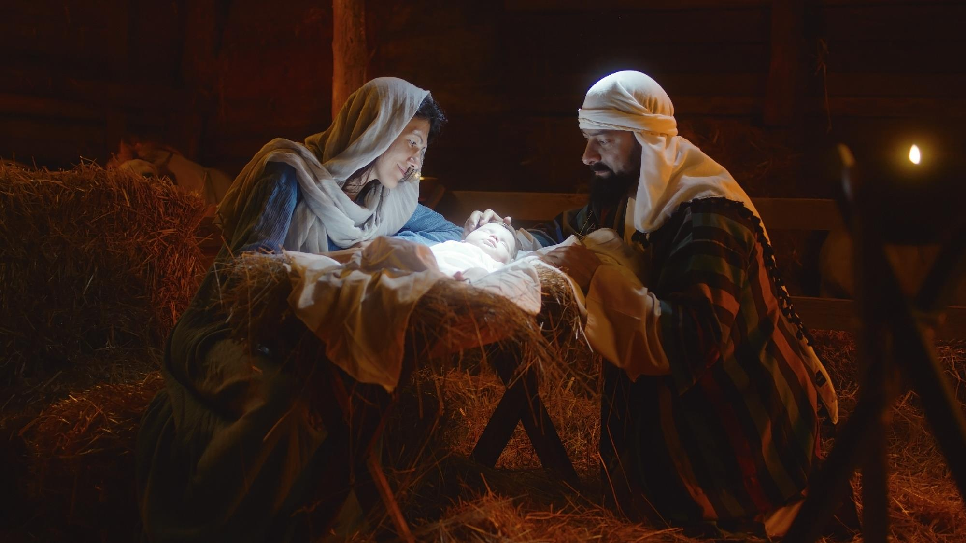

Slide 16
II. Christ’s Preeminence in Redemption (Col. 1:18–23)
A. Christ rules the redeemed (1:18)
B. Christ represents humanity (1:19)

Slide 17
II. Christ’s Preeminence in Redemption (Col. 1:18–23)
A. Christ rules the redeemed (1:18)
B. Christ represents humanity (1:19)
C. Christ reconciles us to God (1:20–23)
1. By His blood (1:20, 21)

Slide 18
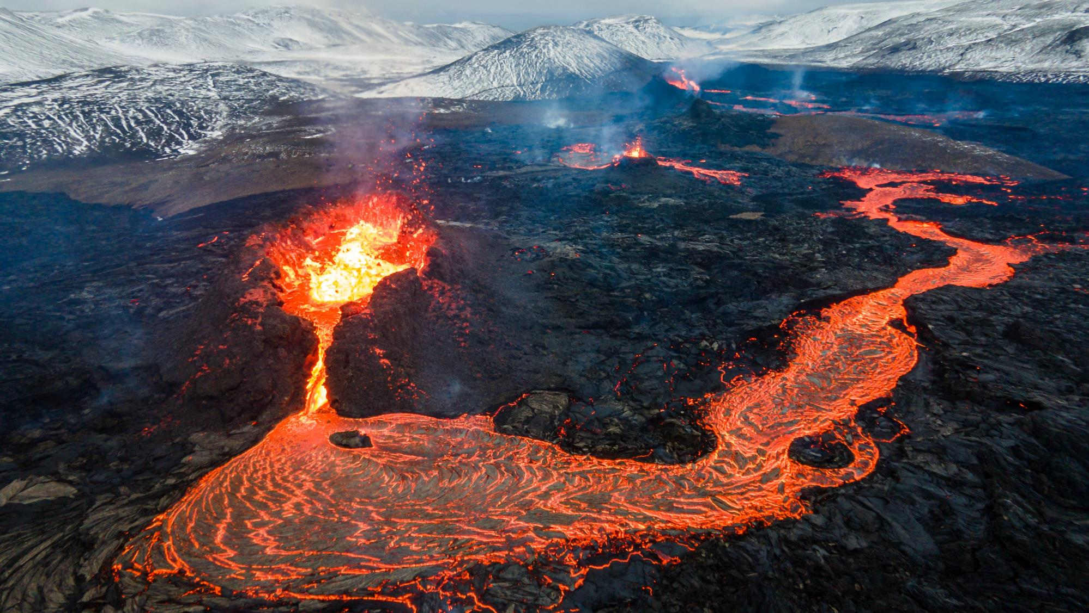
Lava Flow in Iceland

Slide 19
II. Christ’s Preeminence in Redemption (Col. 1:18–23)
A. Christ rules the redeemed (1:18)
B. Christ represents humanity (1:19)
C. Christ reconciles us to God (1:20–23)
1. By His blood (1:20, 21)
2. In His time (1:22, 23)

