Slide 1


Supreme
Putting Christ First: Colossians

Slide 2

I. The Request to Know God’s Will (Col. 1:9)
A. Fully (1:9)

Slide 3
I. The Request to Know God’s Will (Col. 1:9)
A. Fully (1:9)
B. Functionally (1:9)

Slide 4
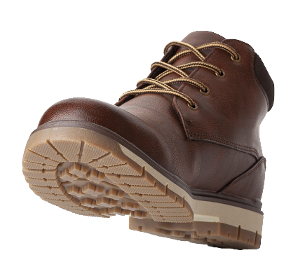
II. The Request to Walk Worthy (Col. 1:10–14)

Slide 5
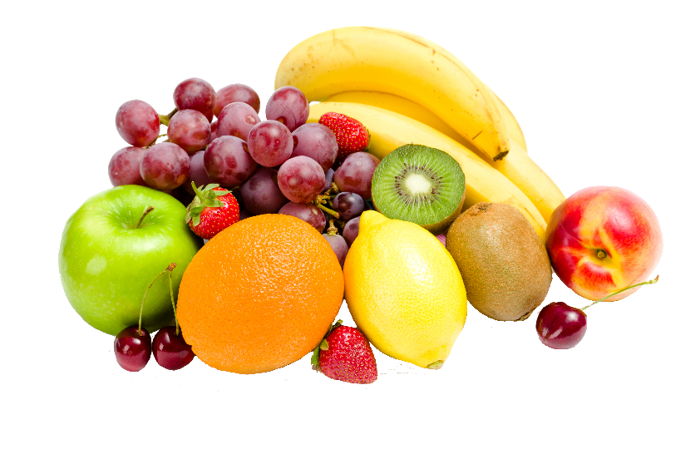
II. The Request to Walk Worthy (Col. 1:10–14)
A. Bearing fruit (1:10)

Slide 6
II. The Request to Walk Worthy (Col. 1:10–14)
A. Bearing fruit (1:10)
B. Increasing in knowledge (1:10)

Slide 7
II. The Request to Walk Worthy (Col. 1:10–14)
A. Bearing fruit (1:10)
B. Increasing in knowledge (1:10)
C. Being strengthened (1:11)
1. Extensively (1:11)

Slide 8

II. The Request to Walk Worthy (Col. 1:10–14)
A. Bearing fruit (1:10)
B. Increasing in knowledge (1:10)
C. Being strengthened (1:11)
1. Extensively (1:11)
2. Practically (1:11)

Slide 9

II. The Request to Walk Worthy (Col. 1:10–14)
A. Bearing fruit (1:10)
B. Increasing in knowledge (1:10)
C. Being strengthened (1:11)
1. Extensively (1:11)
2. Practically (1:11)
D. Giving thanks (1:12—14)
1. For an inheritance (1:12)

Slide 10

II. The Request to Walk Worthy (Col. 1:10–14)
A. Bearing fruit (1:10)
B. Increasing in knowledge (1:10)
C. Being strengthened (1:11)
1. Extensively (1:11)
2. Practically (1:11)
D. Giving thanks (1:12—14)
1. For an inheritance (1:12)
2. For deliverance (1:13)

Slide 11
II. The Request to Walk Worthy (Col. 1:10–14)
A. Bearing fruit (1:10)
B. Increasing in knowledge (1:10)
C. Being strengthened (1:11)
1. Extensively (1:11)
2. Practically (1:11)
D. Giving thanks (1:12—14)
1. For an inheritance (1:12)
2. For deliverance (1:13)
3. For redemption (1:14)

