Slide 1


Slide 2


Slide 3
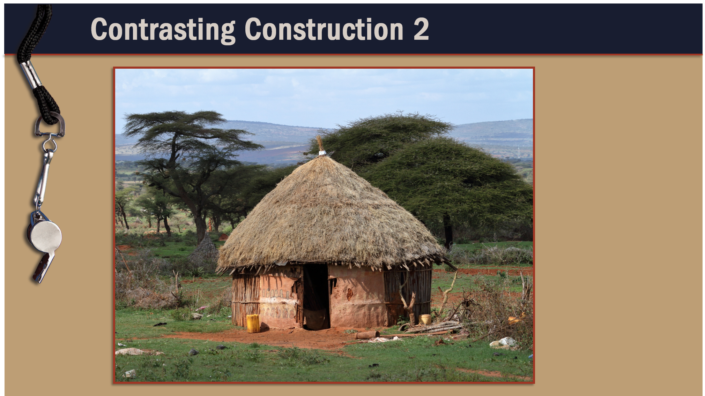

Slide 4
I. Paul Exposed Corinth’s Carnal Ministry
(3:1–4)
A. Reasons for carnality (3:1, 2)
B. Results of carnality (3:3, 4)

Slide 5










Slide 6
II. Paul Explained Servant Ministry (3:5–17)
A. Build on the right Man (3:5–11)
B. Build with the right materials (3:12–13)
C. Build with the right motive (3:14–17)

Slide 7
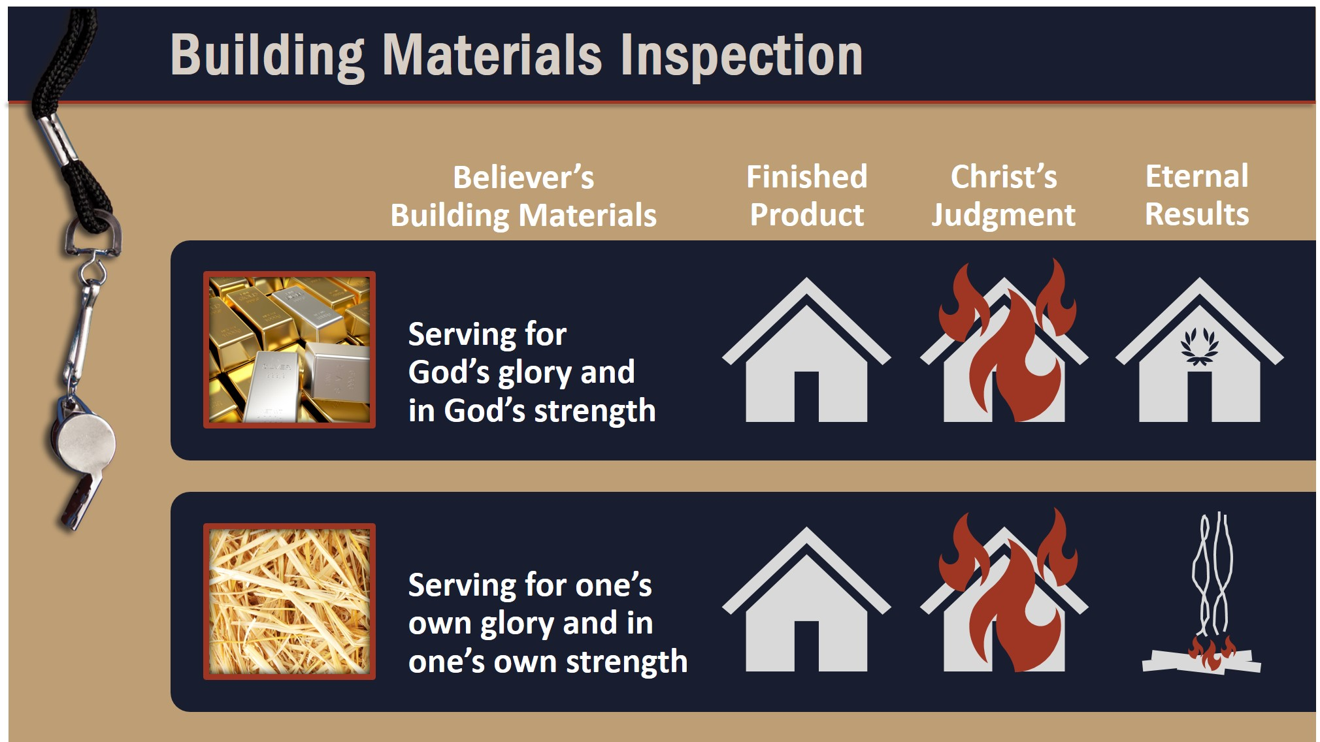

Slide 8
III. Paul Exalted God’s Wisdom (3:18–23)
A. Man’s wisdom is foolish (3:18–20)
B. God’s wisdom causes flourishment
(3:21–23)

Slide 9
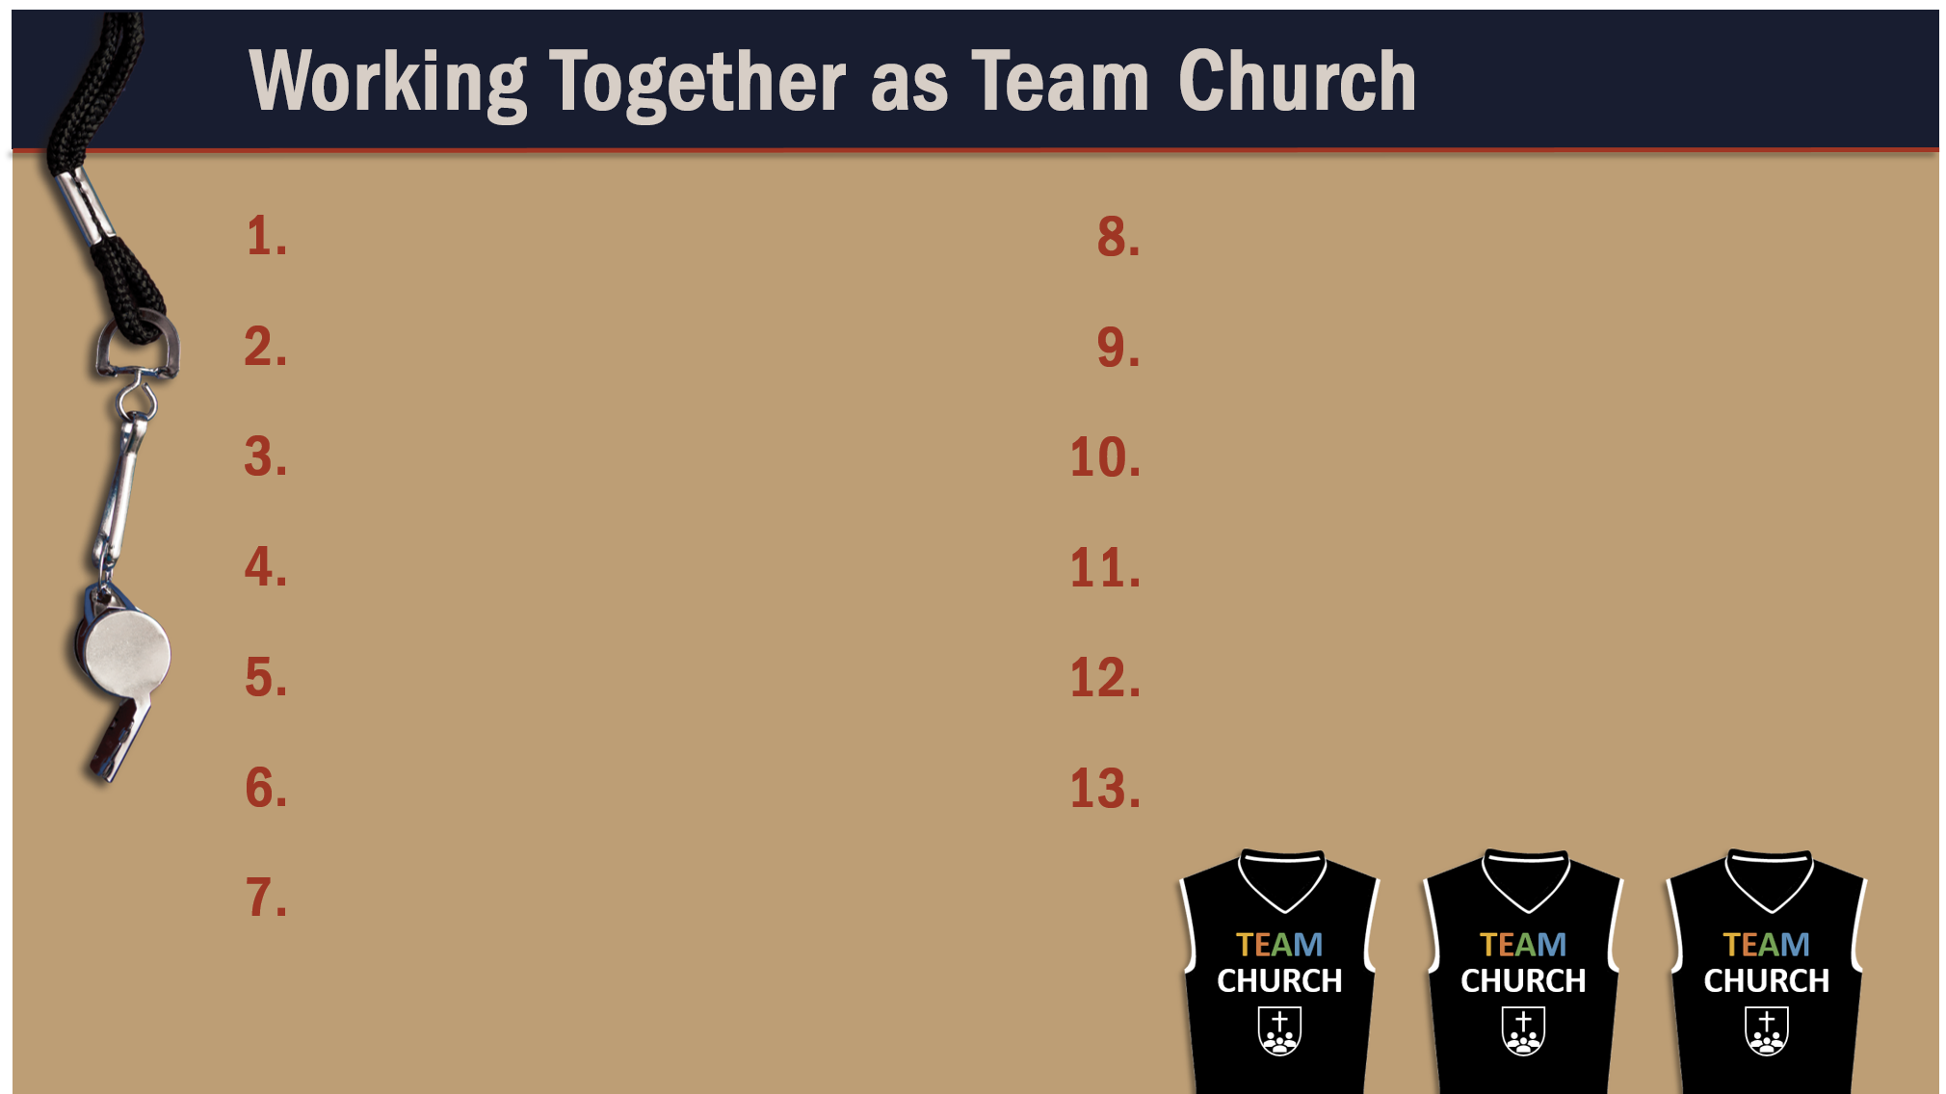
Glorify God as a godly team member.
Recognize the Spirit’s illumination ministry.
Depend of God’s wisdom for growth and ministry.

