Slide 1


Slide 2
I. The Organization
A. Coach Paul (1:1)
B. Team church (1:2)
1. The team’s position
2. The team’s purpose

Slide 3

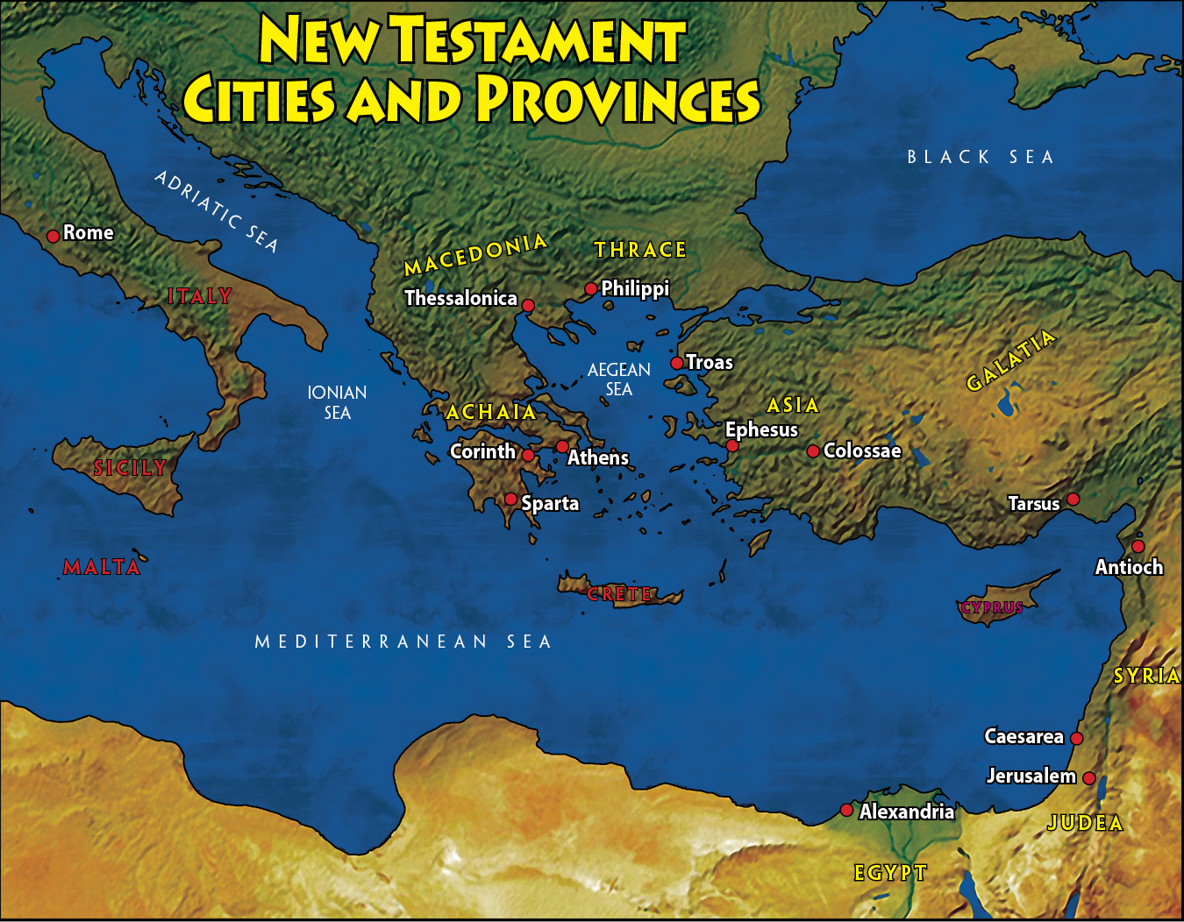

Slide 4
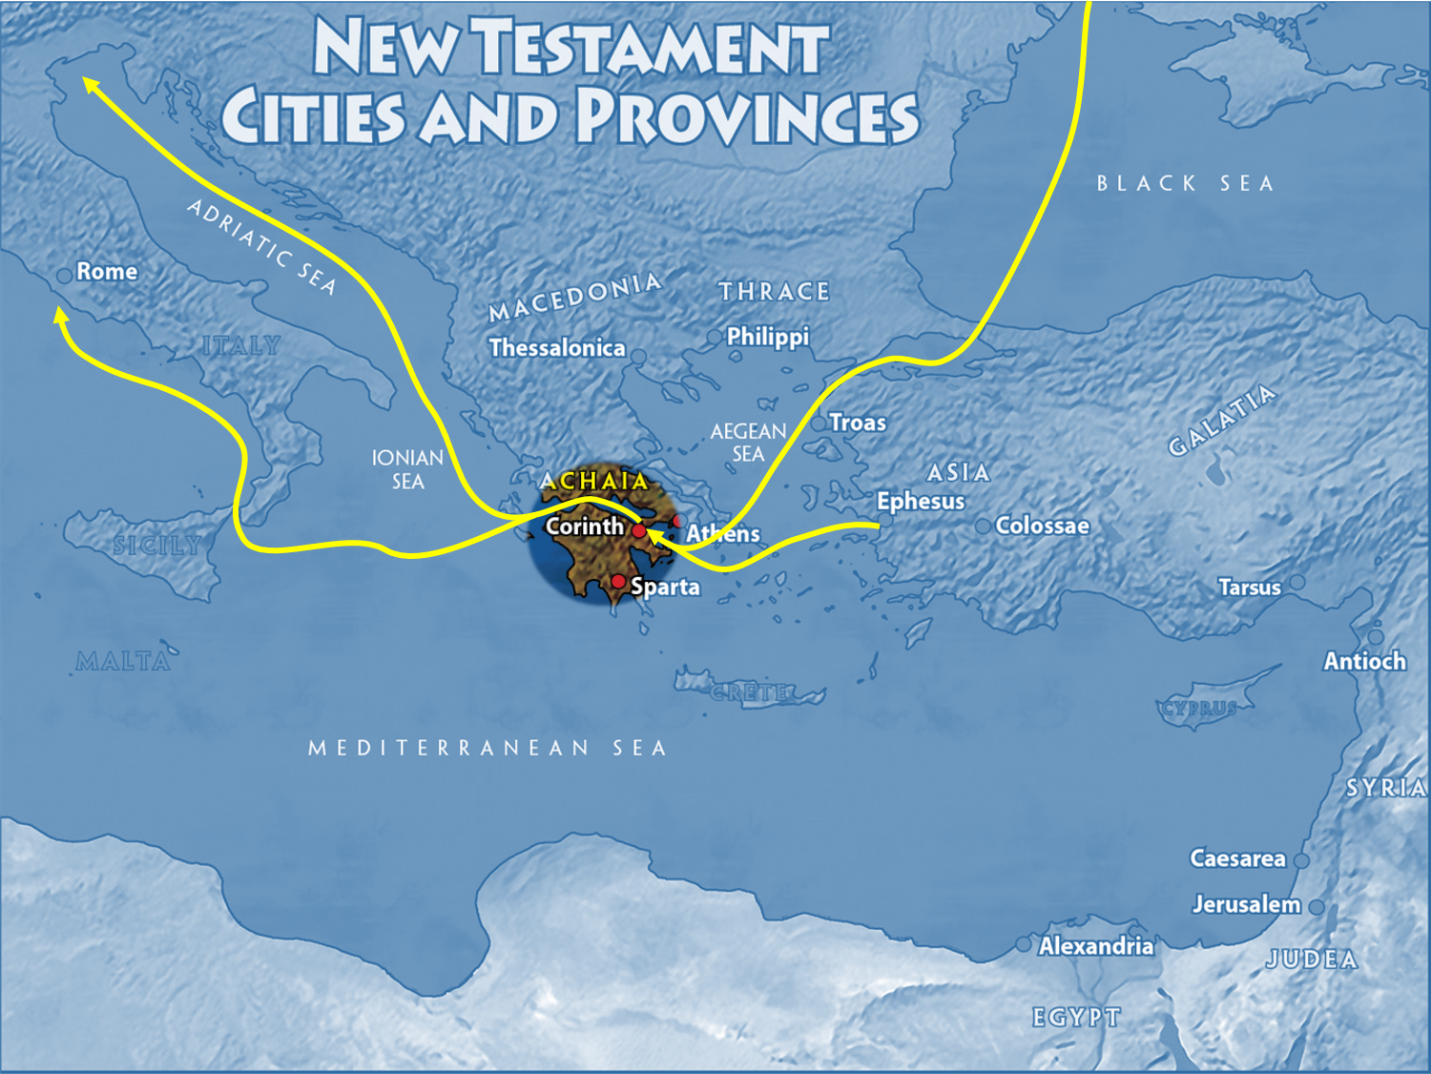

Slide 5
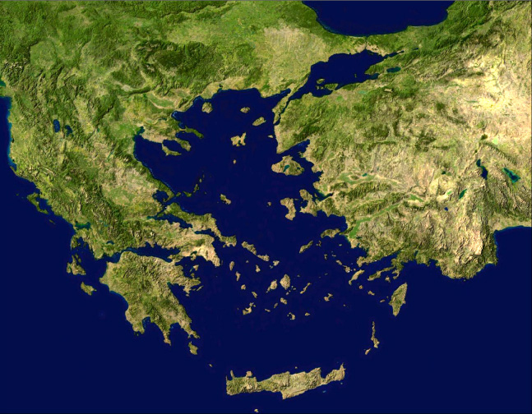
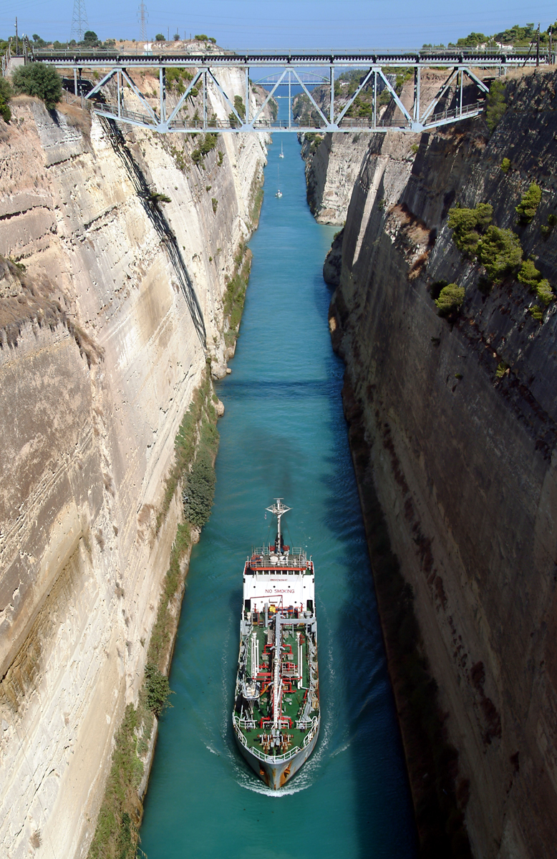
Corinth
Modern
Isthmus

Slide 6
I. The Organization
A. Coach Paul (1:1)
B. Team church (1:2)
1. The team’s position
2. The team’s purpose
C. God, team owner (1:3–9)
1. Equipped the team (1:3–7)
2. Ensured the team’s triumph (1:8, 9)

Slide 7
II. Team Meeting (1:10–31)
A. The problem of disunity (1:10–17)

Slide 8

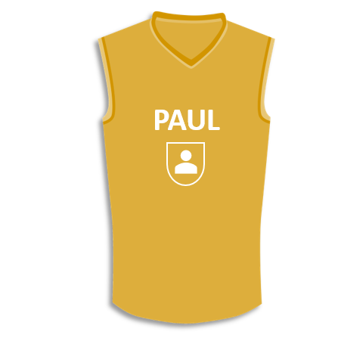
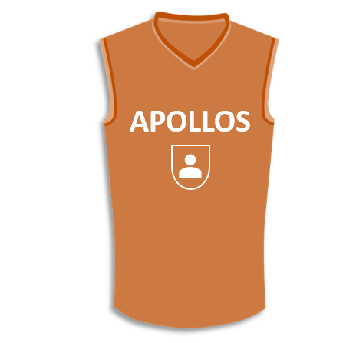
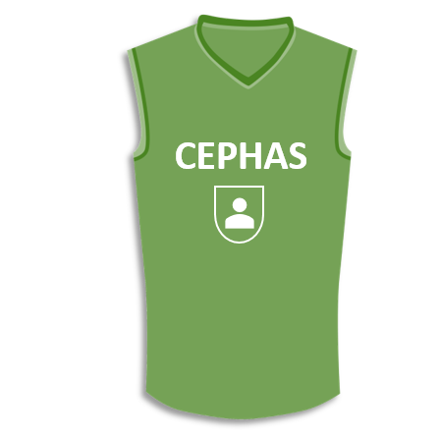
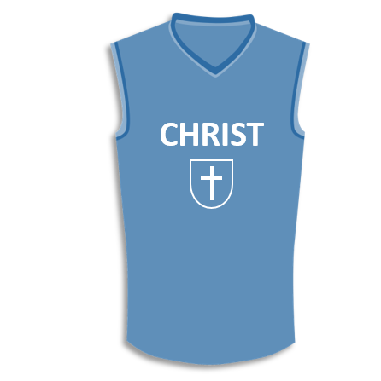

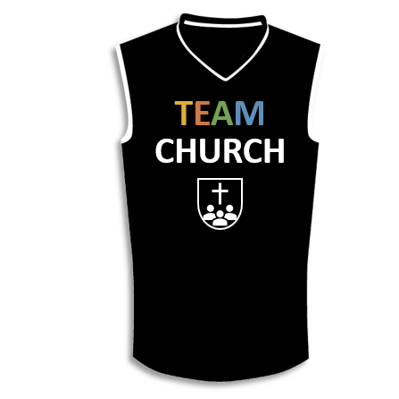



Slide 9
II. Team Meeting (1:10–31)
A. The problem of disunity (1:10–17)
B. The power for unity (1:18–25)
C. The practice of unity (1:26–31)

Slide 10
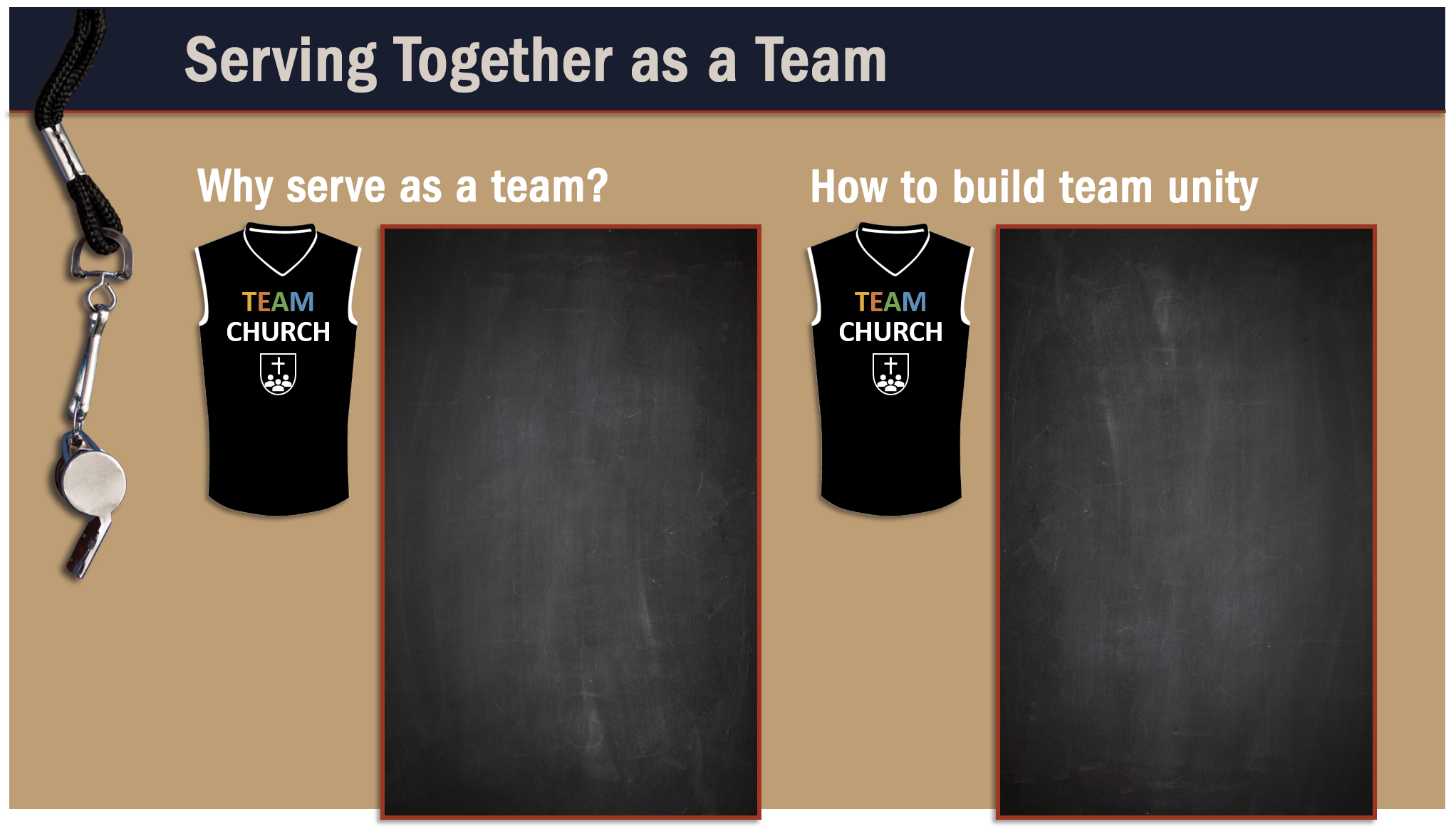
To be a good testimony.
Pray for one another.
Rejoice in victories.
To build Christ’s church.
Praise God for one another.
To communicate the effects of the gospel.
Humbly submit to one another.
To love as Christ loves.
Faithfully use our spiritual gifts.
To glorify the Lord.

Slide 11
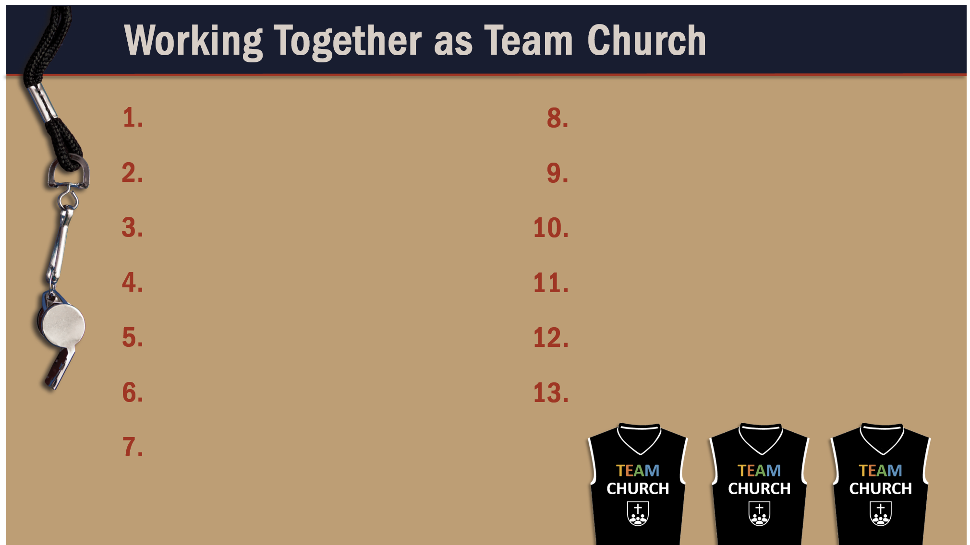
Glorify God as a godly team member.

