Slide 1


Slide 2
I. Paul’s Preaching (2:1–8)
A. Focus: Christ crucified (2:1, 2)
B. Effect: Faith in God (2:3–5)
C. Foundation: Wisdom of God (2:6–8)

Slide 3
II. Paul’s Reception of God’s Word (2:9–16)
A. Revelation of God’s Word (2:9–11)

Slide 4


Slide 5
II. Paul’s Reception of God’s Word (2:9–16)
A. Revelation of God’s Word (2:9–11)
B. Inspiration of God’s Word (2:12, 13)

Slide 7
II. Paul’s Reception of God’s Word (2:9–16)
A. Revelation of God’s Word (2:9–11)
B. Inspiration of God’s Word (2:12, 13)
C. Illumination of God’s Word (2:14–16)

Slide 9
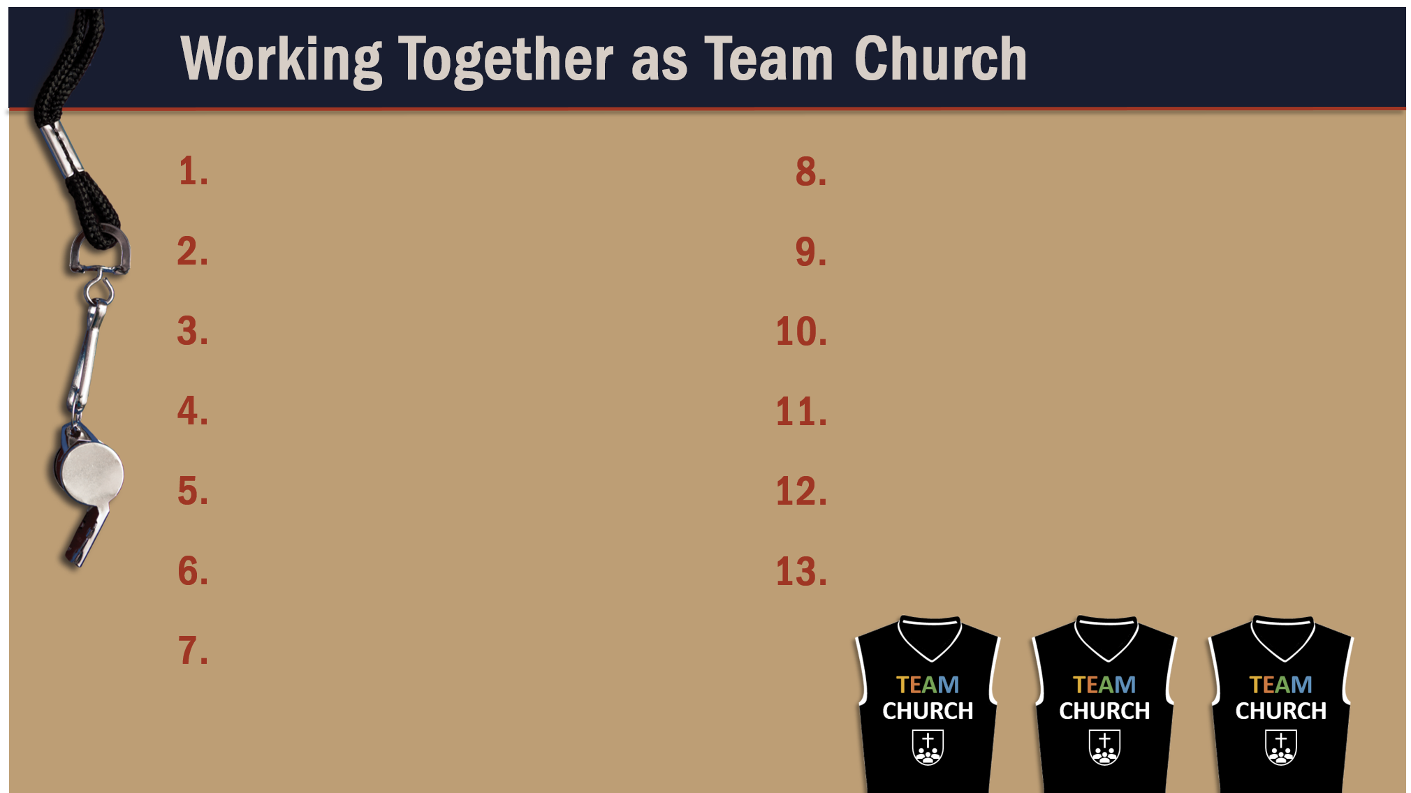
Glorify God as a godly team member.
Recognize the Spirit’s illumination ministry.

