Slide 1


Slide 2
I. Stewardship of Money (16:1–4)
A. Give regularly (16:1, 2)
B. Give personally (16:2)
C. Give proportionately (16:2)
D. Give responsibly (16:3, 4)

Slide 3
II. Stewardship of Opportunities (16:5–9)
A. Open doors (16:5–9a)

Slide 4
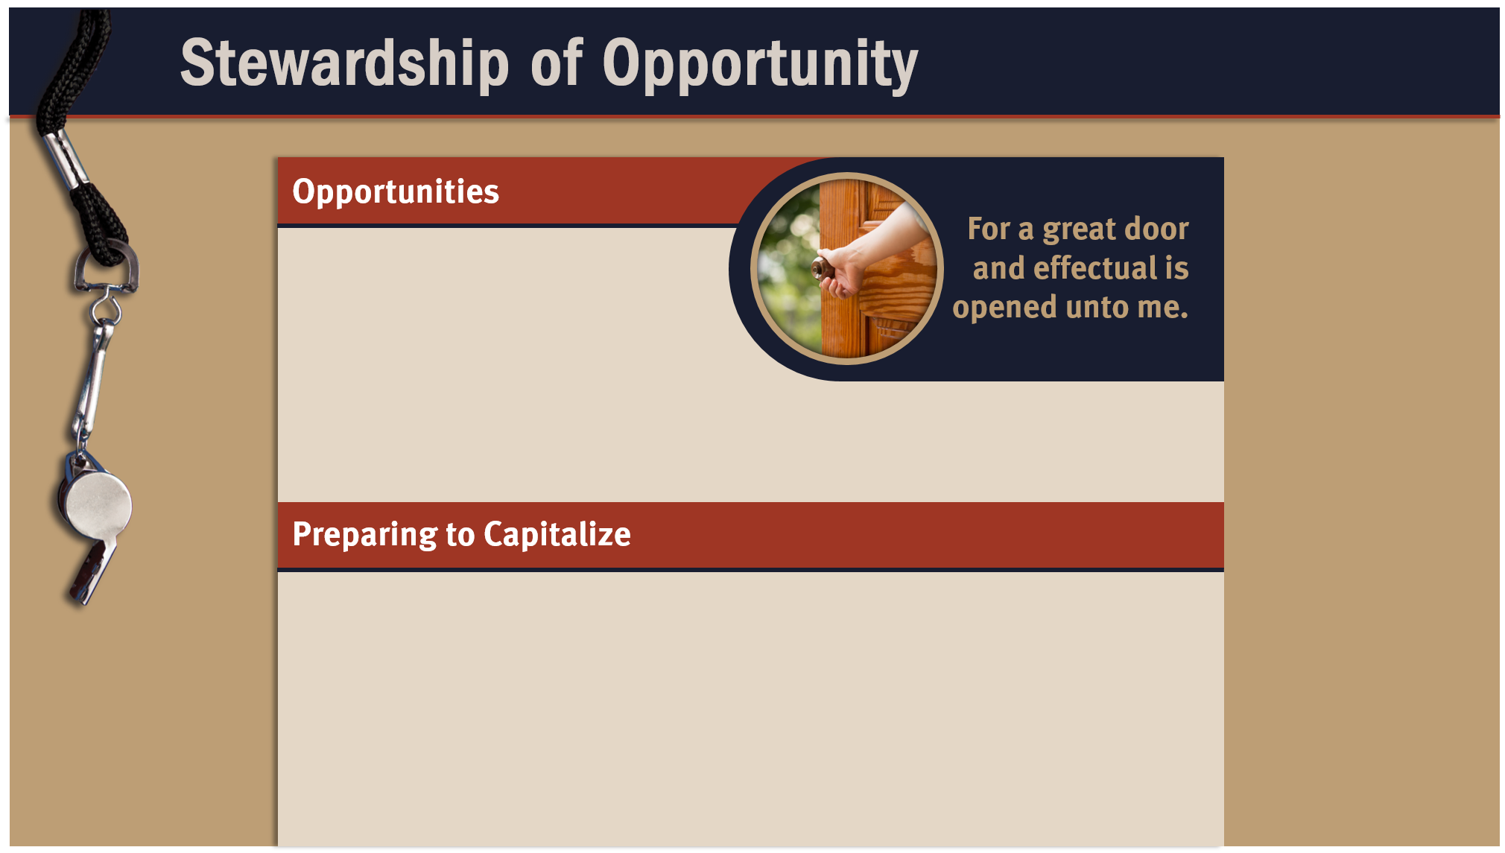
Type text here
Type text here
Type text here
Type text here
Type text here
Identify a common goal
Cooperate
Obey God’s Word
Love the lost
Develop and use of spiritual gifts

Slide 5
II. Stewardship of Opportunities (16:5–9)
A. Open doors (16:5–9a)
B. Opposition (16:9b)

Slide 6
III. Stewardship of Testimony (16:10–24)
A. Paul’s commendations (16:10–18)
B. Paul’s conclusion (16:19–24)

Slide 7
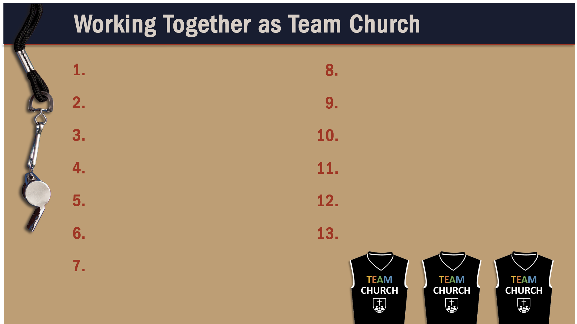
Glorify God as a godly team member.
Exercise liberty within the bounds of love.
Recognize the Spirit’s illumination ministry.
Worship God in harmony with fellow believers.
Depend of God’s wisdom for growth and ministry.
Use your spiritual gifts with love.
Serve God faithfully.
Edify fellow believers in your service for God.
Maintain a pure testimony.
Live in hope of Christ’s resurrection.
Reflect Christ in relating to believers.
Give faithfully to the Lord.
Honor and serve God no matter your lot in life.

