Slide 1


Slide 2
I. Christ’s Resurrection Is Real (15:1–11)
A. Christ’s resurrection is Scriptural (15:1–4)
B. Christ’s resurrection is substantiated
(15:5–11)

Slide 3
II. Christ’s Resurrection Gives Hope (15:12–57)
A. Emptiness of an occupied tomb
(15:12–19)
B. Fullness of an unoccupied tomb
(15:20–57)

Slide 4
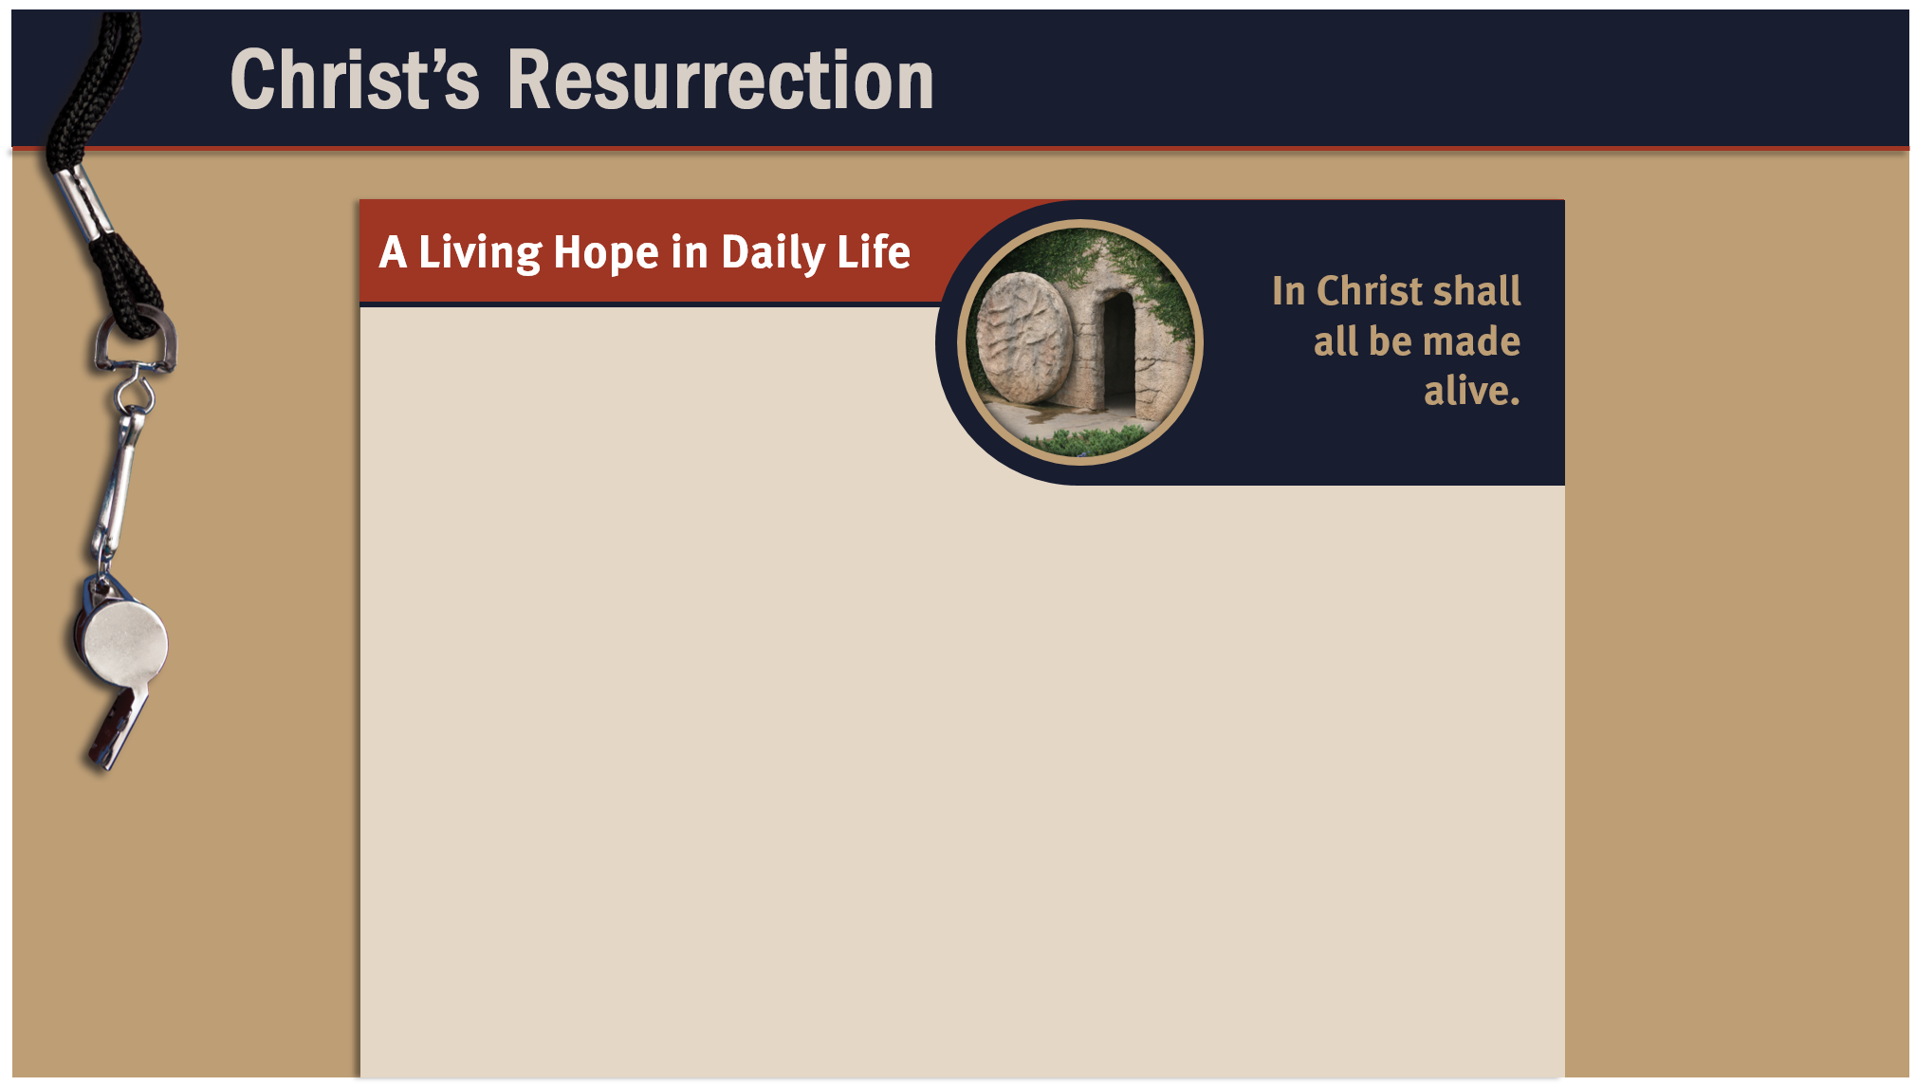
Hope during trials
Hope of a future in Heaven
Hope of being reunited with
loved ones
Hope of experiencing God’s sufficient grace always
Hope of deliverance from sin’s power and presence
Hope of eternal peace and overwhelming joy
Hope of an eternal opportunity to glorify God

Slide 5
III. Christ’s Resurrection Encourages Diligence
(15:58)
A. A steadfast perseverance
B. A sure promise

Slide 6
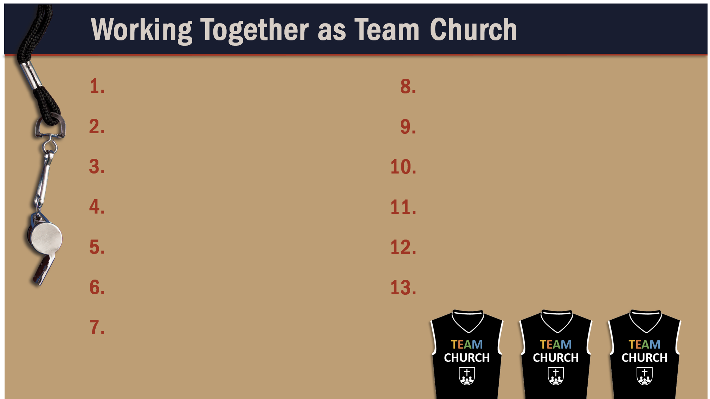
Glorify God as a godly team member.
Exercise liberty within the bounds of love.
Recognize the Spirit’s illumination ministry.
Worship God in harmony with fellow believers.
Depend of God’s wisdom for growth and ministry.
Use your spiritual gifts with love.
Serve God faithfully.
Edify fellow believers in your service for God.
Maintain a pure testimony.
Live in hope of Christ’s resurrection.
Reflect Christ in relating to believers.
Honor and serve God no matter your lot in life.

