Slide 1


Slide 2
I. A Priority Gift (14:1–5)
A. Its identity (14:1)
B. Its importance (14:2–5)

Slide 3
II. A Perspective about Tongues (14:6–12)
A. The clearly defined sound (14:7–9)
B. The intelligible language (14:10–12)

Slide 4
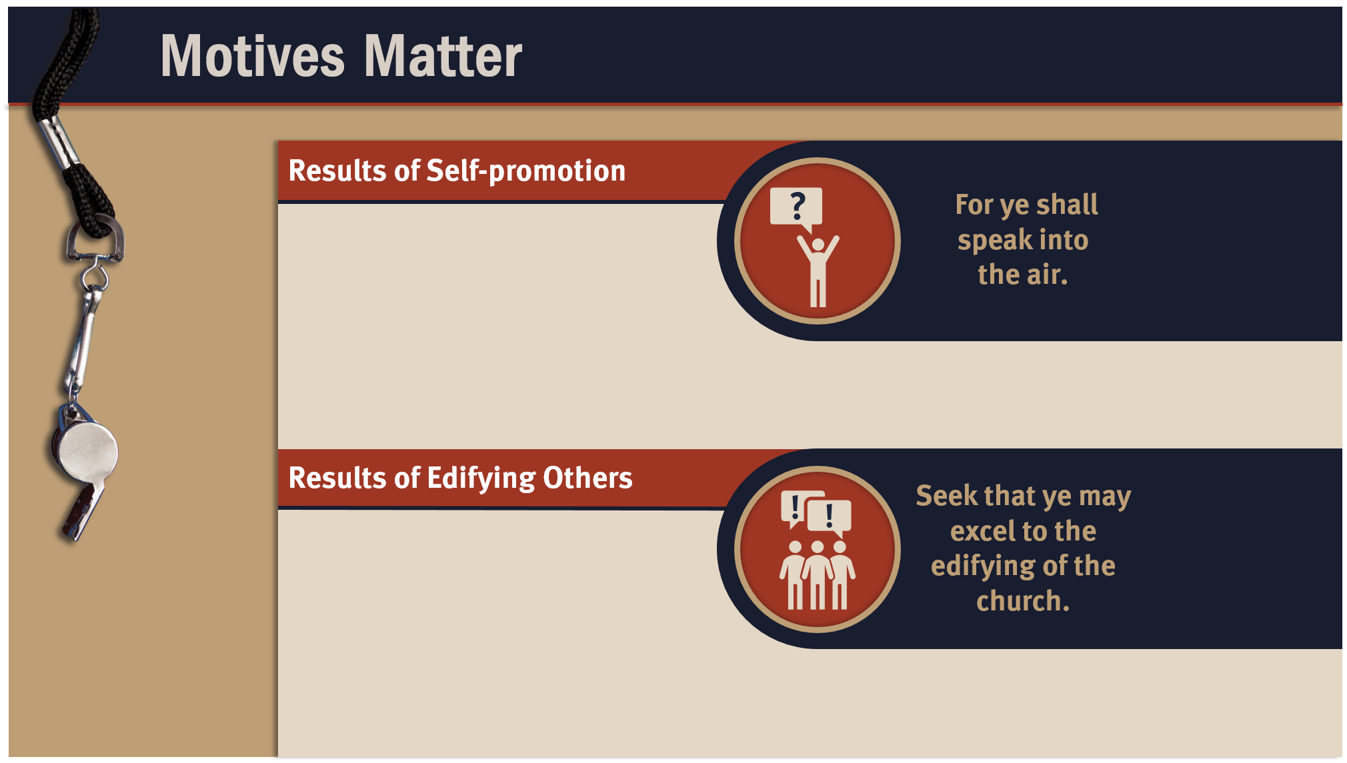
They fill with pride.
They compete for attention.
They become resentful when no one recognizes their work.
They select service opportunities based on their visibility.
The church grows stronger spiritually.
Believers are encouraged to use their spiritual gifts.
Souls are saved.
God is glorified.

Slide 5
III. A Procedure to Follow (14:13–40)
A. Interpretation (14:13–28)
B. Revelation (14:29–40)

Slide 6
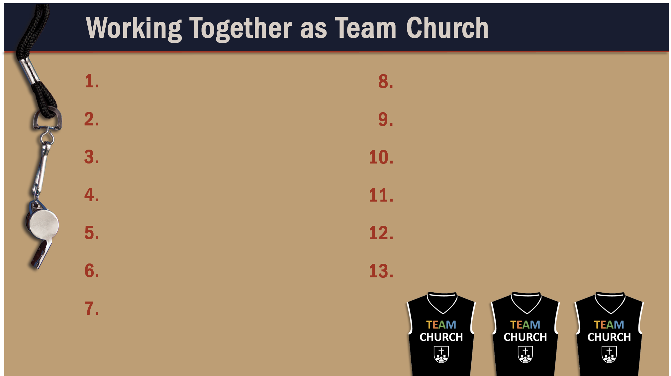
Glorify God as a godly team member.
Exercise liberty within the bounds of love.
Recognize the Spirit’s illumination ministry.
Worship God in harmony with fellow believers.
Depend of God’s wisdom for growth and ministry.
Use your spiritual gifts with love.
Serve God faithfully.
Edify fellow believers in your service for God.
Maintain a pure testimony.
Reflect Christ in relating to believers.
Honor and serve God no matter your lot in life.

