Slide 1


Slide 2
I. The Bestowing of Spiritual Gifts (12)
A. Their scope (12:1–10)
B. Their source (12:11)
C. Their synergy (12:12–31)

Slide 3
II. The Best Spiritual Gift (13)
A. Love excels (13:1–7)

Slide 4
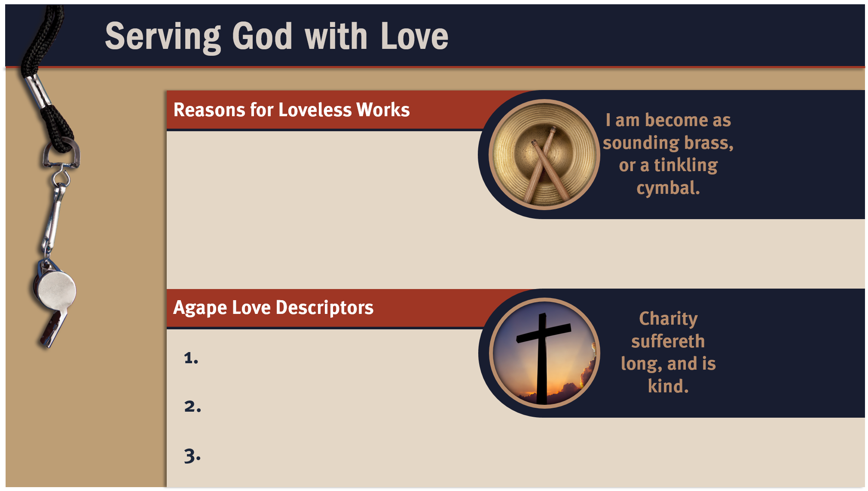
Fear of being disciplined
Guilty feelings
Competition with others
Desire to be recognized
Attempt to earn God’s grace
Sense of duty
Selfless
Pure
Effective

Slide 5
II. The Best Spiritual Gift (13)
A. Love excels (13:1–7)
B. Love endures (13:8–13)

Slide 6
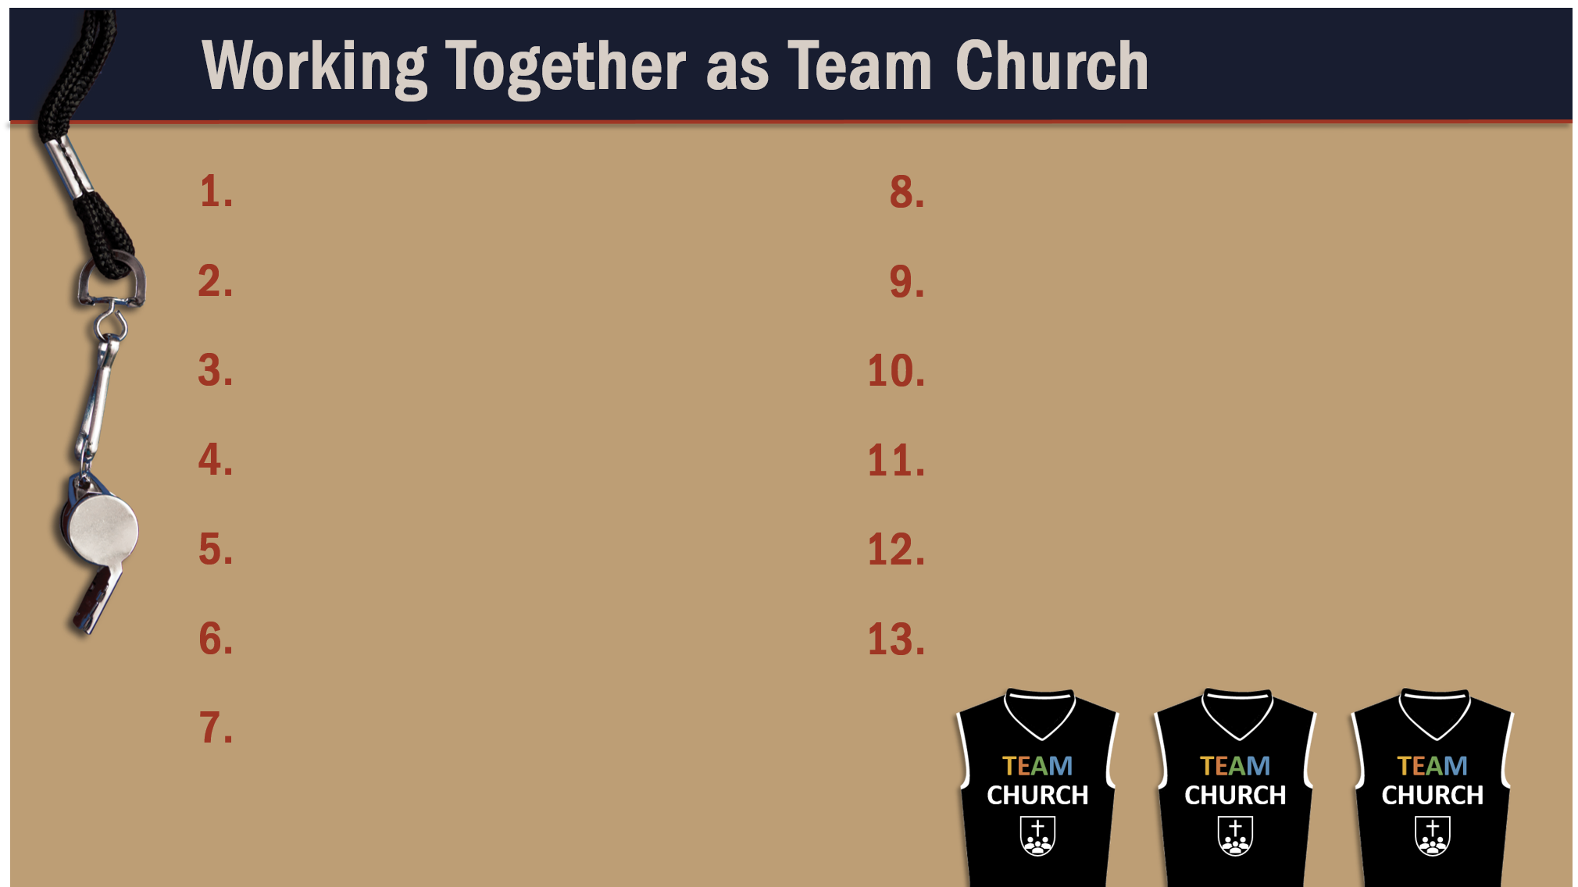
Glorify God as a godly team member.
Exercise liberty within the bounds of love.
Recognize the Spirit’s illumination ministry.
Worship God in harmony with fellow believers.
Depend of God’s wisdom for growth and ministry.
Use your spiritual gifts with love.
Serve God faithfully.
Maintain a pure testimony.
Reflect Christ in relating to believers.
Honor and serve God no matter your lot in life.

