Slide 1


Slide 2
I. Order in Worship (11:1–16)
A. Commendation (11:1, 2)
B. Correction (11:3–16)

Slide 3
II. Order at the Lord’s Table (11:17–34)
A. Prevailing disorders (11:17–22)
B. Prescribed order (11:23–26)
C. Prerequisite preparation (11:27–34)

Slide 4
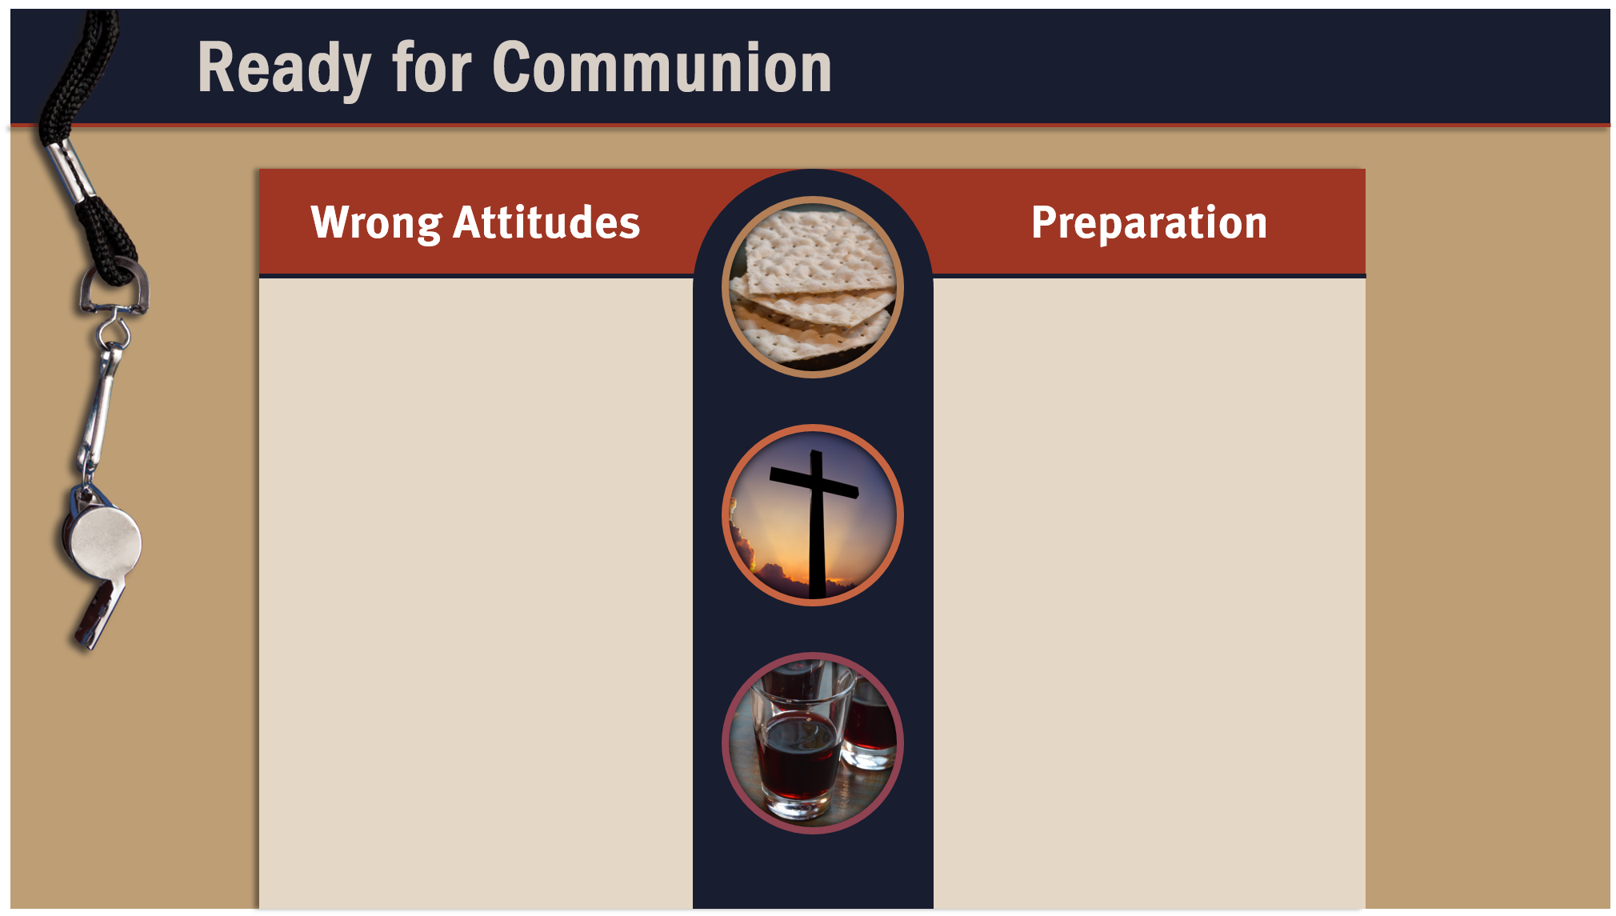
Pride
Envy
Covetousness
Insincerity
Unrepentant spirit
Hatred
Discontentment
Reading Scripture
Praying
Meditating on truth from God’s Word
Sincerely examining one’s heart
Settling differences with other believers
Remembering the suffering Christ endured

Slide 5
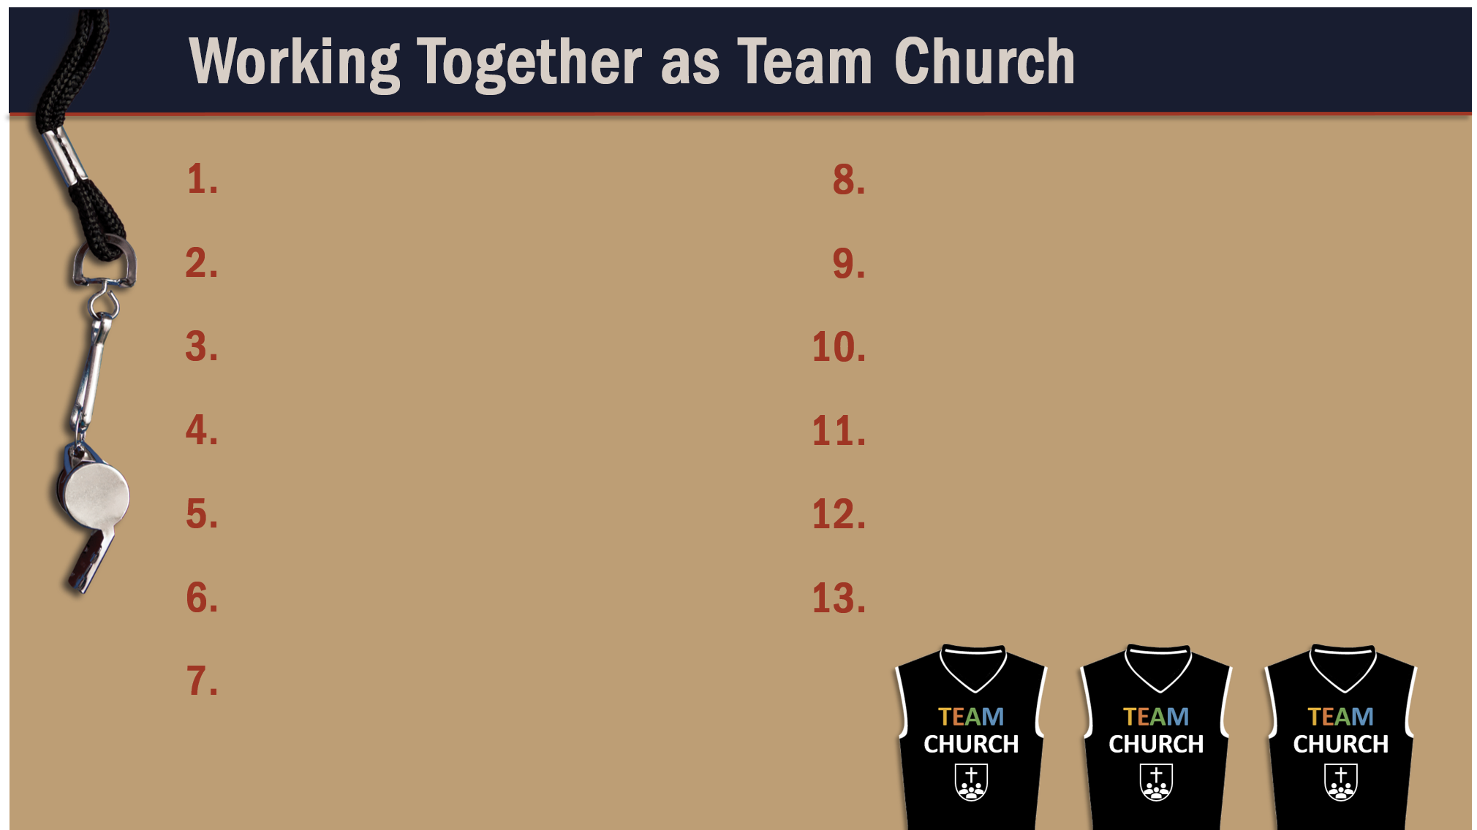
Glorify God as a godly team member.
Exercise liberty within the bounds of love.
Recognize the Spirit’s illumination ministry.
Worship God in harmony with fellow believers.
Depend of God’s wisdom for growth and ministry.
Serve God faithfully.
Maintain a pure testimony.
Reflect Christ in relating to believers.
Honor and serve God no matter your lot in life.

