Slide 1


Slide 2
I. Addressing Christian Liberty Problems
(8:1–8)
A. Knowledge is inadequate (8:1, 2)
B. Love is necessary (8:3–8)

Slide 3
II. Applying Christian Liberty Principles
(8:9—10:33)
A. Be considerate of weaker Christians
(8:9–13)
B. Exercise self-control (9:1–27)
C. Separate from sin (10:1–22)
D. Edify others (10:23, 24)
E. Keep a clear conscience (10:25–30)
F. Glorify God (10:31–33)

Slide 4
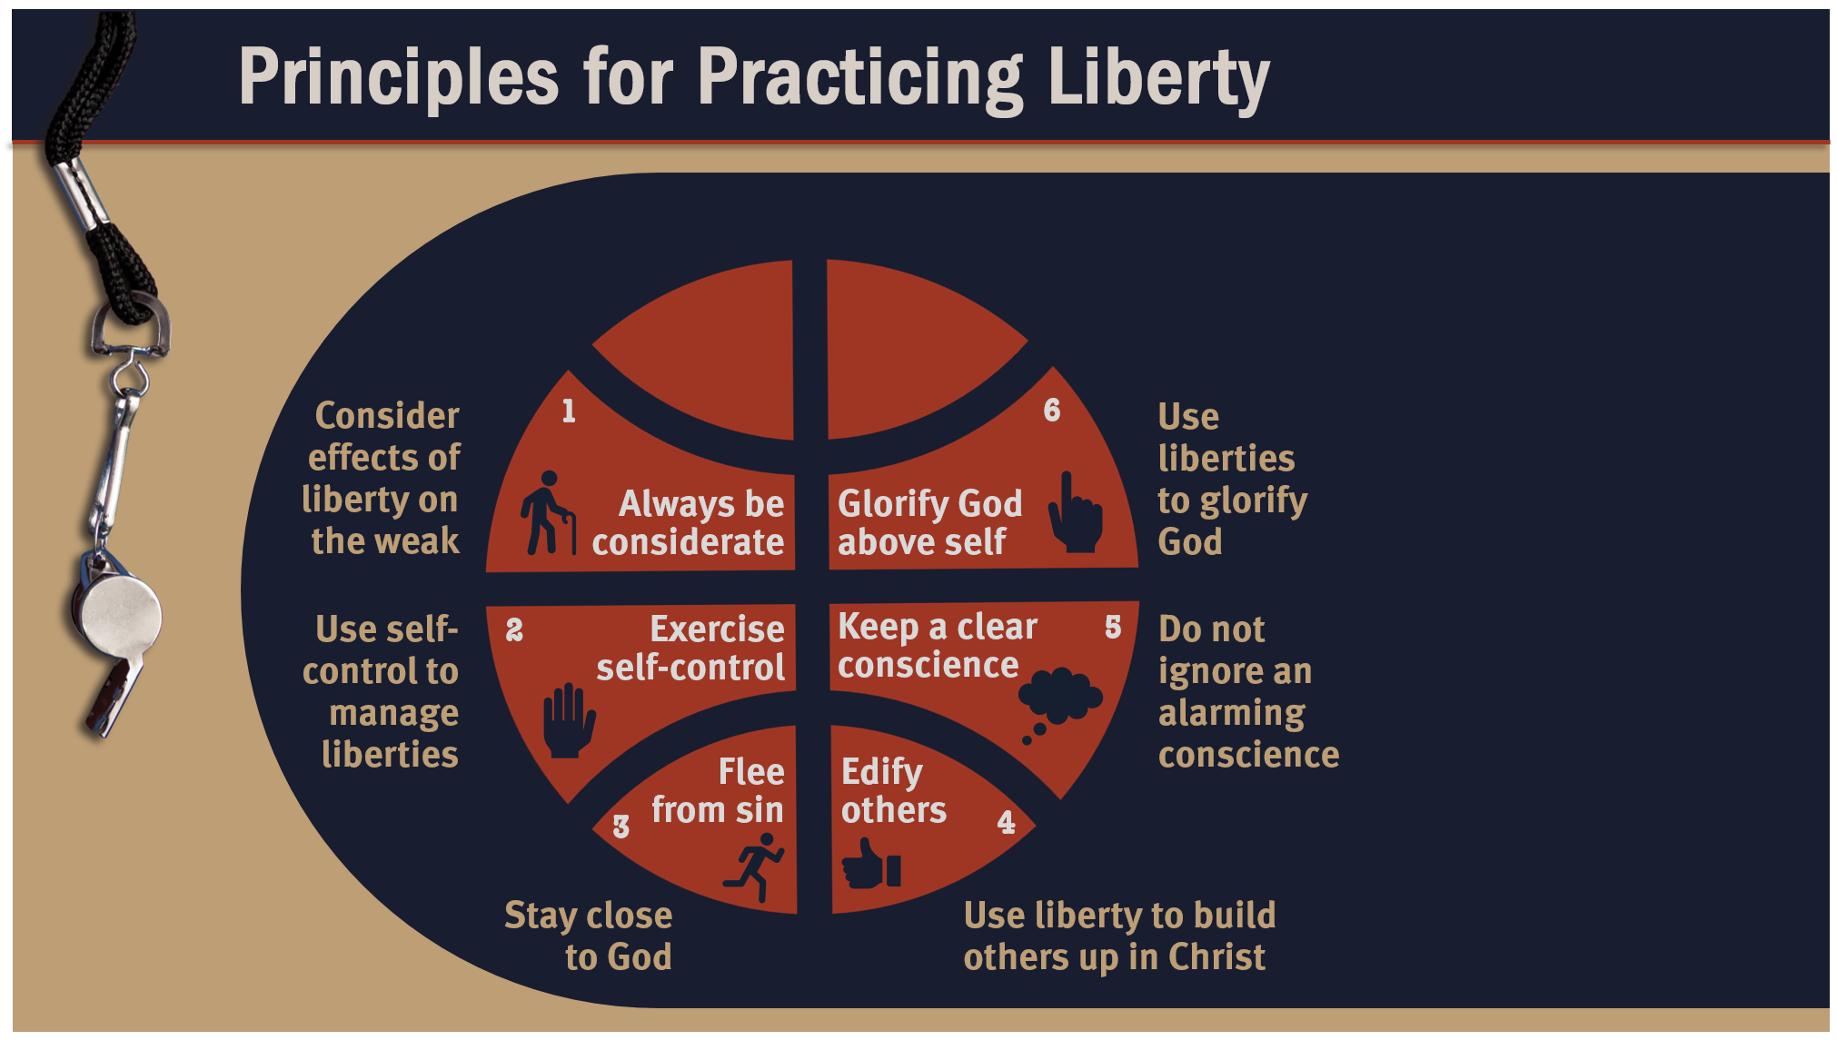

Slide 5
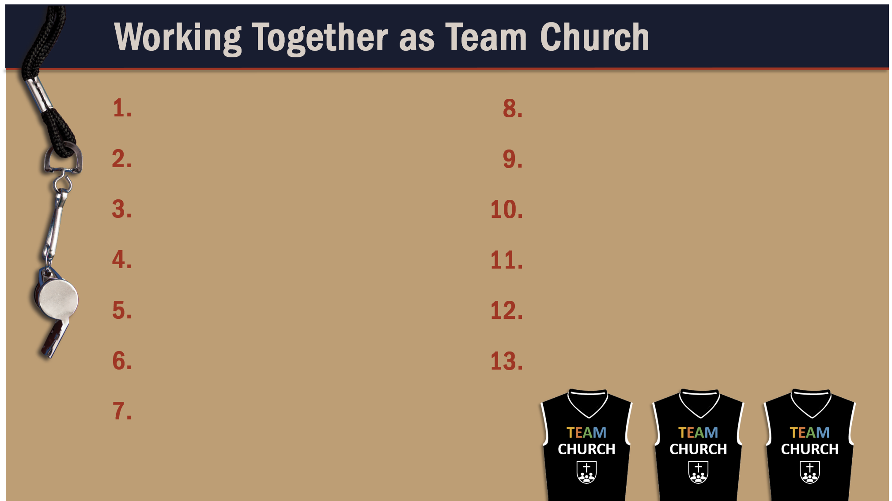
Glorify God as a godly team member.
Exercise liberty within the bounds of love.
Recognize the Spirit’s illumination ministry.
Depend of God’s wisdom for growth and ministry.
Serve God faithfully.
Maintain a pure testimony.
Reflect Christ in relating to believers.
Honor and serve God no matter your lot in life.

