Slide 1


Slide 2
I. Principles about Getting Married (7:1–9)
A. Marriage is normal (7:1, 2)
B. Marriage is a partnership (7:3–5)
C. Marriage is optional (7:6–9)

Slide 3
II. Principles about Staying Married (7:10–24)
A. Instructions for a believing couple
(7:10, 11)
B. Instructions for a believer married to an
unbeliever (7:12–24)

Slide 4
III. Principles about Singleness (7:25–38)
A. Free to stay single or to marry (7:25–28)
B. Free to serve the Lord (7:29–38)

Slide 5
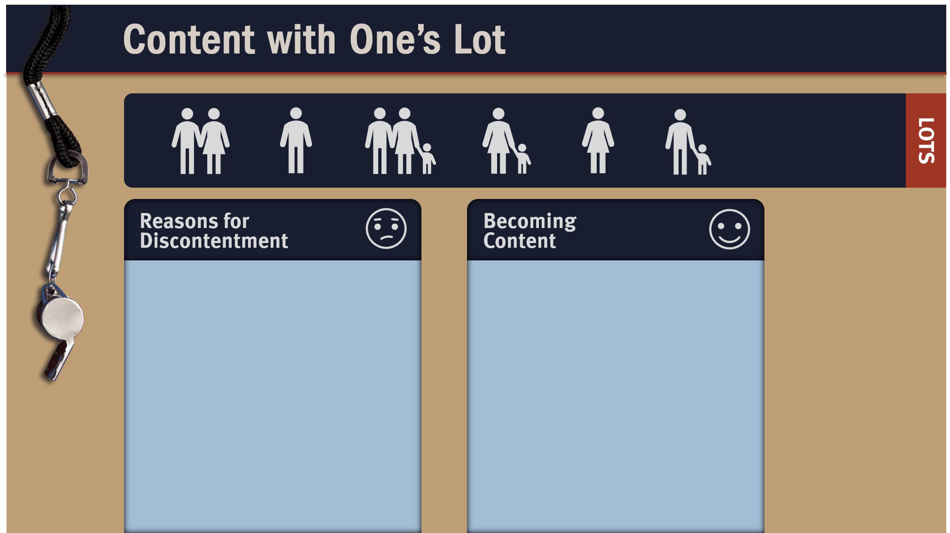
Pride
Jealousy
Envy
Covetousness
Setting selfish goals
Living according to your emotions
Keep eternity in view
Focus on serving others
Count your blessings
Rejoice in the Lord
Find your satisfaction in Christ

Slide 6
IV. Principles about Remarriage (7:39, 40)
A. Free to remarry after spouse dies (7:39)
B. Free to remarry in the Lord (7:39)
C. Free to remain unmarried (7:40)

Slide 7
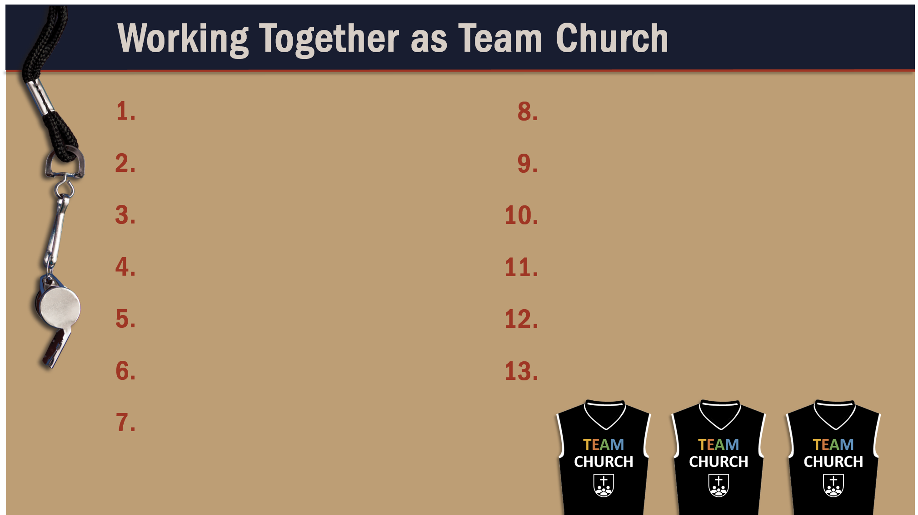
Glorify God as a godly team member.
Recognize the Spirit’s illumination ministry.
Depend of God’s wisdom for growth and ministry.
Serve God faithfully.
Maintain a pure testimony.
Reflect Christ in relating to believers.
Honor and serve God no matter your lot in life.

