Slide 1


Slide 2
I. Serious Problems (5:1, 2)
A. Gross immorality
B. Tolerance of sin

Slide 3
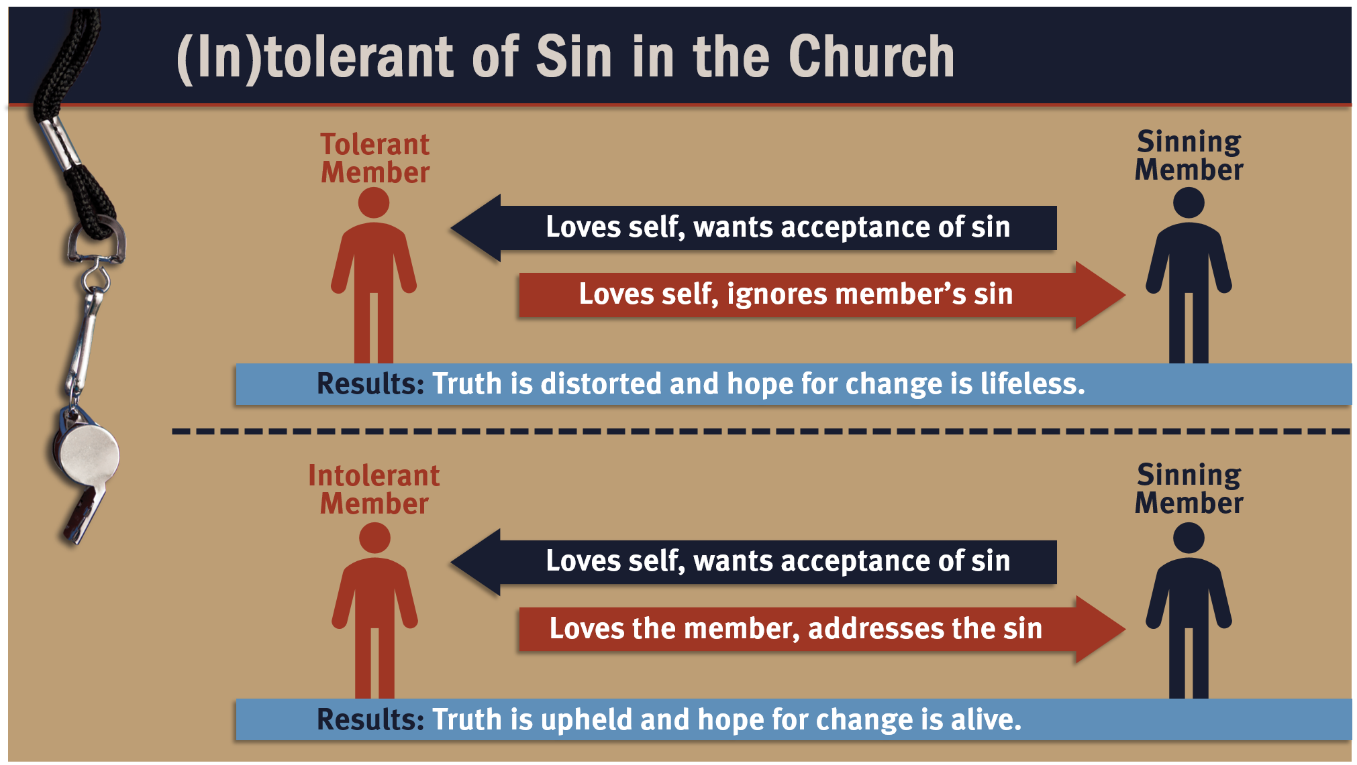

Slide 5
II. A Specific Procedure (5:3–5)
A. Paul’s role
B. The church’s role

Slide 6
III. A Solemn Principle (5:6)
A. The principle
B. The illustration

Slide 7
IV. Spiritual Purposes (5:7, 8)
A. Create a picture of the Passover

Slide 8
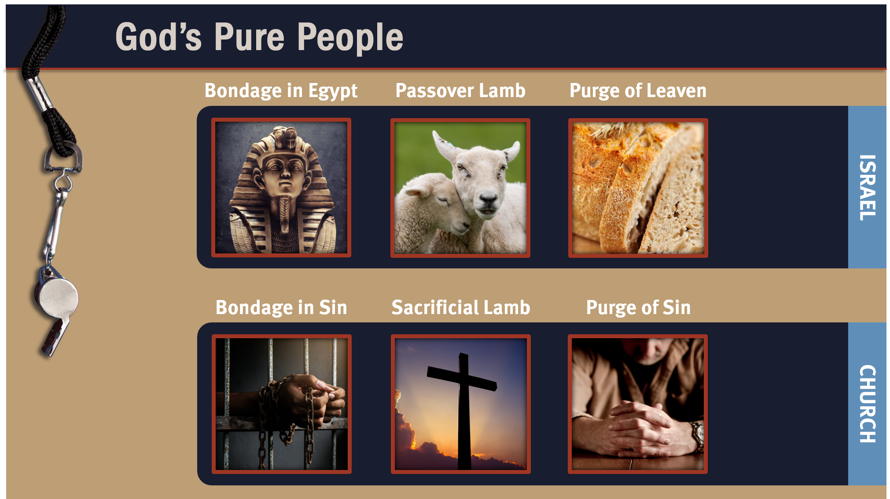

Slide 9
IV. Spiritual Purposes (5:7, 8)
A. Create a picture of the Passover
B. Purify God’s people

Slide 11
V. A Sensible Practice (5:9–13)
A. Disassociate from unrepentant members
B. Distinguish between the church and the
world

Slide 12
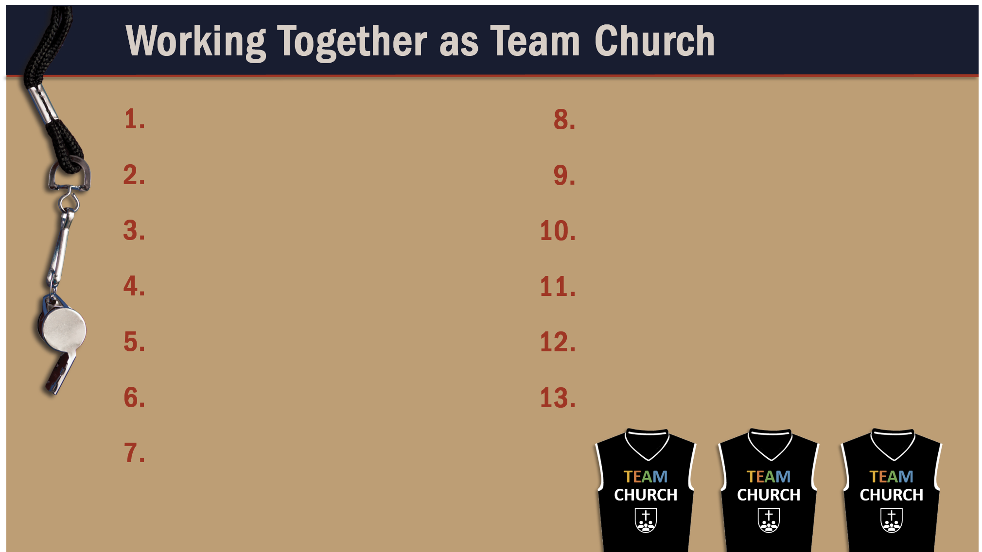
Glorify God as a godly team member.
Recognize the Spirit’s illumination ministry.
Depend of God’s wisdom for growth and ministry.
Serve God faithfully.
Maintain a pure testimony.

