Slide 1
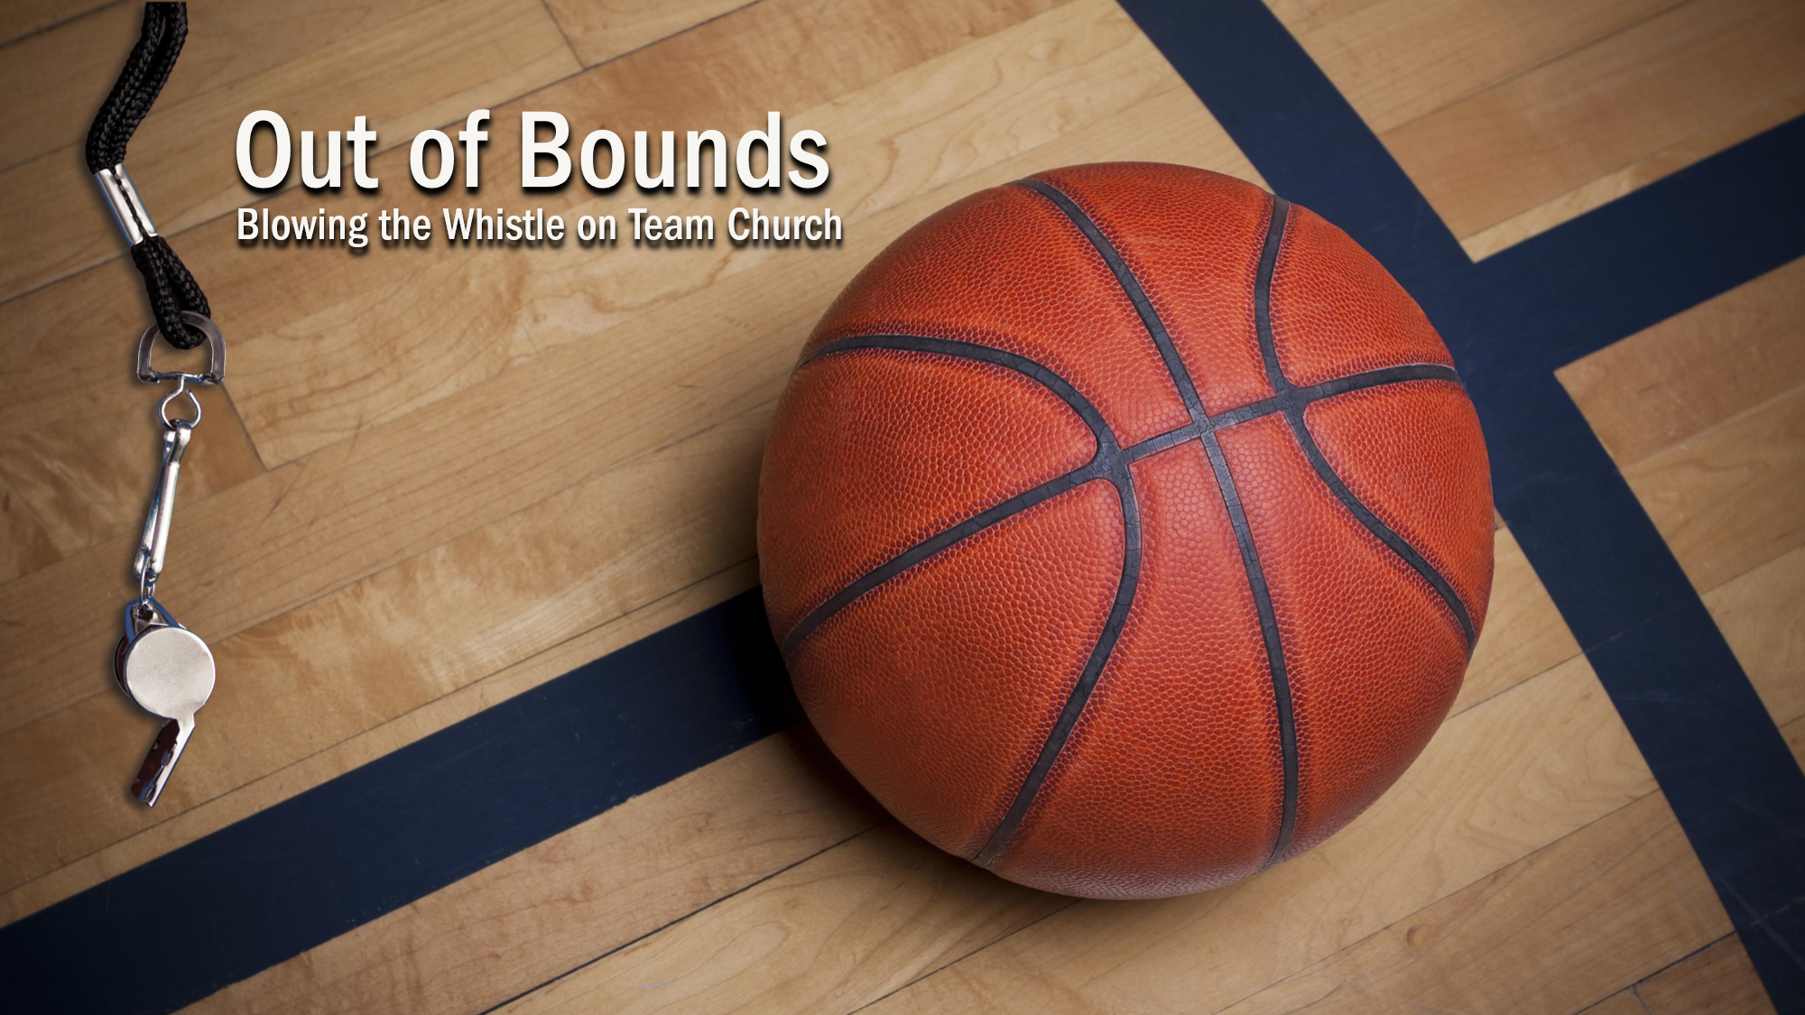

Slide 2
I. God Will Disclose Faithful Service (4:1–5)
A. Steward’s responsibility (4:1)

Slide 3
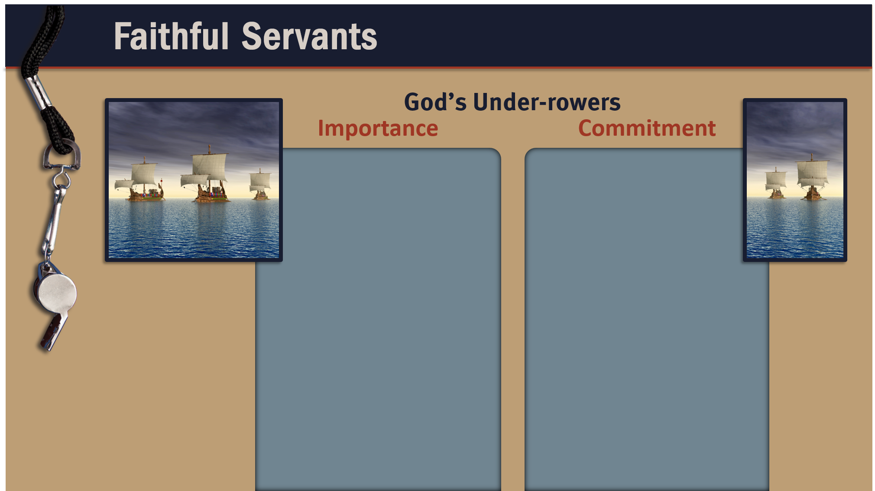
Everyone in the ship counted on the under-rowers to row hard and well.
Under-rowers had to serve with all their might and courage.
The difficulty of
rowing shows that commitment involves being faithful even when the task is hard.
The task of rowing demanded humility, which is intrinsic to faithfulness.

Slide 4
I. God Will Disclose Faithful Service (4:1–5)
A. Steward’s responsibility (4:1)
B. Steward’s requirement (4:2)
C. Steward’s reward (4:3–5)

Slide 5
II. Paul Demonstrated Faithful Service (4:9–13)
A. Paul’s purpose (4:6)
B. Corinth’s perception (4:7, 8)

Slide 6




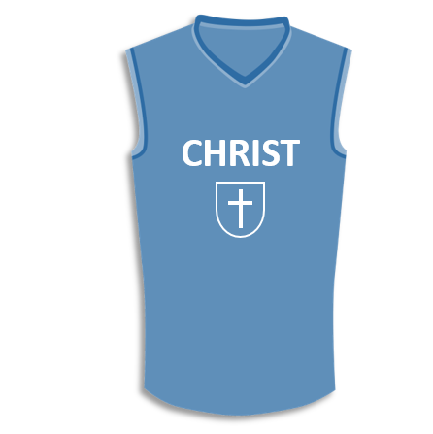

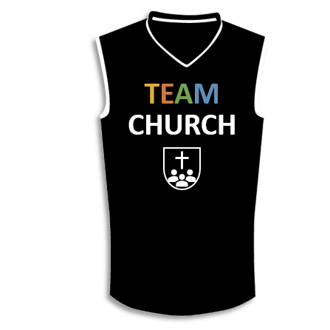



Slide 7
II. Paul Demonstrated Faithful Service (4:9–13)
A. Paul’s purpose (4:6)
B. Corinth’s perception (4:7, 8)
C. Apostles’ position (4:9–13)

Slide 8
III. Paul Demanded Faithful Service (4:14–21)
A. Paul’s intentions (4:14)
B. Paul’s instructions (4:15–17)
C. Paul’s intervention (4:18–21)

Slide 9
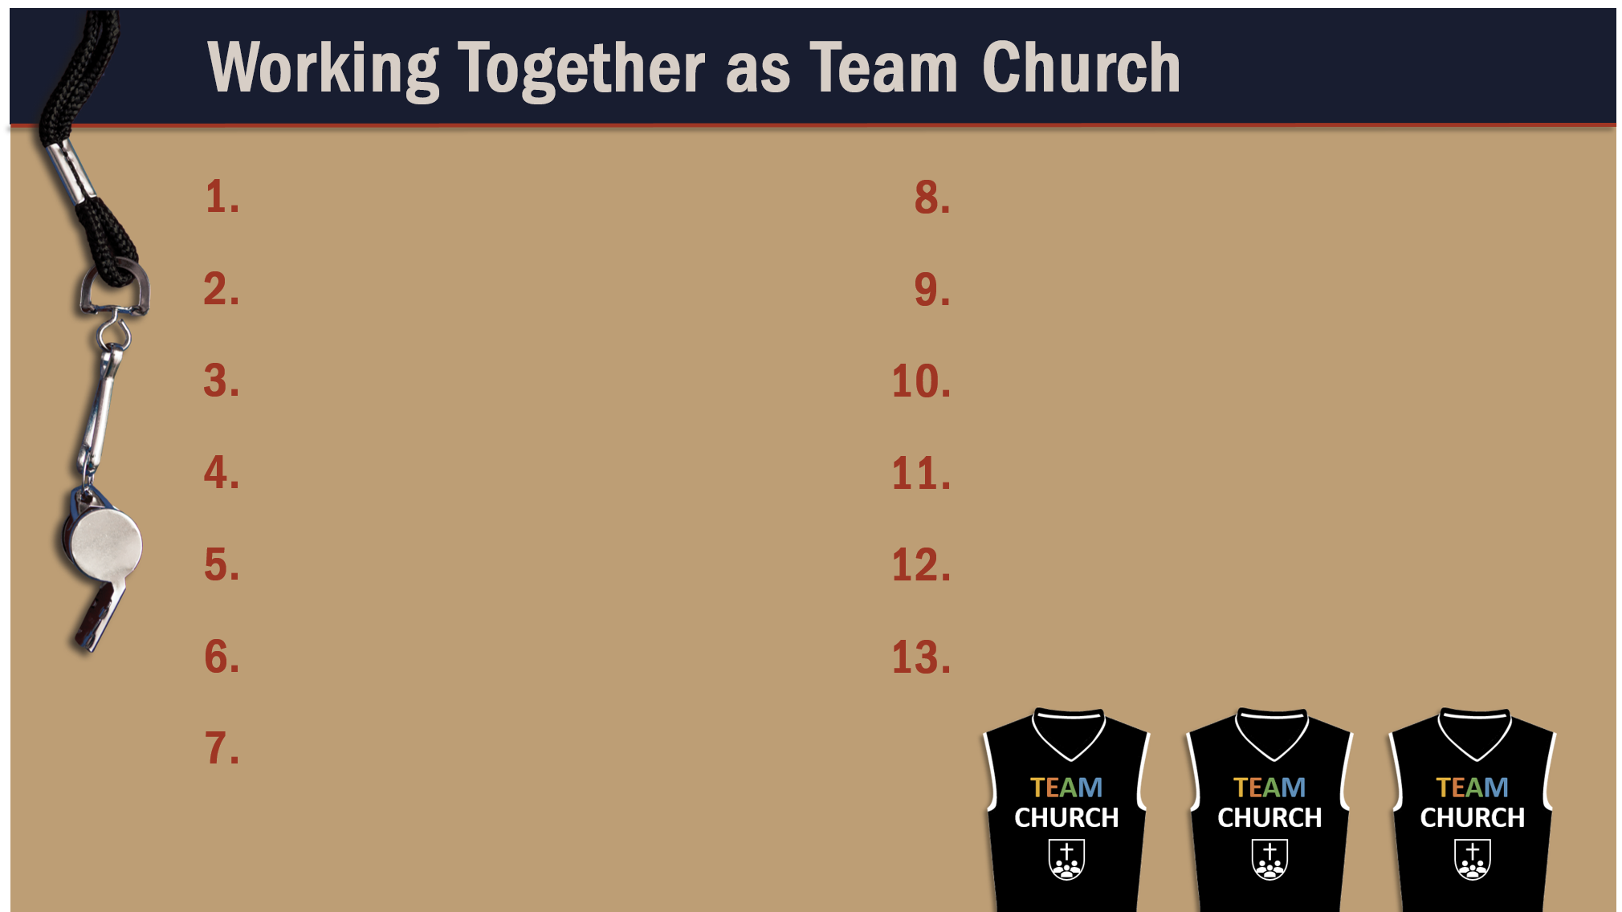
Glorify God as a godly team member.
Recognize the Spirit’s illumination ministry.
Depend of God’s wisdom for growth and ministry.
Serve God faithfully.

