Slide 1
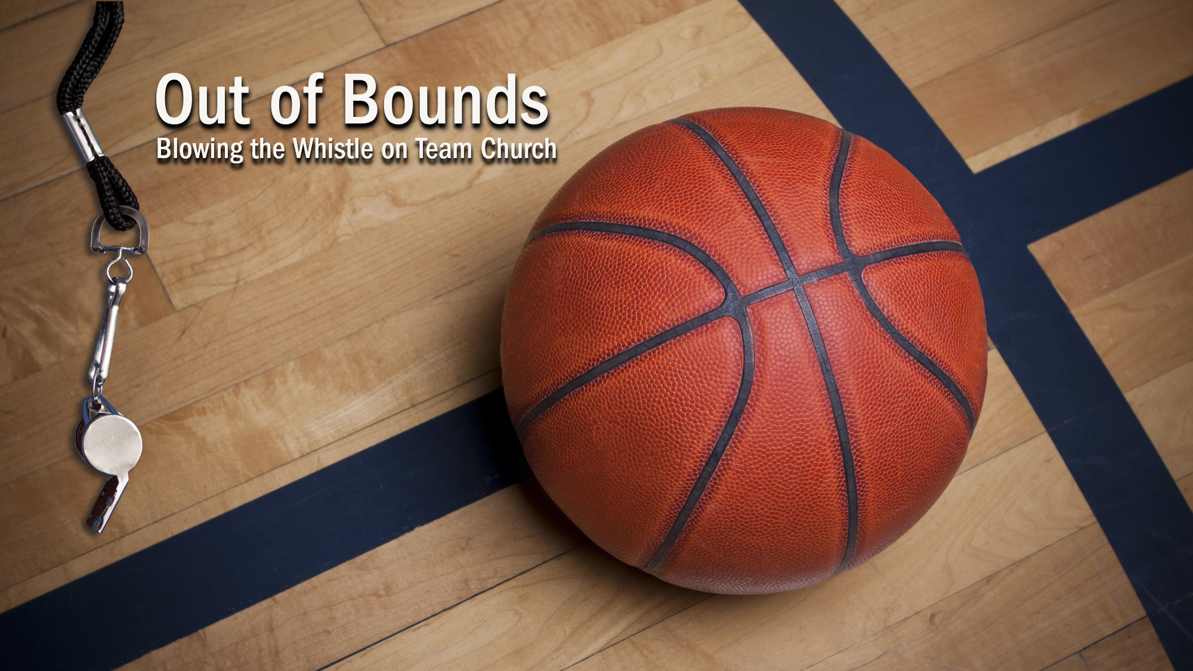

Slide 2
I. Resolving Disputes (6:1–11)
A. A shameful practice (6:1–7a)
B. A selfless principle (6:7b, 8)
C. A sobering point (6:9–11)

Slide 3
II. Maintaining Distinctiveness (6:12–20)
A. Maintain godly purity (6:12–18)

Slide 4
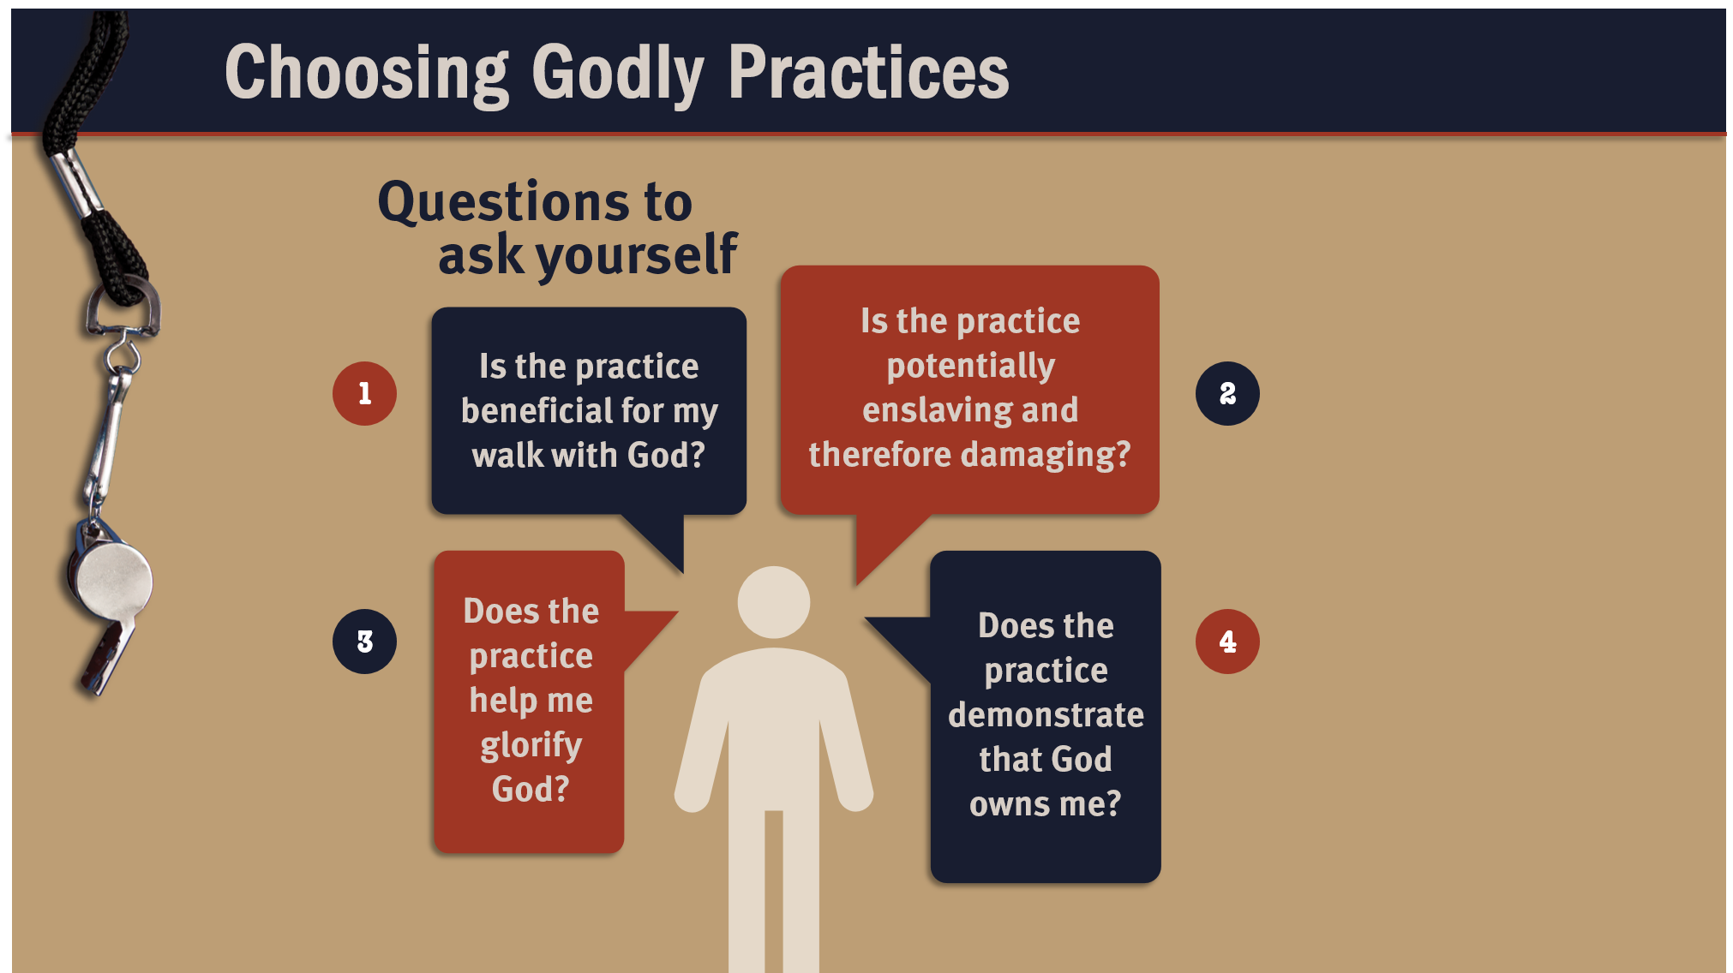

Slide 5
II. Maintaining Distinctiveness (6:12–20)
A. Maintain godly purity (6:12–18)
B. Maintain a godly ambition (6:19, 20)

Slide 6
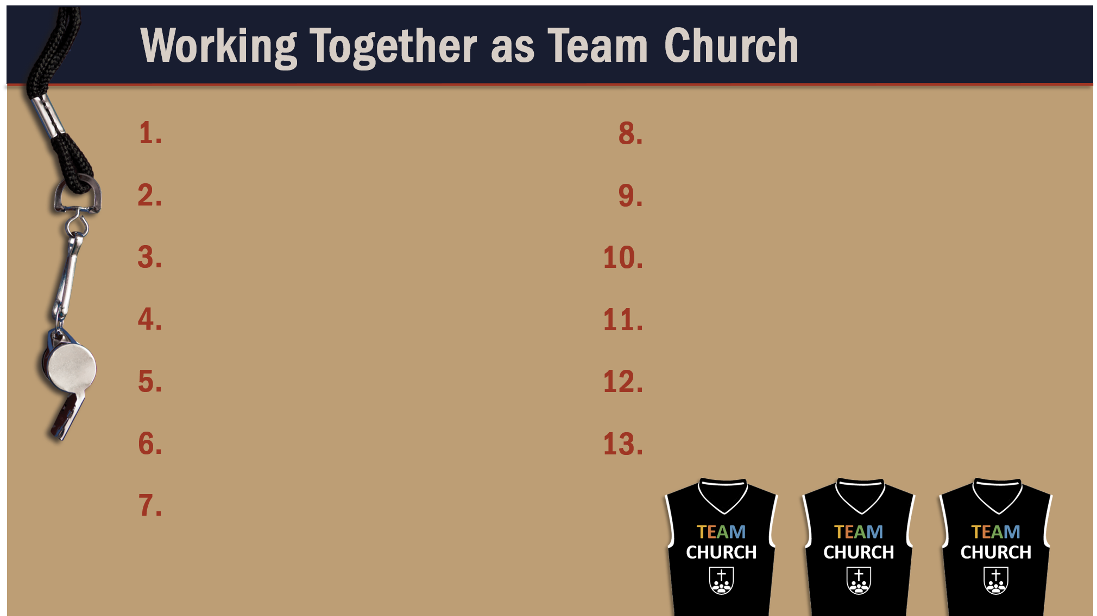
Glorify God as a godly team member.
Recognize the Spirit’s illumination ministry.
Depend of God’s wisdom for growth and ministry.
Serve God faithfully.
Maintain a pure testimony.
Reflect Christ in relating to believers.

