Slide 1


Slide 2
I. The Confronter (2 Cor. 7:2–9)
A. Genuine life (7:2)
B. Genuine love (7:3)
C. Guarded lips (7:8, 9)

Slide 3
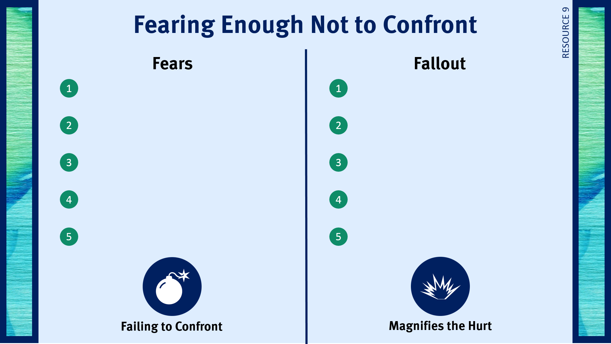
Being criticized by the person.
The sins progresses in the individual.
Appearing to be spiritually superior.
The sin destroys relationships.
Losing a friendship.
The sin ruins the person’s testimony.
Appearing to be nosy.
The sin robs God of His glory.
Coming across as condescending.
The sin spreads to others.

Slide 4
II. The Confronted (2 Cor. 7:9–11)
A. Genuine sorrow (7:9, 10)
B. Genuine repentance (7:11)

Slide 5
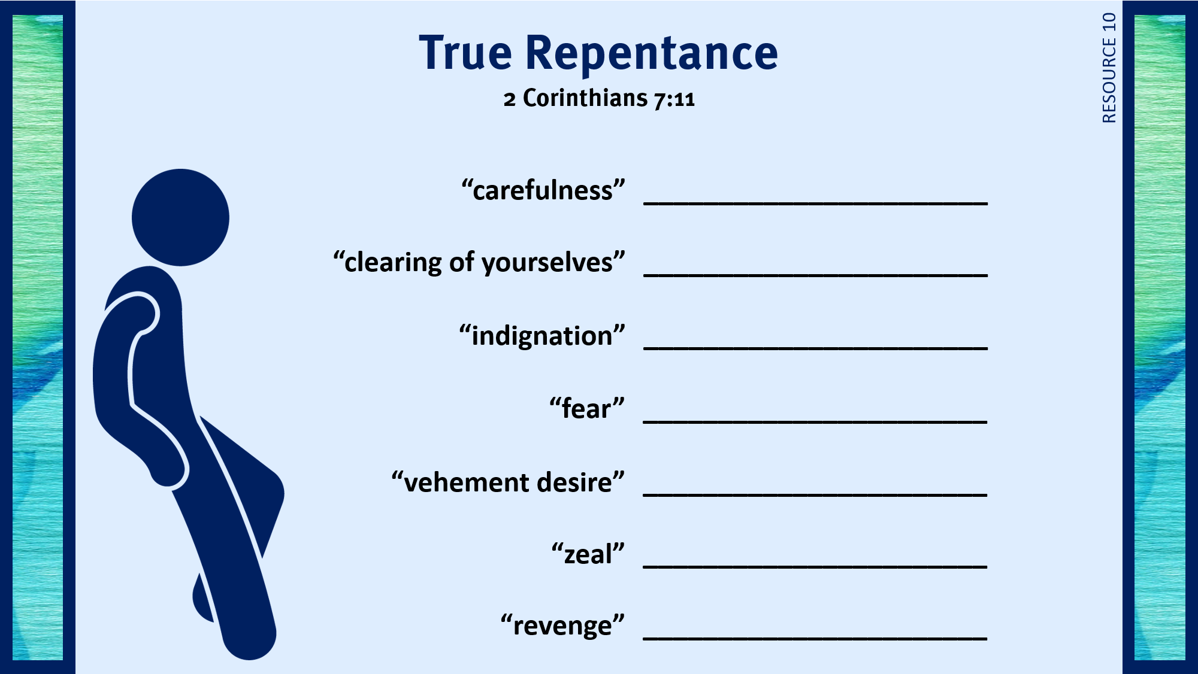
diligent
real and true
embarrassed
respect for God
ready for restoration
earnestness
just

Slide 6
III. The Consequences (2 Cor. 7:12–16)
A. Care is shown (7:12)
B. Comfort is shared (7:13)
C. Confidence is stated (7:14–16)

Slide 7
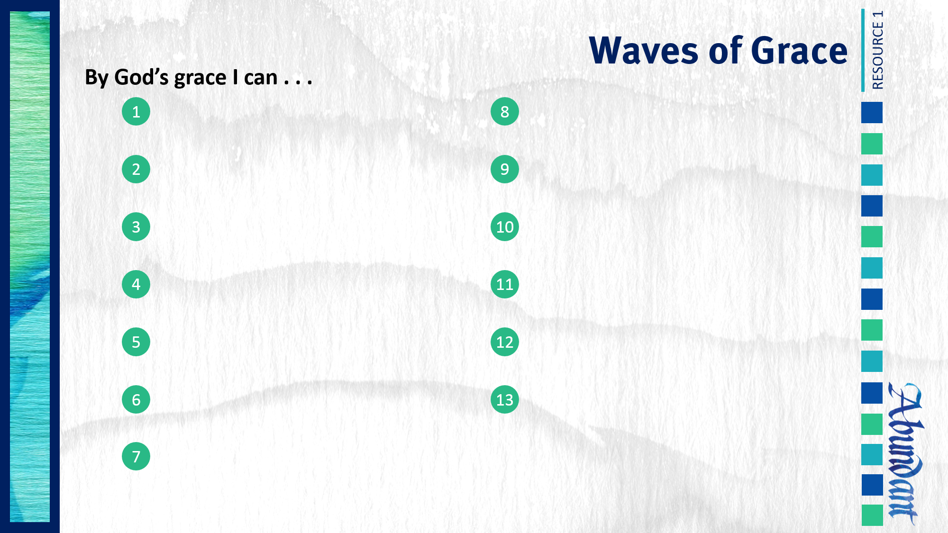
Respond to trials with peace and confidence.
Practice repentance.
Live in the sight of God.
Use my liberty in Christ to do God’s will.
Share the light of my treasure.
Anticipate eternity by serving God.
Exhibit excellence as Christ’s ambassador.
Separate from sin and apostasy.

