Slide 1


Slide 2
I. Fellowship with Believers (2 Cor. 6:11–13)
A. Paul’s openness (6:11, 12)
B. Paul’s plea (6:12, 13)

Slide 3
II. Avoid Partnerships with Unbelievers (2 Cor. 6:14–17)
A. The inevitable compromise (6:14)
B. The obvious contrasts (6:14–16)
C. The practical implications (6:14–16)
1. Religious alliances

Slide 4
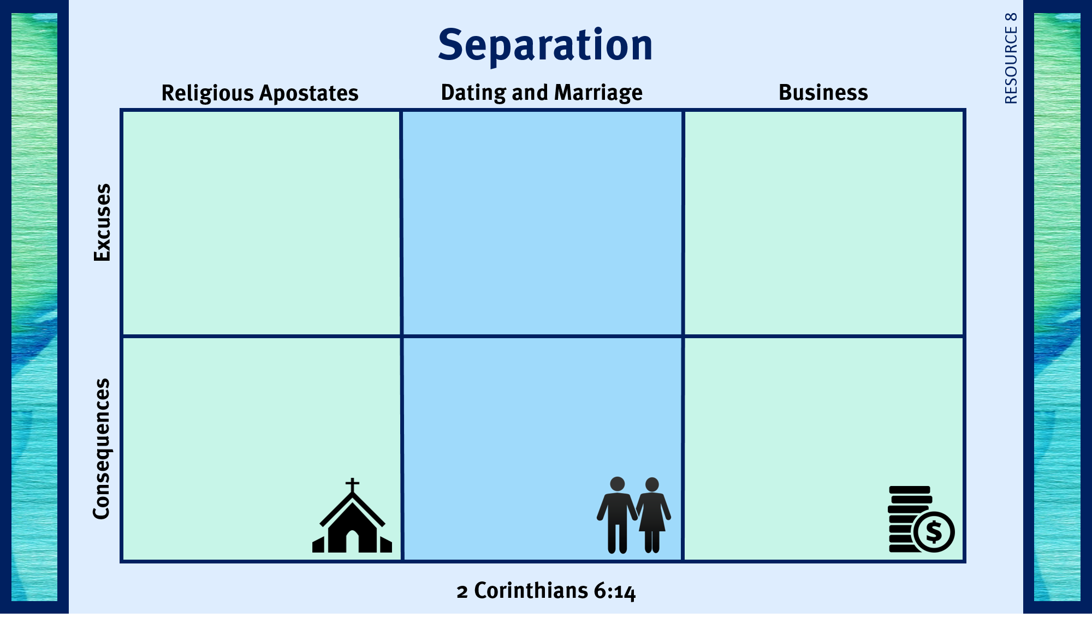
We are all serving the same God.
Cooperating helps us build community relationships.
We don’t want to be offensive.
Undermining the truth.
Generations to come leave the faith.
Testimony is weakened.

Slide 5
II. Avoid Partnerships with Unbelievers (2 Cor. 6:14–17)
A. The inevitable compromise (6:14)
B. The obvious contrasts (6:14–16)
C. The practical implications (6:14–16)
1. Religious alliances
2. Dating and marriage

Slide 6
We are all serving the same God.
Cooperating helps us build community relationships.
We don’t want to be offensive.
I am trying to win my boyfriend to Christ.
My girlfriend is nice.
I don’t know any Christians my age.
We don’t plan to marry.
Undermining the truth.
Generations to come leave the faith.
Testimony is weakened.
Compromise in other areas of life.
Shallow relationship.
Disagreements over important
decisions.

Slide 7
II. Avoid Partnerships with Unbelievers (2 Cor. 6:14–17)
A. The inevitable compromise (6:14)
B. The obvious contrasts (6:14–16)
C. The practical implications (6:14–16)
1. Religious alliances
2. Dating and marriage
3. Business partnerships

Slide 8
We are all serving the same God.
Cooperating helps us build community relationships.
We don’t want to be offensive.
I am trying to win my boyfriend to Christ.
My girlfriend is nice.
I don’t know any Christians my age.
We don’t plan to marry.
I have no other options.
I will earn more money to give to the Lord.
My business partner is respectful of my views.
Undermining the truth.
Generations to come leave the faith.
Testimony is weakened.
Compromise in other areas of life.
Shallow relationship.
Disagreements over important
decisions.
Compromise in order to avoid disagreements.
Testimony is hampered.
Possible problems with the law.

Slide 9
II. Avoid Partnerships with Unbelievers (2 Cor. 6:14–17)
A. The inevitable compromise (6:14)
B. The obvious contrasts (6:14–16)
C. The practical implications (6:14–16)
1. Religious alliances
2. Dating and marriage
3. Business partnerships
D. The clear command (6:17)

Slide 10
III. God’s Promises to Separated Believers (2 Cor. 6:16—7:1)
A. The promises (6:16–18)
B. The response (7:1)

Slide 11

Respond to trials with peace and confidence.
Live in the sight of God.
Use my liberty in Christ to do God’s will.
Share the light of my treasure.
Anticipate eternity by serving God.
Exhibit excellence as Christ’s ambassador.
Separate from sin and apostasy.

