Slide 1


Slide 2
I. The Ambassador’s Work (2 Cor. 5:16—6:2)
A. Message (5:16, 17)
B. Ministry (5:18—6:2)

Slide 3
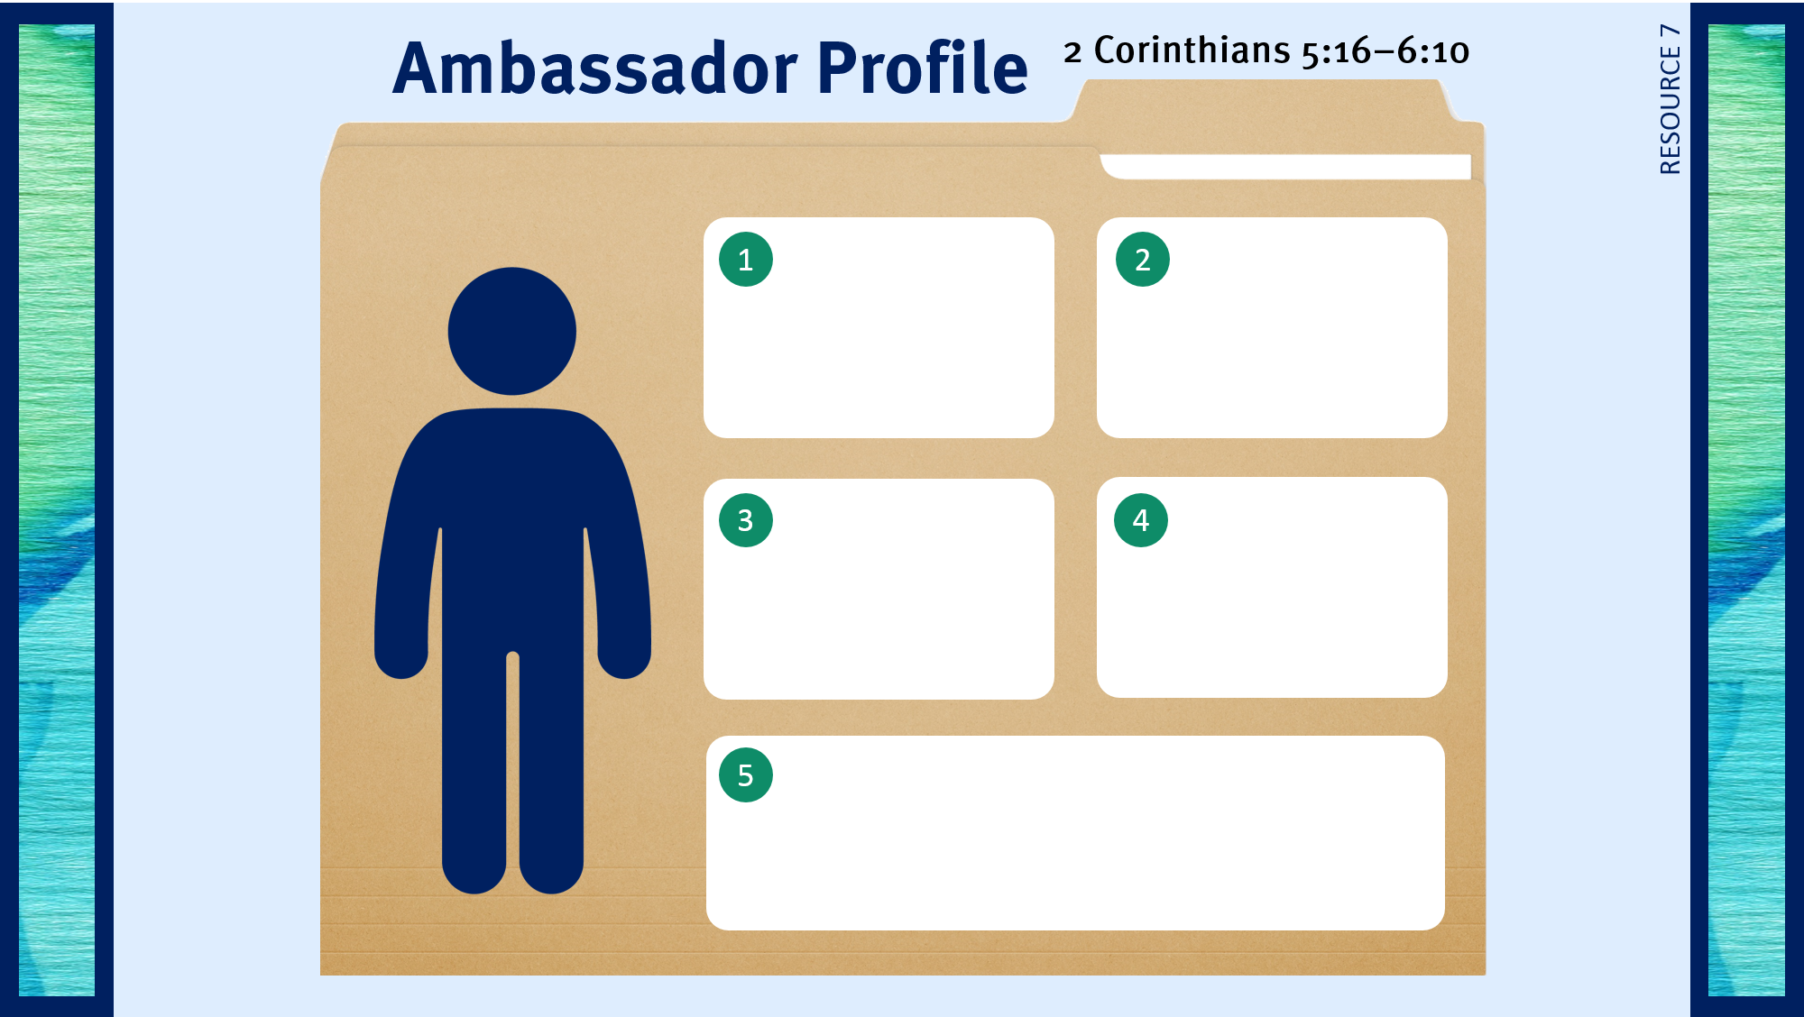
Serves as a minister of reconciliation.

Slide 4
II. The Ambassador’s Example (2 Cor. 6:3–10)
A. His blameless life (6:3)
B. His hardships (6:4, 5)

Slide 5
Serves as a minister of reconciliation.
Responds to God’s leading.
Takes the job seriously.

Slide 6
II. The Ambassador’s Example (2 Cor. 6:3–10)
A. His blameless life (6:3)
B. His hardships (6:4, 5)
C. His spiritual qualities (6:6, 7)

Slide 7
Serves as a minister of reconciliation.
Responds to God’s leading.
Takes the job seriously.
Lives an exemplary life.

Slide 8
II. The Ambassador’s Example (2 Cor. 6:3–10)
A. His blameless life (6:3)
B. His hardships (6:4, 5)
C. His spiritual qualities (6:6, 7)
D. His consistency (6:8–10)

Slide 9
Serves as a minister of reconciliation.
Responds to God’s leading.
Takes the job seriously.
Lives an exemplary life.
Endures criticism patiently.

Slide 10

Respond to trials with peace and confidence.
Live in the sight of God.
Use my liberty in Christ to do God’s will.
Share the light of my treasure.
Anticipate eternity by serving God.
Exhibit excellence as Christ’s ambassador.

