Slide 1


Slide 2
I. The Prospect of a Glorified Body (2 Cor. 5:1–8)
A. The temporal tent versus the heavenly house (5:1)
B. The groaning and desire (5:2–4)
C. The down payment (5:5)
D. The confident believer’s preference (5:6–8)

Slide 3
II. The Motivations for Present Service (2 Cor. 5:9–15)
A. To please the Lord (5:9)
B. The Judgment Seat of Christ (5:10)

Slide 4
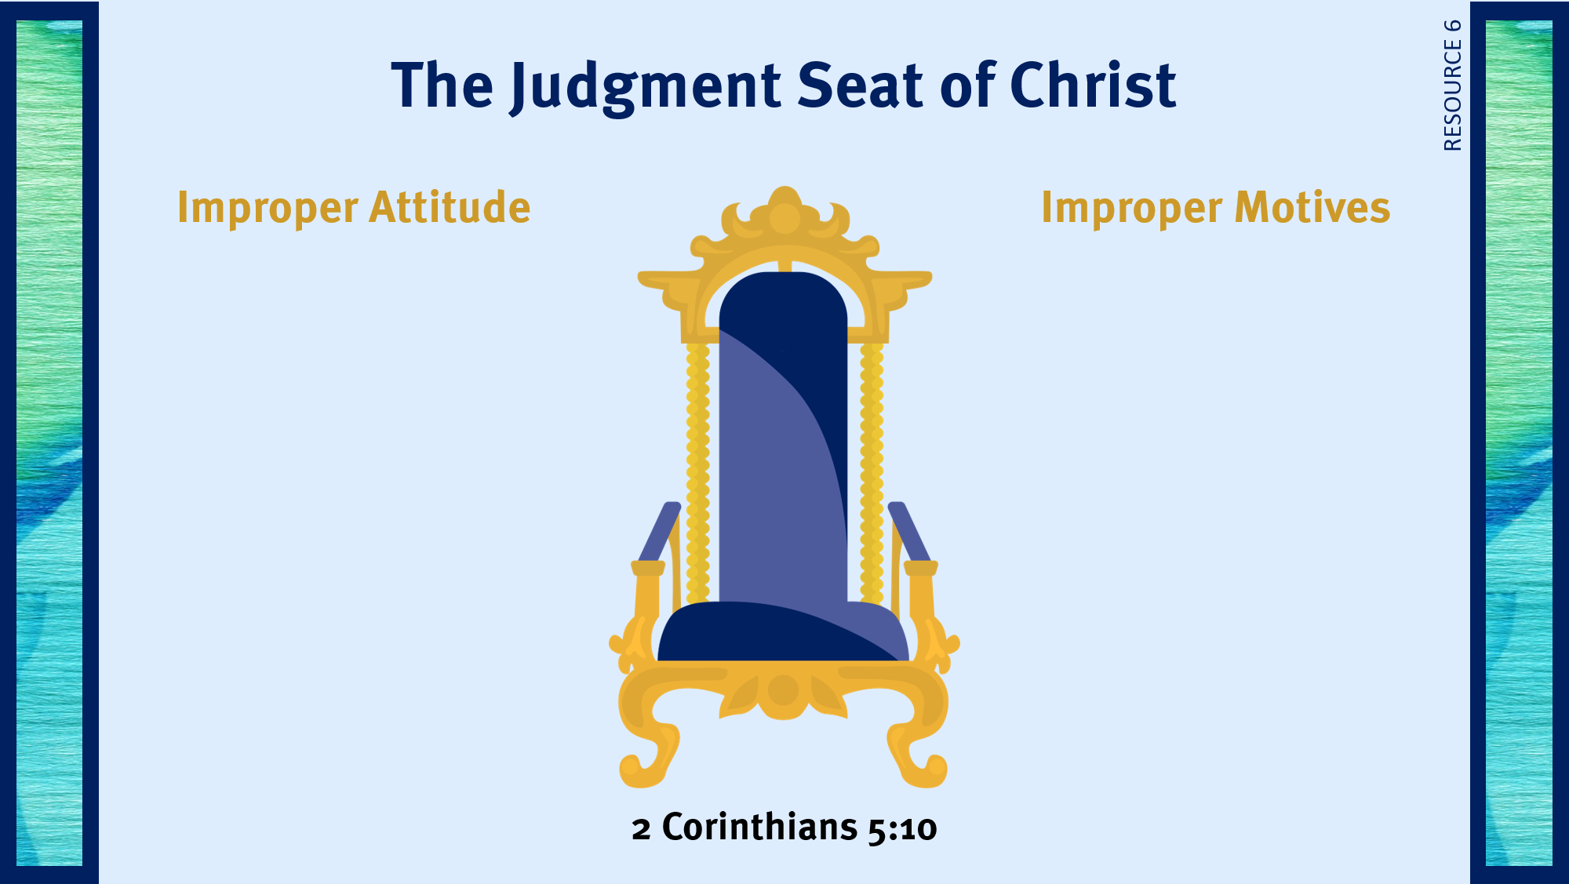
Serving out of obligation.
Serving self-righteously.
Serving out of pride.
Serving out of self-confidence.
Serving to gain complements.
Serving to appear righteous.
Serving for financial gain.
Serving for fame.
Serving to shame others.

Slide 5
II. The Motivations for Present Service (2 Cor. 5:9–15)
A. To please the Lord (5:9)
B. The Judgment Seat of Christ (5:10)
C. The fear of the Lord (5:11–14)
D. The love of Christ (5:14)
E. The lostness of the unsaved (5:14, 15)

Slide 6
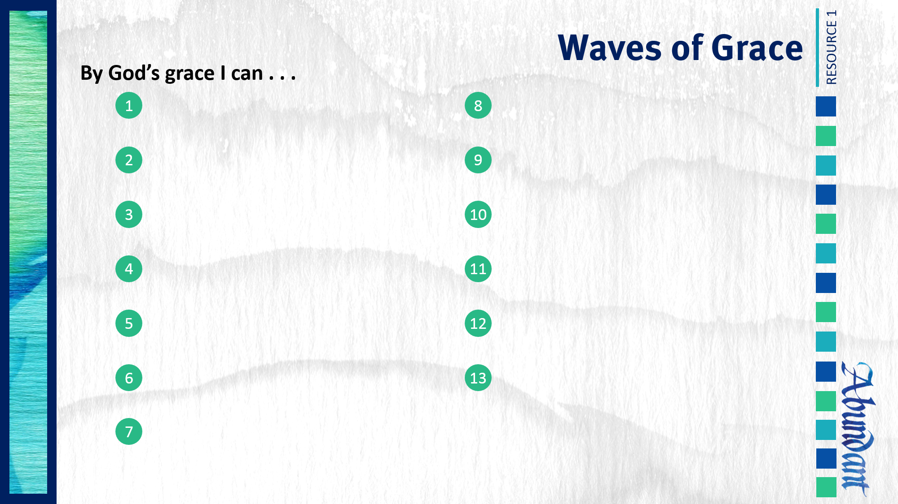
Respond to trials with peace and confidence.
Live in the sight of God.
Use my liberty in Christ to do God’s will.
Share the light of my treasure.
Anticipate eternity by serving God.

