Slide 1


Slide 2
I. The Servant’s Confidence (2 Cor. 4:1–6)
A. His perseverance (4:1)
B. His openness and honesty (4:2)
C. His opponent (4:3, 4)

Slide 3
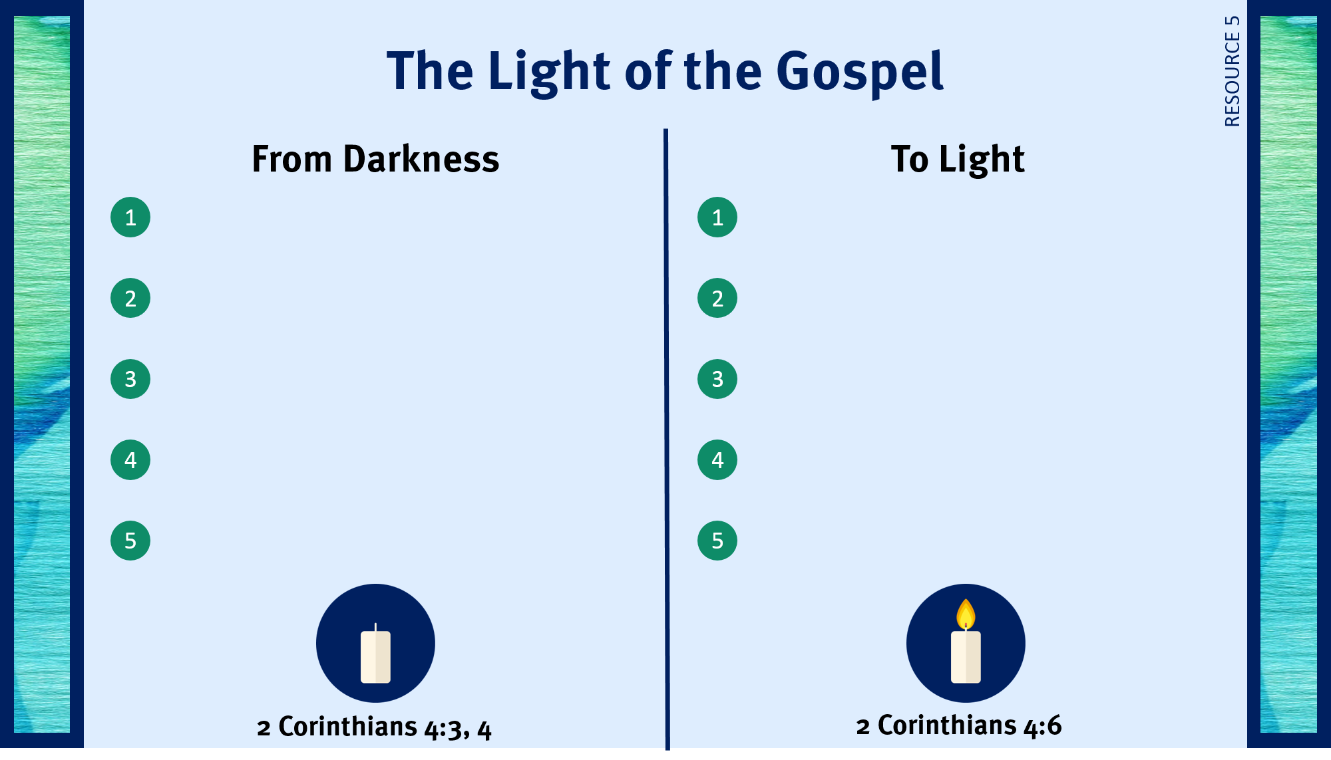
Unfounded philosophies.
Subtle lies.
Selfish pursuits.
Appeals to lustful desires.
Appeals to pride.

Slide 4
I. The Servant’s Confidence (2 Cor. 4:1–6)
A. His perseverance (4:1)
B. His openness and honesty (4:2)
C. His opponent (4:3, 4)
D. His preaching (4:5, 6)

Slide 5
Unfounded philosophies.
Live before the lost as an example of joy and contentment.
Subtle lies.
Love the lost.
Selfish pursuits.
Show the lost God’s grace.
Appeals to lustful desires.
Share testimonies of God’s work in your life.
Appeals to pride.
Boldly proclaim the gospel.

Slide 6
II. The Servant’s Difficulties (2 Cor. 4:7–15)
A. His weakness (4:7)
B. His hardships (4:8–15)
1. The work of death
2. The ministry of life

Slide 7
III. The Servant’s Hope (2 Cor. 4:16–18)

Slide 8

Respond to trials with peace and confidence.
Live in the sight of God.
Use my liberty in Christ to do God’s will.
Share the light of my treasure.

