Slide 1


Slide 2
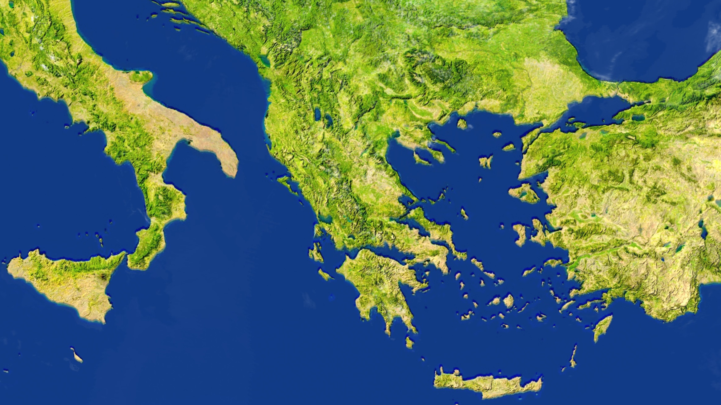
CORINTH
Greece
Riskier Route

Slide 3
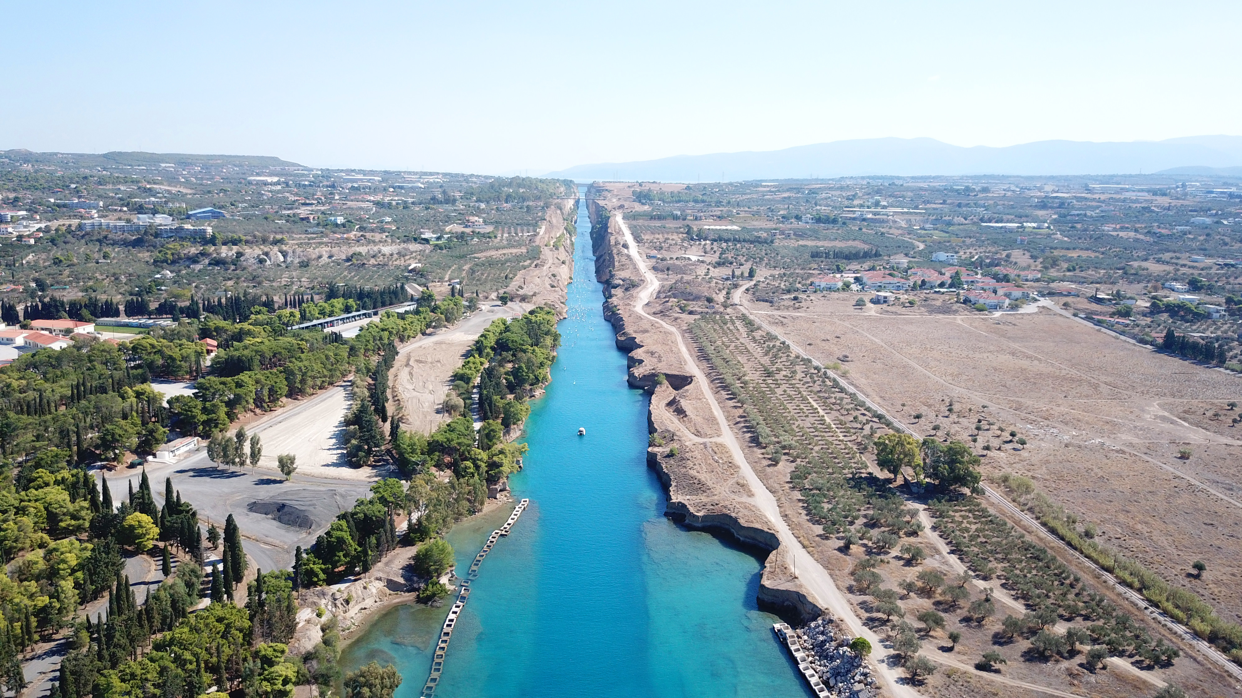

Slide 4


Slide 5
I. Personal Greetings

Slide 6
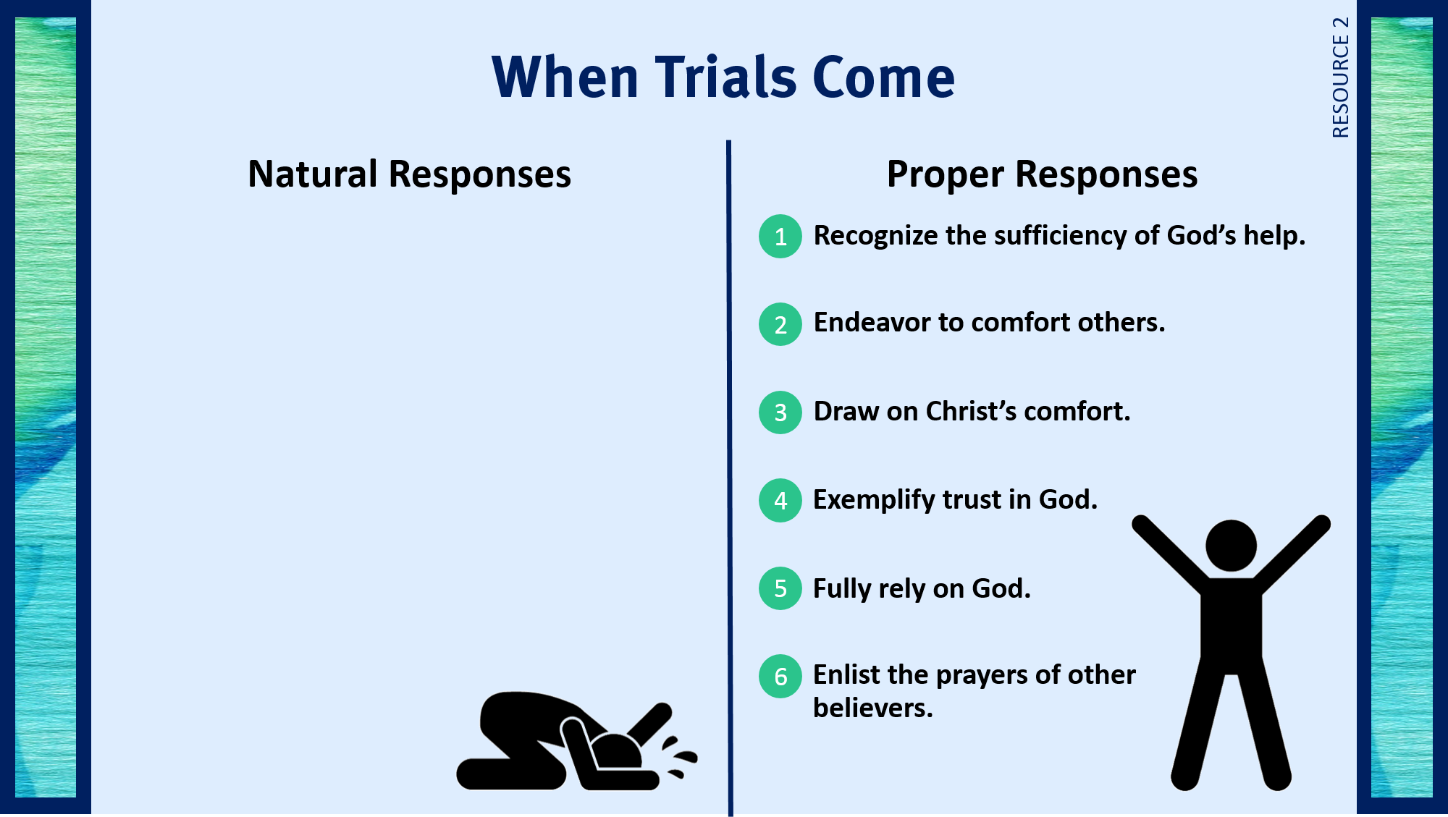
1
Become depressed.
2
Get angry.
3
Indulge in harmful activities.
4
Whine and complain.
5
Worry and fret.
6
Deny the trial exists.

Slide 7
II. Comfort in Suffering
A. The God Who helps (1:3)

Slide 8
1
Become depressed.
2
Get angry.
3
Indulge in harmful activities.
4
Whine and complain.
5
Worry and fret.
6
Deny the trial exists.

Slide 9
II. Comfort in Suffering
A. The God Who helps (1:3)
B. The reasons for suffering (1:4–11)
1. Opportunities to help others

Slide 10
1
Become depressed.
2
Get angry.
3
Indulge in harmful activities.
4
Whine and complain.
5
Worry and fret.
6
Deny the trial exists.

Slide 11
II. Comfort in Suffering
A. The God Who helps (1:3)
B. The reasons for suffering (1:4–11)
1. Opportunities to help others
2. Comfort from Christ

Slide 12
1
Become depressed.
2
Get angry.
3
Indulge in harmful activities.
4
Whine and complain.
5
Worry and fret.
6
Deny the trial exists.

Slide 13
II. Comfort in Suffering
A. The God Who helps (1:3)
B. The reasons for suffering (1:4–11)
1. Opportunities to help others
2. Comfort from Christ
3. Example for others

Slide 14
1
Become depressed.
2
Get angry.
3
Indulge in harmful activities.
4
Whine and complain.
5
Worry and fret.
6
Deny the trial exists.

Slide 15
II. Comfort in Suffering
A. The God Who helps (1:3)
B. The reasons for suffering (1:4–11)
1. Opportunities to help others
2. Comfort from Christ
3. Example for others
4. Reliance on God

Slide 16
1
Become depressed.
2
Get angry.
3
Indulge in harmful activities.
4
Whine and complain.
5
Worry and fret.
6
Deny the trial exists.

Slide 17
II. Comfort in Suffering
A. The God Who helps (1:3)
B. The reasons for suffering (1:4–11)
1. Opportunities to help others
2. Comfort from Christ
3. Example for others
4. Reliance on God
5. Prayer and thanksgiving

Slide 18
1
Become depressed.
2
Get angry.
3
Indulge in harmful activities.
4
Whine and complain.
5
Worry and fret.
6
Deny the trial exists.

Slide 19
II. Comfort in Suffering
A. The God Who helps (1:3)
B. The reasons for suffering (1:4–11)
1. Opportunities to help others
2. Comfort from Christ
3. Example for others
4. Reliance on God
5. Prayer and thanksgiving

Slide 20
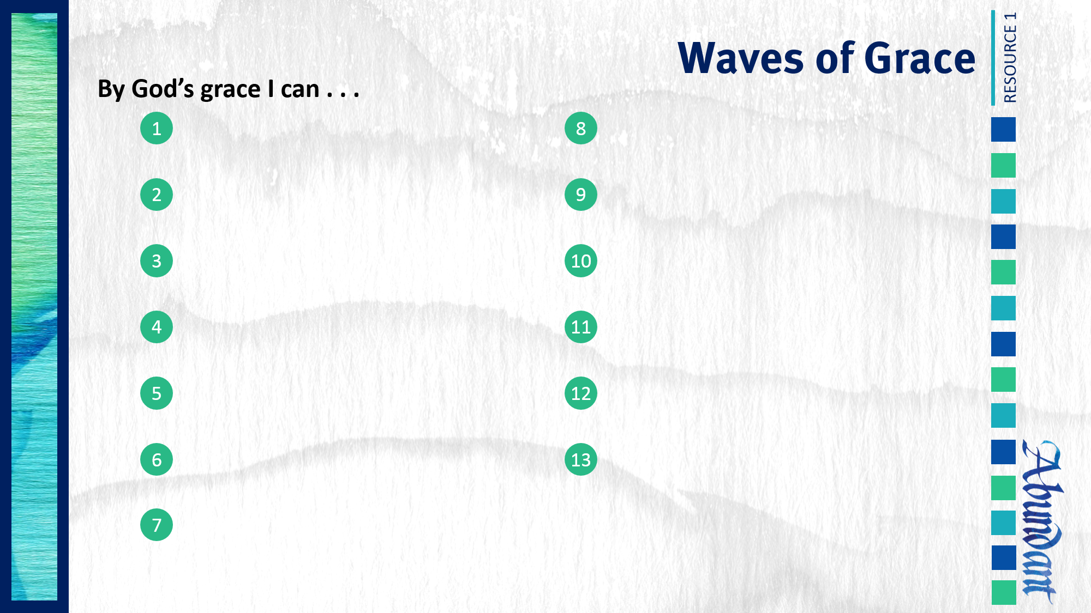
Respond to trials with peace and confidence.

