Slide 1


Slide 2
I. Paul’s Sincere Life and Ministry (2 Cor. 1:12—2:4)
A. In his methods (1:12)
B. In his writings (1:13)
C. In his mutual glorying (1:14)
D. In his plans (1:15–22)
E. In his intentions (1:23—2:4)

Slide 3
II. Paul’s Charge for the Sincere Believer (2 Cor. 2:5–11)

Slide 4
III. Paul’s Sincere Concern for the Church (2 Cor. 2:12, 13)

Slide 5
IV. Paul’s Sincere Confidence in God (2 Cor. 2:14–17)

Slide 6
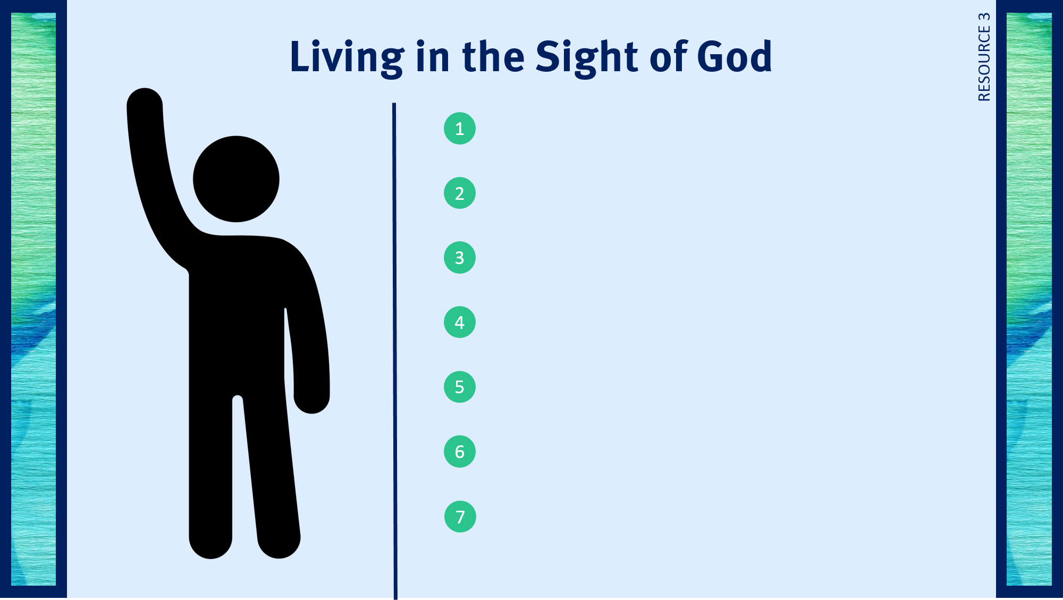
Spends time allowing God to evaluate his or her life.
Asks God for forgiveness for sins only God knows about.
Endures criticism with patience.
Does not seek man’s praise.
Speaks the truth.
Values God’s approval above man’s approval.
Consistently prays about decisions and problems.

Slide 7

Respond to trials with peace and confidence.
Live in the sight of God.

