Slide 1


Slide 2
I. Paul’s Life as a Defense (2 Cor. 11:1–12)
A. Paul’s jealous care (11:1–4)
B. Paul’s knowledge (11:5, 6)
C. Paul’s financial integrity (11:7–12)

Slide 3
II. Paul’s Case against the Judaizers (2 Cor. 11:13–21)
A. The Judaizers were false apostles (11:13–15)
B. Paul’s foolish boasting (11:16–18)
C. The Judaizers were fools (11:19–21)

Slide 4
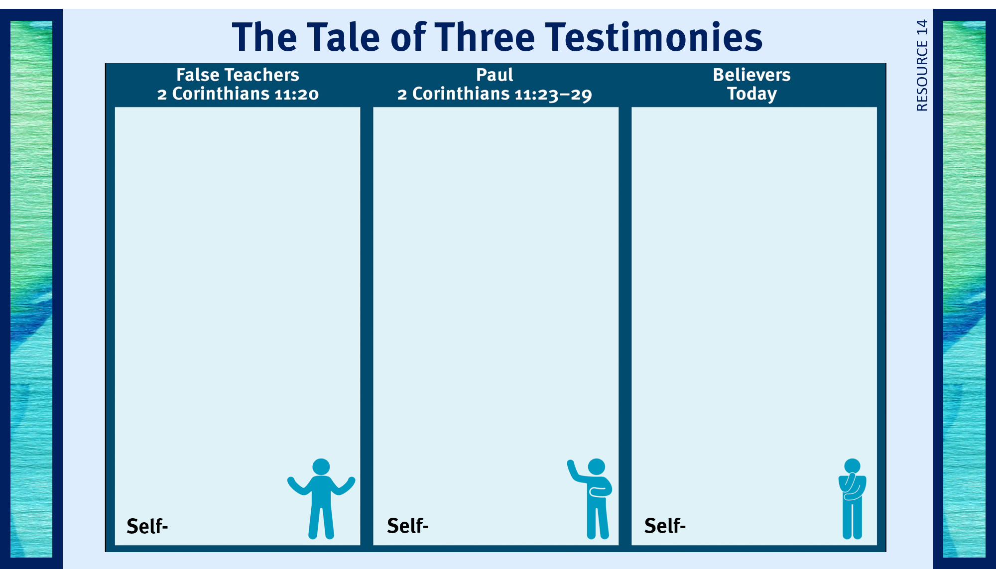
1. Enslaved the church.
2. Used them for financial gain.
3. Took from them.
4. Acted as dictators over them.
5. Humiliated them.
serving

Slide 5
III. Paul’s Testimony as an Apostle (2 Cor. 11:21–33)
A. Paul’s pedigree (11:21, 22)
B. Paul’s trials (11:23–33)

Slide 6
1. Enslaved the church.
2. Used them for
financial gain.
3. Took from them.
4. Acted as dictators over them.
5. Humiliated them.
1. Exhausting toil.
2. Lashings.
3. Imprisonment.
4. Life-threatening
situations.
5. Stoning and beatings.
6. Adrift at sea.
7. Hunger and thirst.
8. Sleeplessness.
1. Guard their lips.
2. Live with conviction.
3. Stand for the truth.
4. Show unconditional
love.
5. Rejoice even in trials.
6. Praise God for blessings.
serving
sacrificing
?

Slide 7

Respond to trials with peace and confidence.
Practice repentance.
Live in the sight of God.
Gratefully give of myself to God.
Use my liberty in Christ to do God’s will.
Give to God cheerfully.
Share the light of my treasure.
Handle criticism in a God-honoring way.
Anticipate eternity by serving God.
Lead a self-sacrificing life.
Exhibit excellence as Christ’s ambassador.
Separate from sin and apostasy.

