Slide 1


Slide 2
I. Paul’s Defense of His Apostleship (2 Cor. 12:1–12)
A. Paul’s revelations as proof (12:1–4)
B. Paul’s thorn as proof (12:5–12)

Slide 3
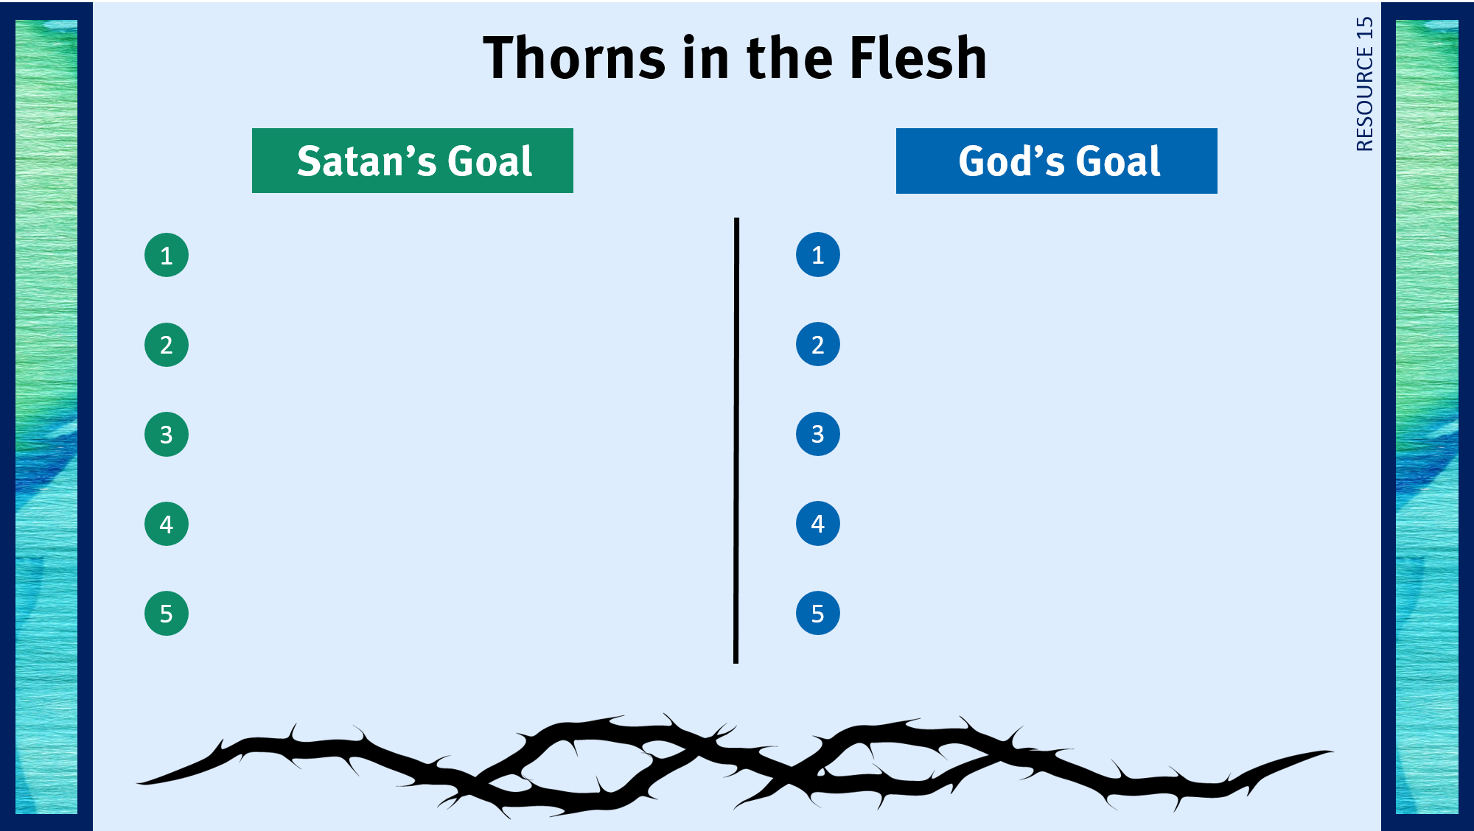
Discourage believers from following Christ.
To teach believers to rely on Him.
Distract believers from serving God.
To glorify His name.
Cause believers to doubt God’s goodness.
To show His sustaining power.
Cause believers to doubt that serving God brings His blessings.
To display His sufficient grace.
Cause believers to be proud of how they put up with the thorn.
To keep believers humble.

Slide 4
I. Paul’s Defense of His Apostleship (2 Cor. 12:1–12)
A. Paul’s revelations as proof (12:1–4)
B. Paul’s thorn as proof (12:5–12)
C. Paul’s position and performance as proof (12:11, 12)

Slide 5
II. Paul’s Dealings with the Corinthians (2 Cor. 12:13–18)

Slide 6
III. Paul’s Desires for the Corinthians (2 Cor. 12:19—13:10)
A. That they repent (12:19—13:4)
B. That they practice self-examination (13:5–10)

Slide 7
IV. Paul’s Conclusion to the Letter (2 Cor. 13:11–14)

Slide 8

Respond to trials with peace and confidence.
Practice repentance.
Live in the sight of God.
Gratefully give of myself to God.
Use my liberty in Christ to do God’s will.
Give to God cheerfully.
Share the light of my treasure.
Handle criticism in a God-honoring way.
Anticipate eternity by serving God.
Lead a self-sacrificing life.
Exhibit excellence as Christ’s ambassador.
Prepare for Christ’s coming.
Separate from sin and apostasy.

