Slide 1


Slide 2
I. The Administration of the Gift (2 Cor. 8:16—9:5)

Slide 3
II. The Benefits of the Gift (2 Cor. 9:6–15)
A. Blessings to the givers (9:6–9)

Slide 4
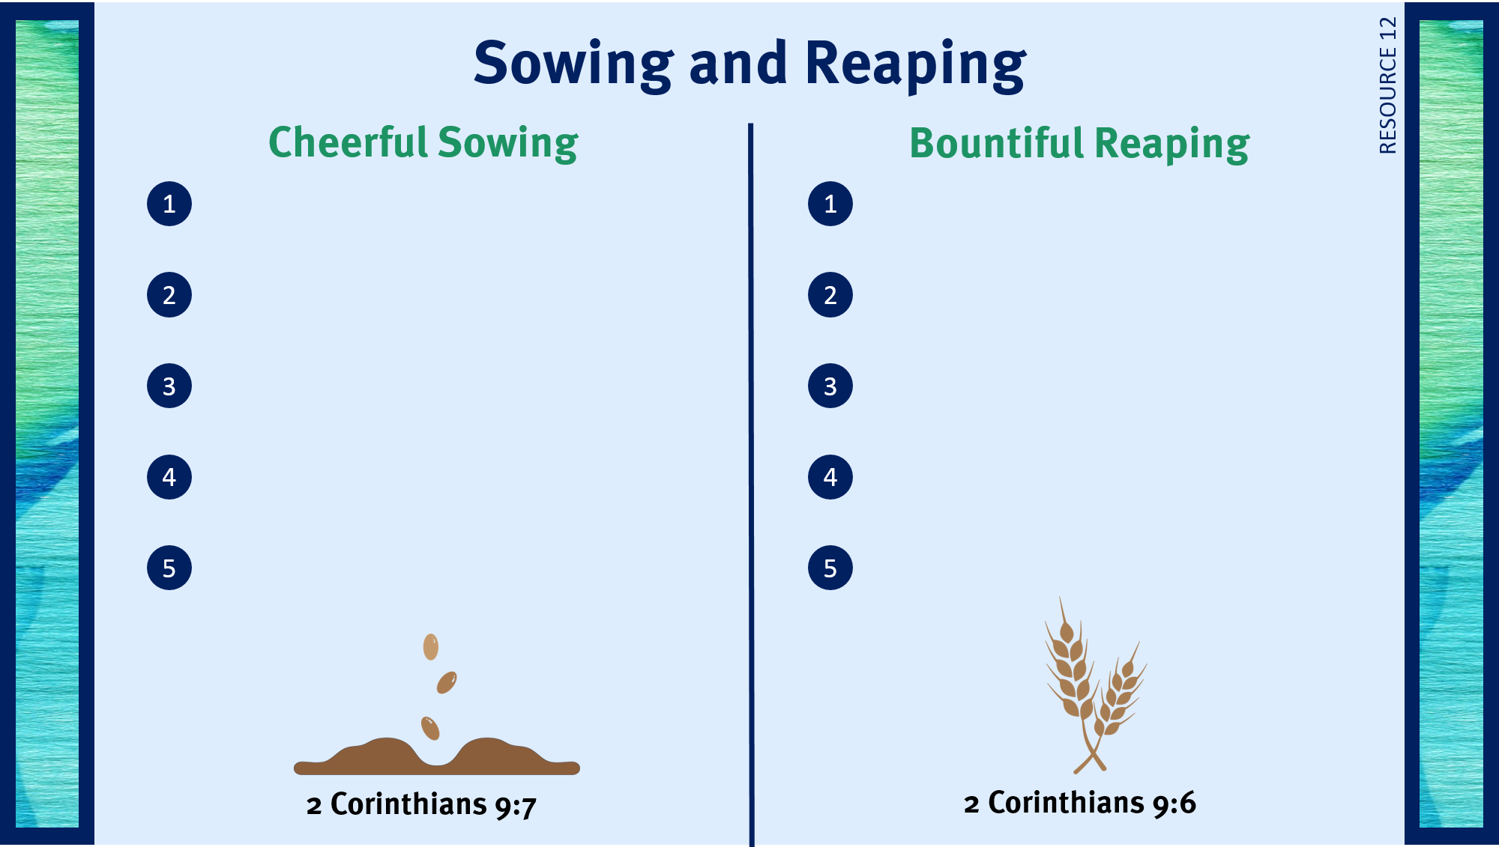
Finds joy in giving to God.
Eternal reward.
Trusts God to meet personal needs.
Souls saved around the world.
Understands God’s plan is to use people to meet needs.
Joy from the Lord.
Looks for opportunities to give time and money.
Seeing others rejoice in the Lord.
Seeks God’s direction for using money.
Contentment with life.

Slide 5
II. The Benefits of the Gift (2 Cor. 9:6–15)
A. Blessings to the givers (9:6–9)
B. Thanksgiving to God (9:10, 11)
C. Provision for the needy (9:12–15)

Slide 6
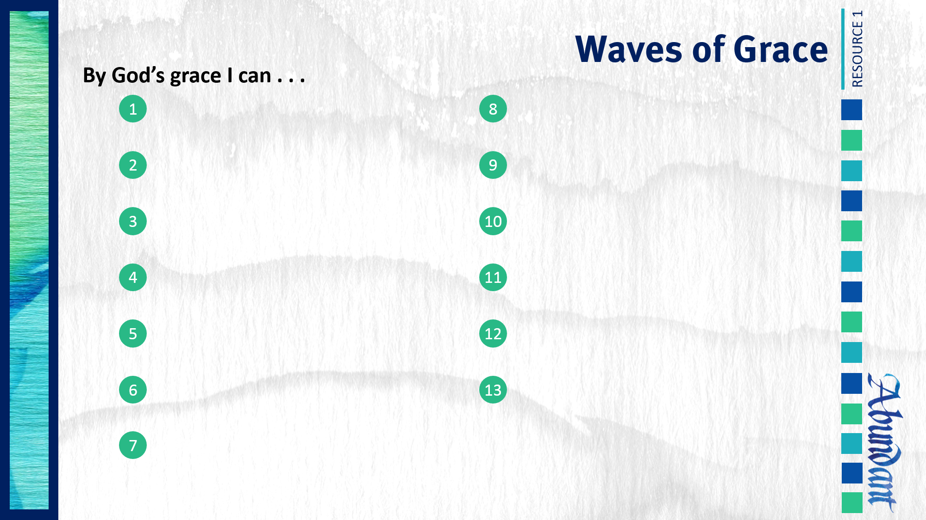
Respond to trials with peace and confidence.
Practice repentance.
Live in the sight of God.
Gratefully give of myself to God.
Use my liberty in Christ to do God’s will.
Give to God cheerfully.
Share the light of my treasure.
Anticipate eternity by serving God.
Exhibit excellence as Christ’s ambassador.
Separate from sin and apostasy.

