Slide 1


Slide 2
I. The Example of the Macedonians (2 Cor. 8:1–8)

Slide 3
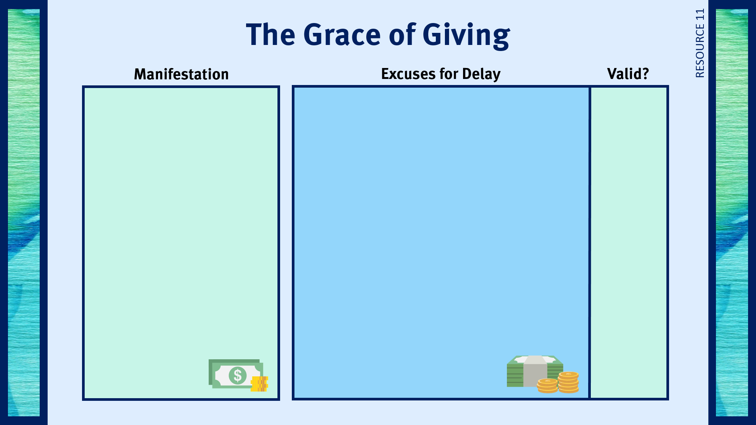
Regular financially giving to the Lord’s work.
Giving anonymous gifts to the needy.
Sensitivity to people’s needs.
Giving time and energy to meet needs.
Motivating others to faithful giving.

Slide 4
II. The Example of Christ (2 Cor. 8:9)

Slide 5
III. The Corinthians’ Previous Generosity (2 Cor. 8:10–12)

Slide 6
Regular financially giving to the Lord’s work.
Giving anonymous gifts to the needy.
Sensitivity to people’s needs.
Giving time and energy to meet needs.
Motivating others to faithful giving.
I don’t make enough money to give any of it away.
I want to get out of debt before I start giving.
I prefer to give to charities instead of the church.
I am behind in saving for retirement and can’t afford to give to the Lord.
I have given extra all my life and now I want to buy some things for myself.
No
No
No
No
No

Slide 7
IV. The Example in the Old Testament (2 Cor. 8:13–15)

Slide 8

Respond to trials with peace and confidence.
Practice repentance.
Live in the sight of God.
Gratefully give of myself to God.
Use my liberty in Christ to do God’s will.
Share the light of my treasure.
Anticipate eternity by serving God.
Exhibit excellence as Christ’s ambassador.
Separate from sin and apostasy.

