Slide 1


Slide 2
I. Paul Answered His Critics’ First Charge (2 Cor. 10:1–7)
A. Their charge of cowardliness (10:1, 2)
B. Paul’s defense (10:3–7)
1. He did not walk after the flesh

Slide 3



Combating Critics
RESOURCE 13
2 Corinthians 10:3–5
Carnal Weapons
Spiritual Weapons
Cleverness.
Charm.
Forceful personality.
Threats.
Whole armor of God.
Word of God.
Prayer.
Support of fellows
believers.
Results
Results
The ministry will be
ineffective.
Results will be superficial
at best.
The ministry will be effective.
Results will be real
and worthy or reward.
God will be glorified.

Slide 4
I. Paul Answered His Critics’ First Charge (2 Cor. 10:1–7)
A. Their charge of cowardliness (10:1, 2)
B. Paul’s defense (10:3–7)
1. He did not walk after the flesh
2. He did not want to be severe with all
3. He cited his critics’ bias

Slide 5
II. Paul Answered His Critics’ Second Charge (2 Cor. 10:8–18)
A. Their charge of weakness (10:8–10)
B. Paul’s defense (10:11–18)
1. His critics would soon see his strength
2. His critics unwisely commended themselves
3. The Corinthians’ faith commended Paul
4. The Lord commended him

Slide 6
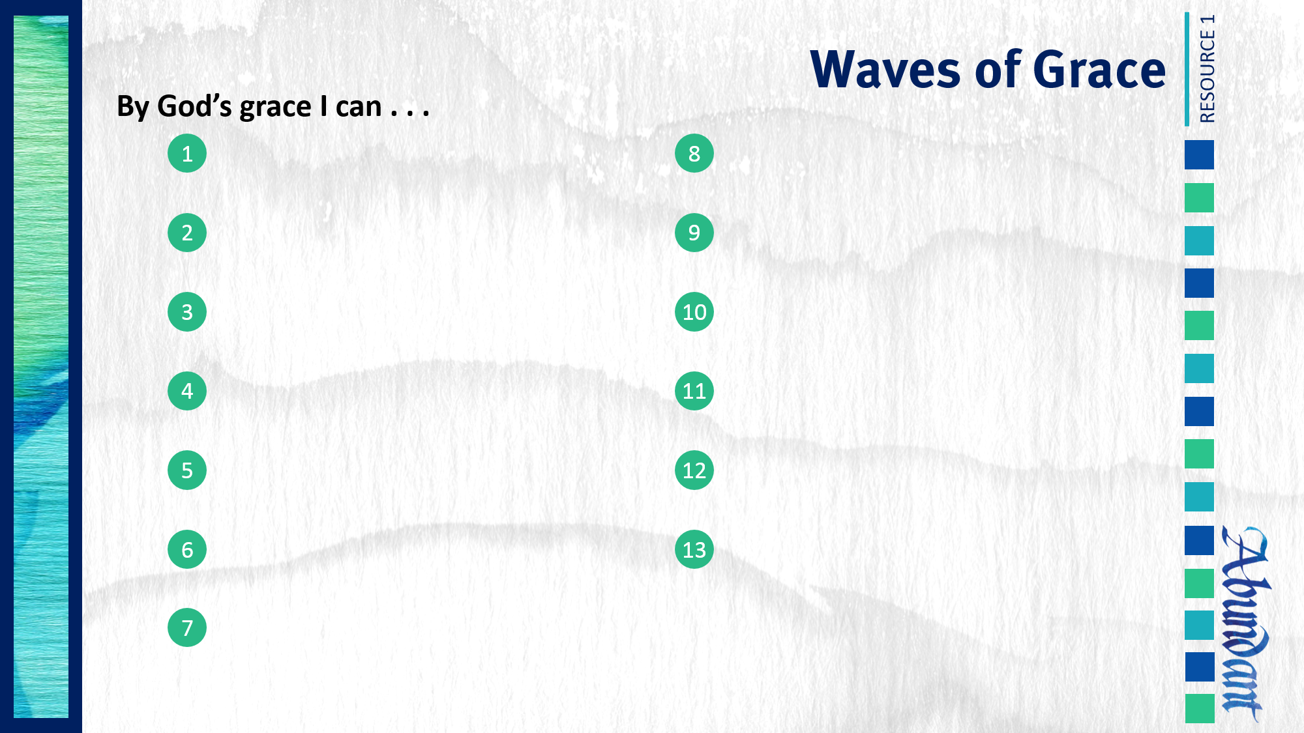
Respond to trials with peace and confidence.
Practice repentance.
Live in the sight of God.
Gratefully give of myself to God.
Use my liberty in Christ to do God’s will.
Give to God cheerfully.
Share the light of my treasure.
Handle criticism in a God-honoring way.
Anticipate eternity by serving God.
Exhibit excellence as Christ’s ambassador.
Separate from sin and apostasy.

